Slide 1

Update on Partner Projects
Meghan Noe Fellows
Director of Estuary Science & Restoration
Notes:
CIB proposes to plan and implement Sunset Beach LSL project, planning and implementation funded in part by CIB BIL funding; will need to obtain additional funding for expected implementation, CWQIG and 319

Slide 2
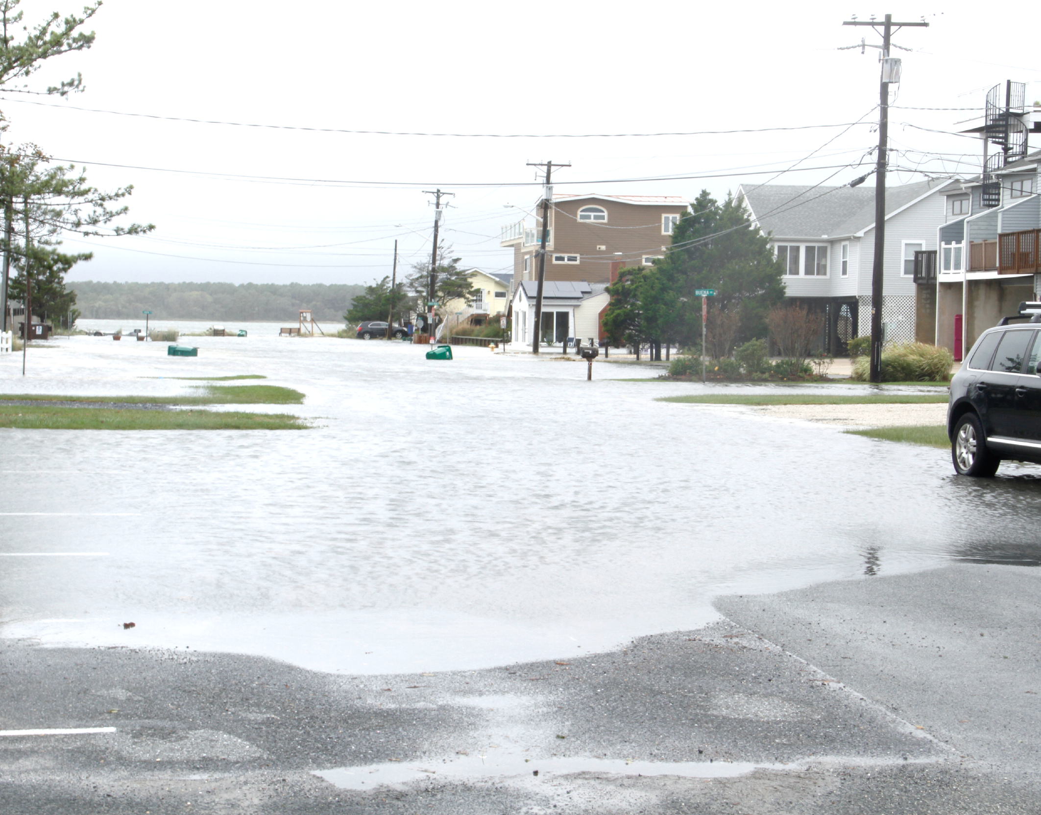
Dewey Beach Stormwater Planning
Phase II Stormwater Planning Report completed August 2017.
Identifies priority stormwater BMP retrofit opportunities/concepts.
Bioretention, permeable pavement/ pavement removal, living shoreline projects.
NEXT STEPS: Seek funding and implement recommendations
Notes:
Top priority project ID’d in master plan just completed by the Town. Grant partnership (DB, CIB, DelDOT, RKK).
Prioritizations had input from Commissioners, infrastructure committee.
DB has been working hard to identify ways to mitigate flooding and improve WQ. Friend of the Bays award.
Next step to implement, taking advantage of grants, loans, leveraged funds.
Read Ave, project

Slide 3
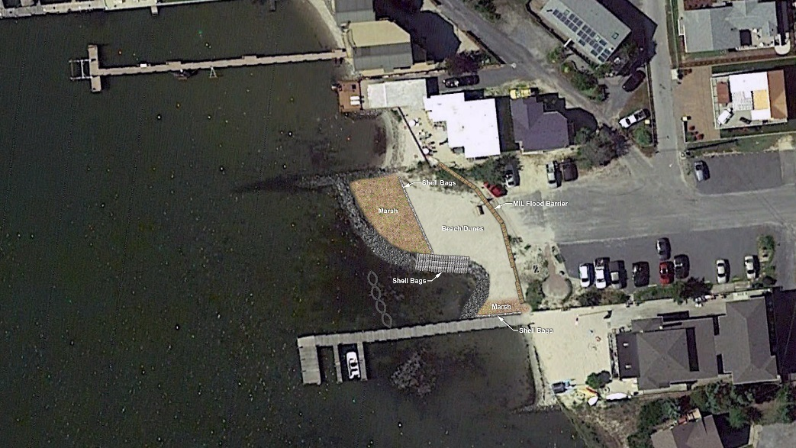
Completed Projects
Stormwater Planning Document
Read Ave. Shoreline Project
Little Store Bioretention Project

Slide 4
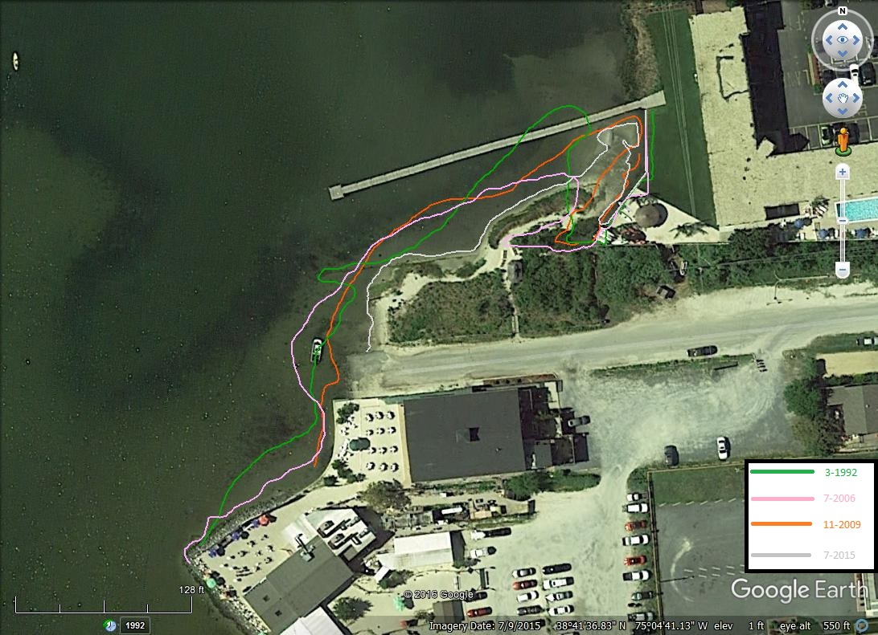
Proposed Project – Sunset Park

Slide 5
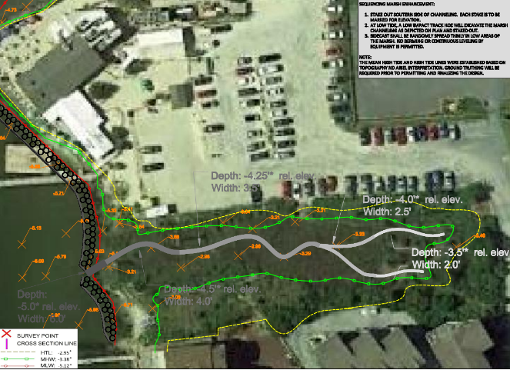
Optional
Marsh Extension

Slide 6
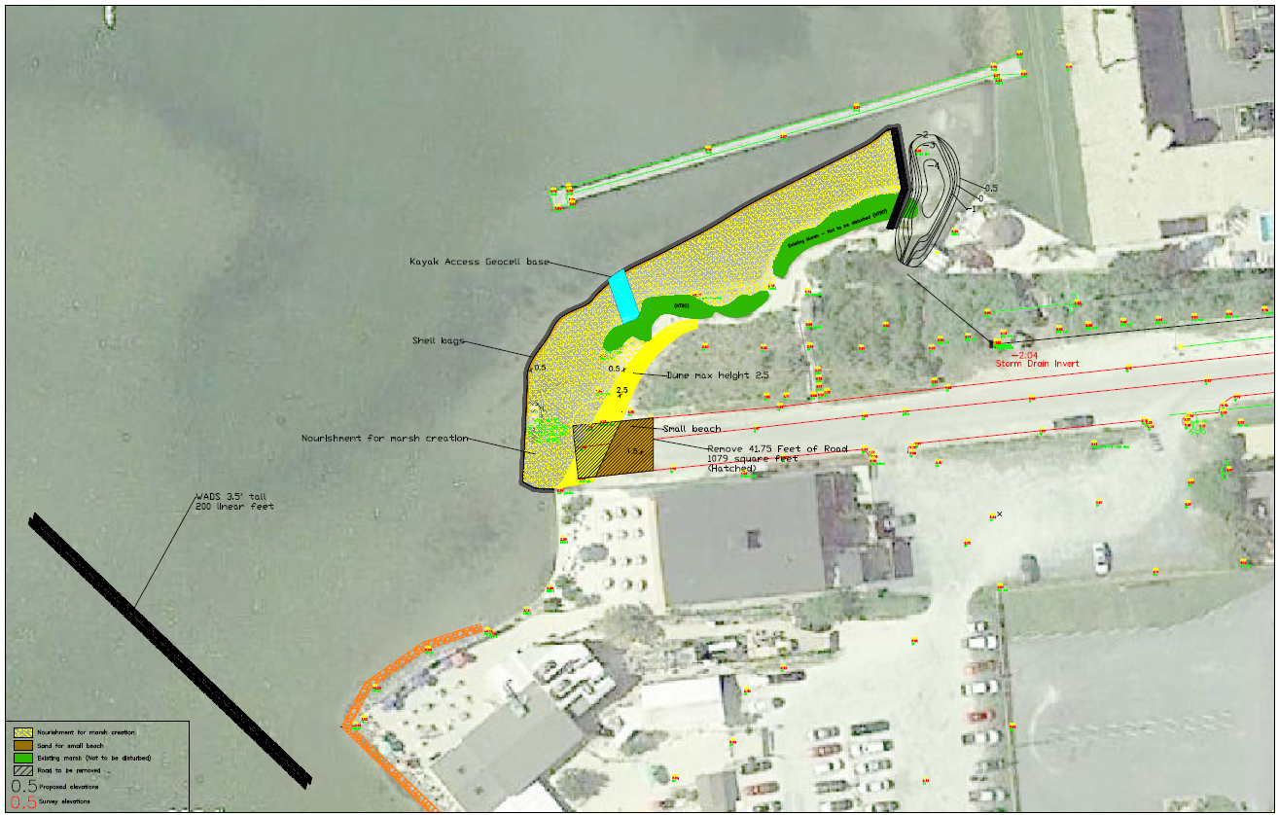
Concepts
Shoreline stabilization
Marsh creation
Drainage improvements
Kayak launch
Removal of Impervious surface
Native plant enhancements
Additional areas

Slide 7
Sunset Park Shoreline/Drainage
Cost estimate, 2022 proposal:
Engineering/permitting $175-210 K
Construction $480-760 K
Project mgt & indirect $100 K
Already funded Sunset Park Improvements to be incorporated into design
Design can be modified for Town’s priorities, water quality, cost, etc. as needed
CIB prioritized funding for planning and implementation as part of our BIL funding
CIB would write additional grant applications to make up the anticipated funding gap; CIB manage project, coordinated with the Town

Slide 8
Sunset Park Shoreline/Drainage
Estimated Timeline:
Project Kick Off: Spring 2023
Design Phases: 90-120 Days
Permitting: 240-360 Days
Construction Start: October 2024
Monitoring Period: 3, 6 and 12 months post construction

Slide 9
What we need from you:
Feedback
With your approval then CIB will work with Sovereign Consulting, Straughan Environmental, the Town on design, timeline and updated budgets

Slide 10
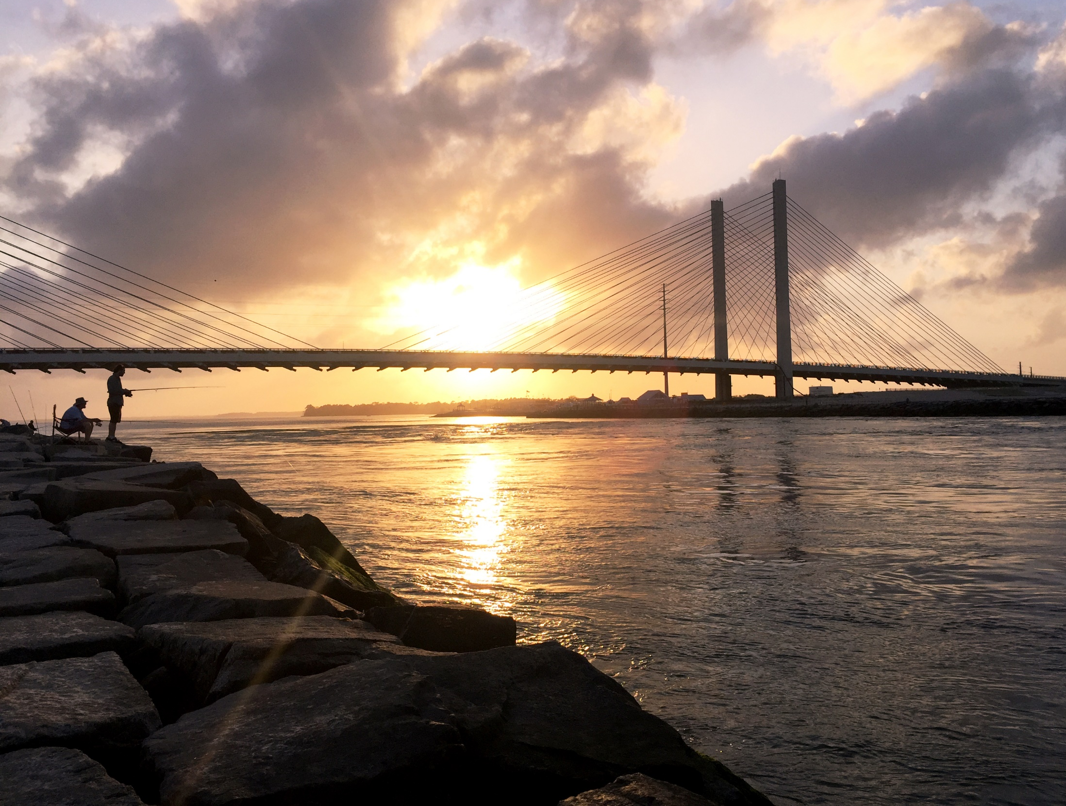
Thank You

