Slide 1
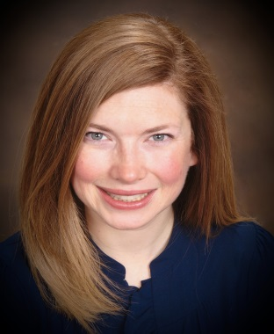
Jennifer McDermott
Executive Director
JPMorgan Chase
Global Technology Workforce Strategy
Jennifer is currently the global area product owner for cohort hiring and is responsible for higher education engagement for Global Technology, supporting 50,000+ global employees. As part of her higher education engagement role, Jennifer also manages the unique public/private collaboration between the University of Delaware and JPMorgan Chase and oversees the JPMorgan Chase Innovation Center on the University of Delaware campus. Jennifer is responsible for JPMorgan Chase Global Technology external relations in the Delaware community.
Jennifer is actively engaged in STEM initiatives both in the local Delaware community and nationally. She recently was a member of the advisory board for the Tech Council of Delaware. She was appointed by former Governor Markell to the Delaware STEM Council and was also part of the White House TechHire Steering Committee for the State of Delaware. She has spoken externally at conferences on STEM workforce topics.
During her 23-year tenure at JPMorgan Chase, Jennifer has held multiple roles in the technology organization managing software engineering teams, process reengineering initiatives and overseeing technology program management activities. She is now focused on transforming the way we hire and engage technology talent.
Prior to joining JPMorgan Chase, Jennifer worked at Accenture as a Telecommunications and High-Tech consultant in Washington D.C. and as a Project Director at an internet startup. Jennifer holds a Bachelor’s degree in Finance from Virginia Tech. She resides in Delaware with her husband and three children.

