Slide 1


Read Avenue Outfalls Repair Project
Project Review, Update and Recommendations
November 8, 2023

Slide 2

Overview
After some investigation, we firmly believe that the valves entering the bay are no longer working properly. This causes sand and water to wash into the pipes during high tide. It’s verified that the pipes are partially under sand causing backups and flooding.
This work included excavating the sand below the invert of the pipes, removal of the three outfall valves, and the installation of a cofferdam around the three pipe locations. After the silt was removed, the area was stabilized before the installation of an underwater barrier using riprap R-5 or R-6 stone around the three pipes in order to protect the area from erosion. (See attached project area maps for reference).
This adjunct to Phase 1 of the stormwater pipe relining project breaks down as follows:
Read Avenue:
36” RCP (x3) – (Structures 67 to 60, 69, 70)
Note: Included heavy cleaning the line segments above due to the flooding from the pipes in the bay.
  Town of Dewey Beach

Slide 3
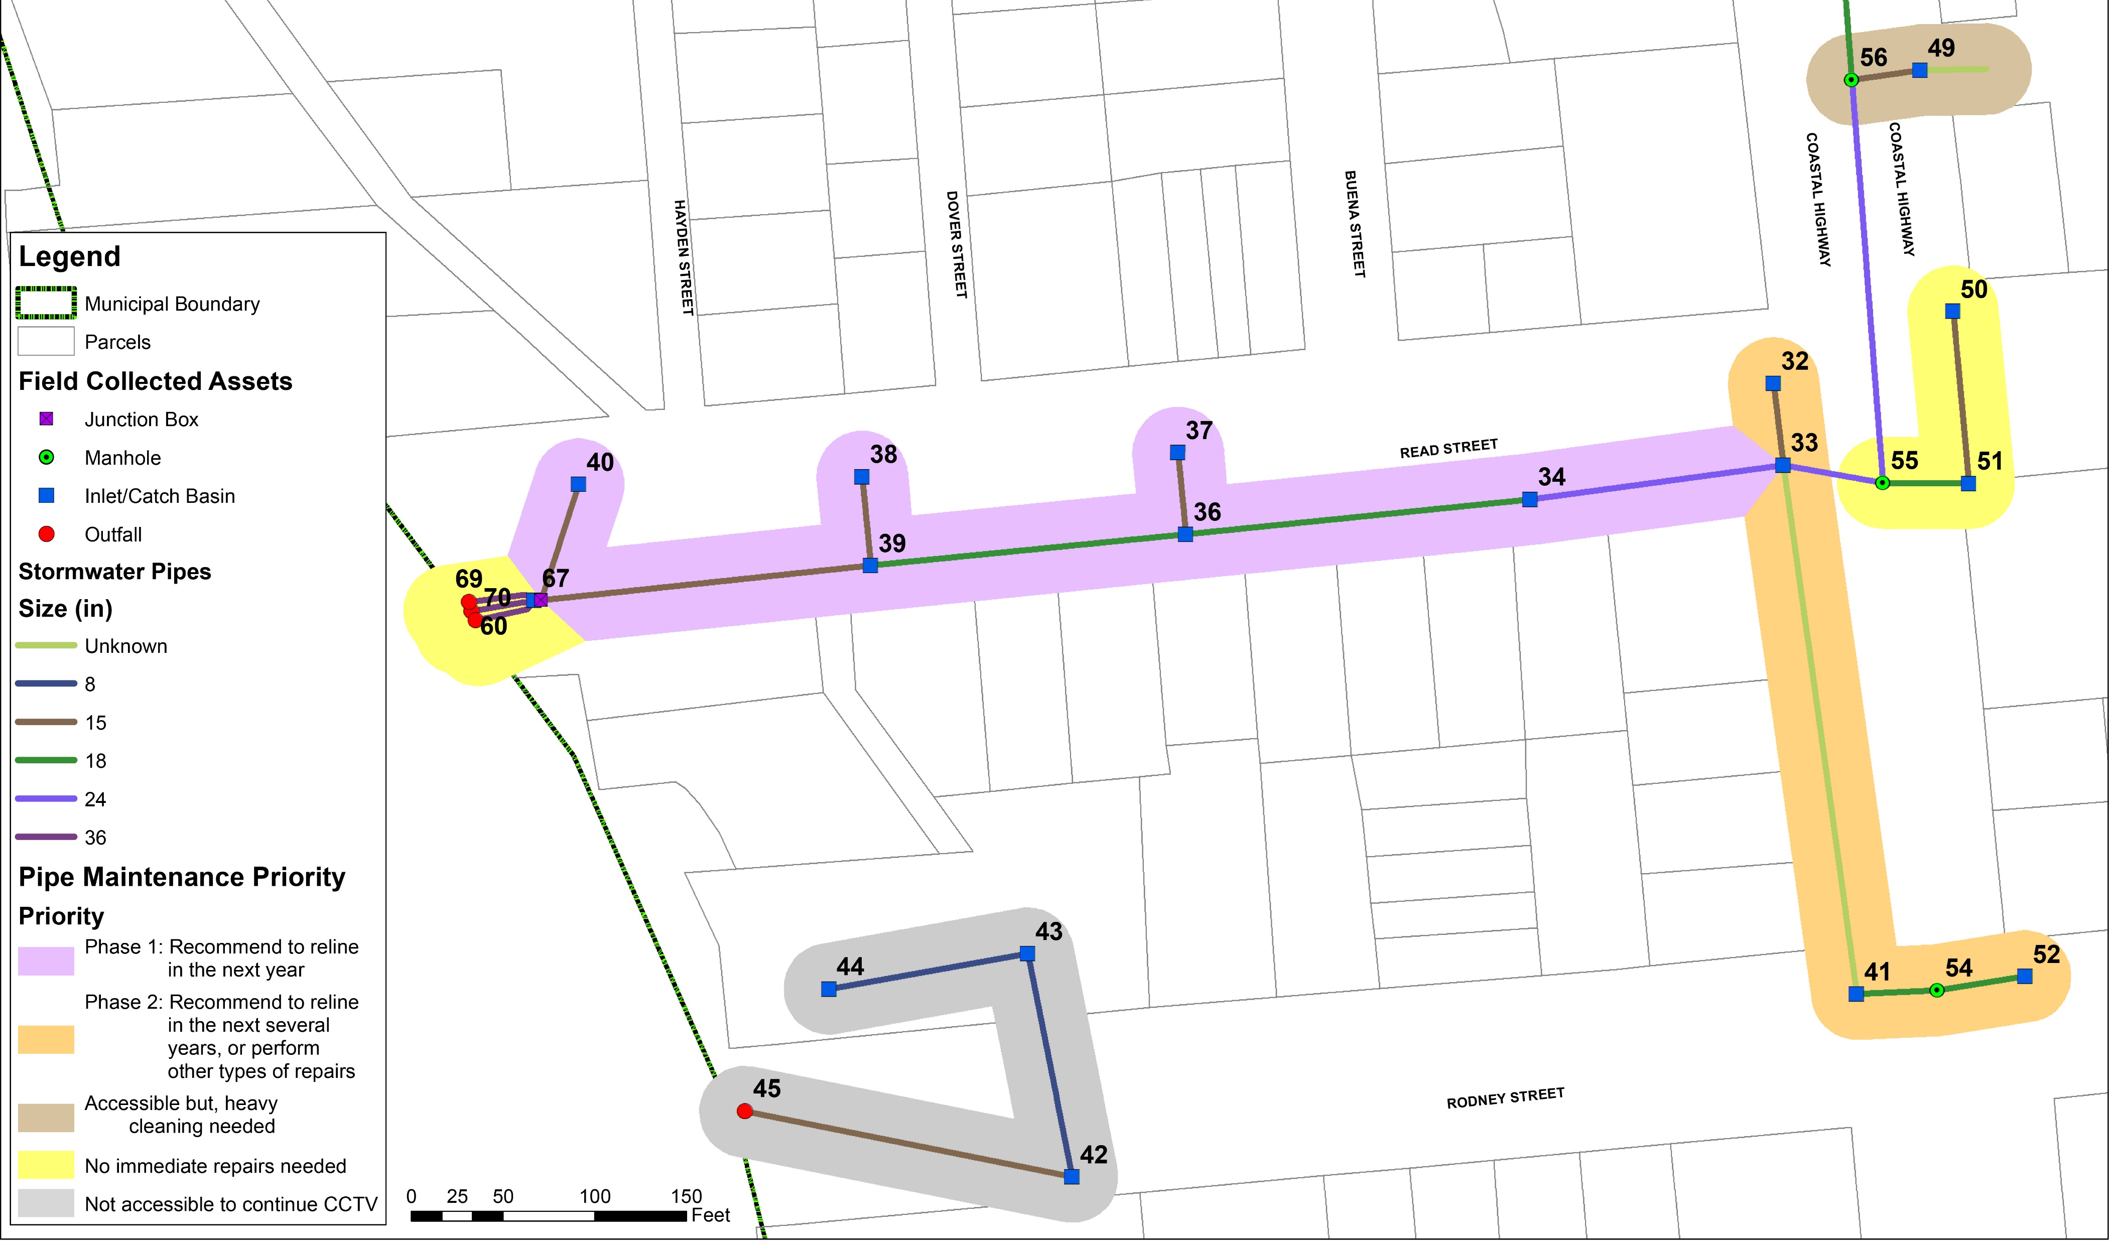
  Town of Dewey Beach

Slide 4
Project Objective
  Town of Dewey Beach

Slide 5
Original design from RK&K for the outfalls at the end of Read Street.
  Town of Dewey Beach

Slide 6
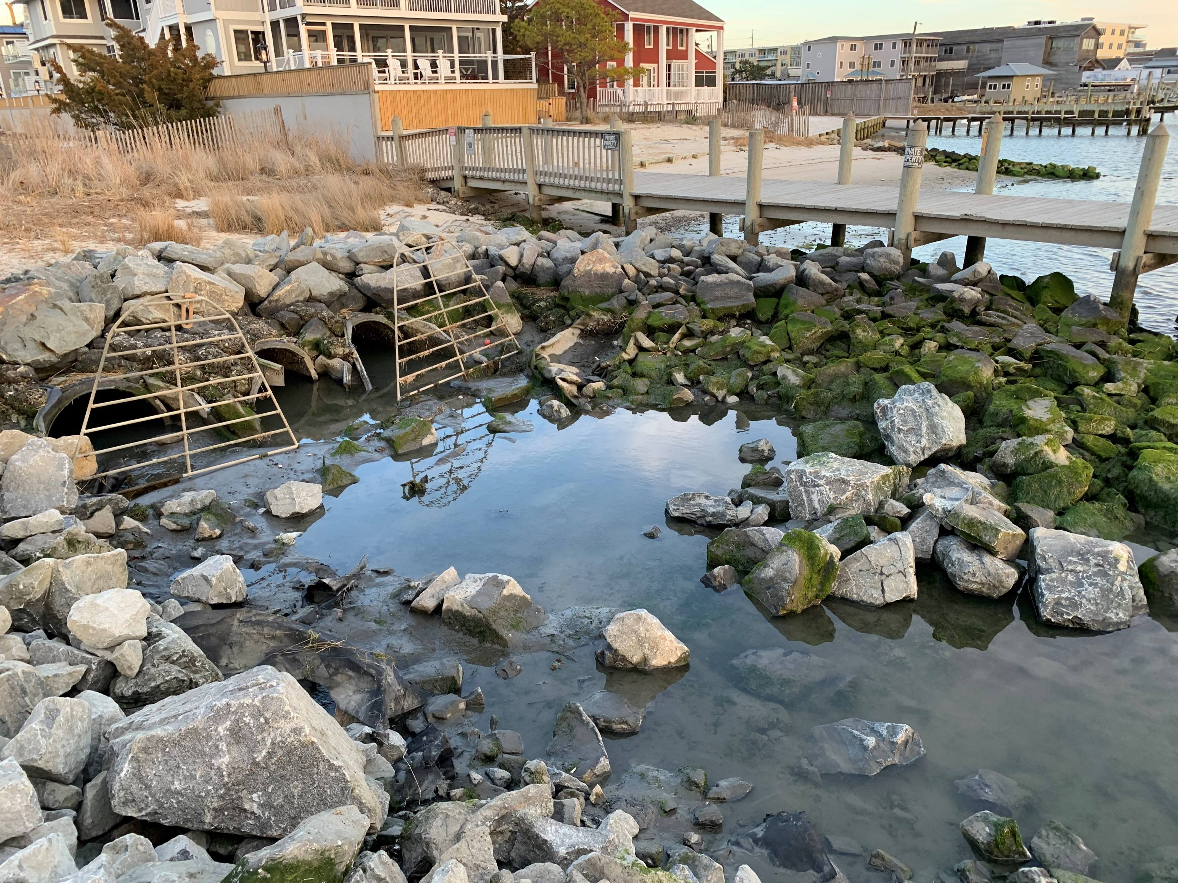
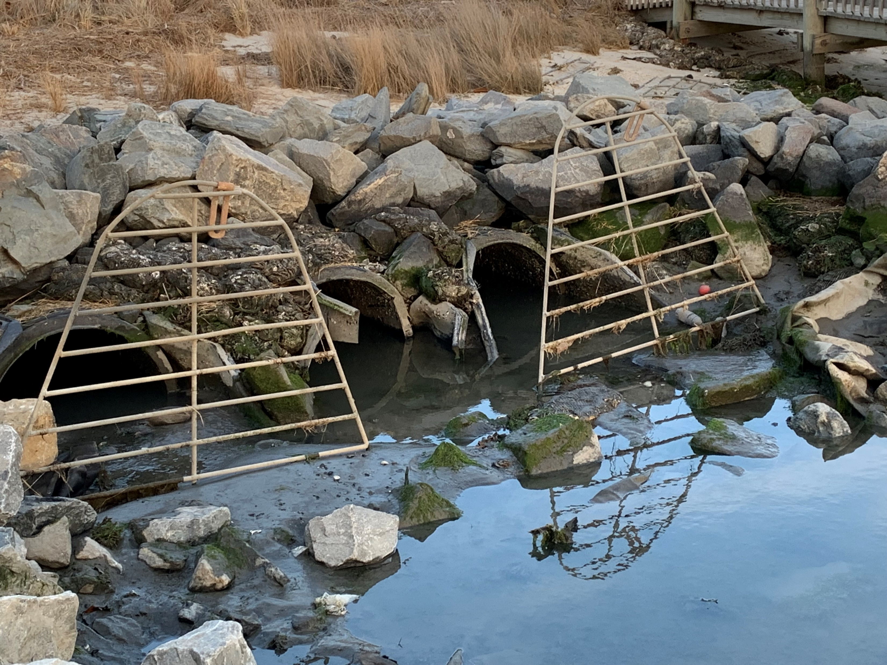
Original design from RK&K for the outfalls at the end of Read Avenue.
  Town of Dewey Beach

Slide 7
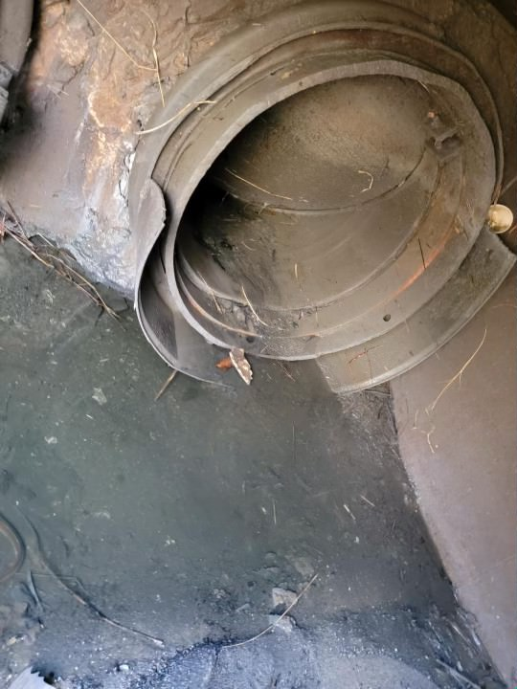
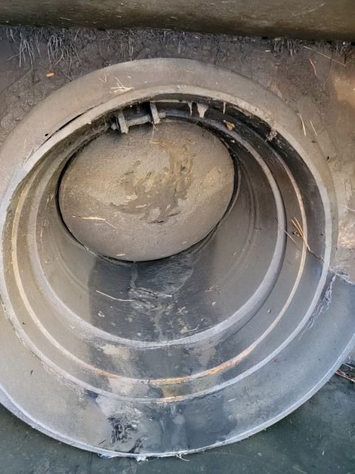
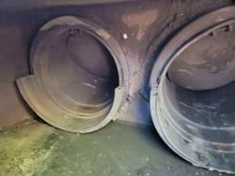

Slide 8
The red shows removal to help rebuild the canoe path. The green shows the riprap repair.
  Town of Dewey Beach

Slide 9
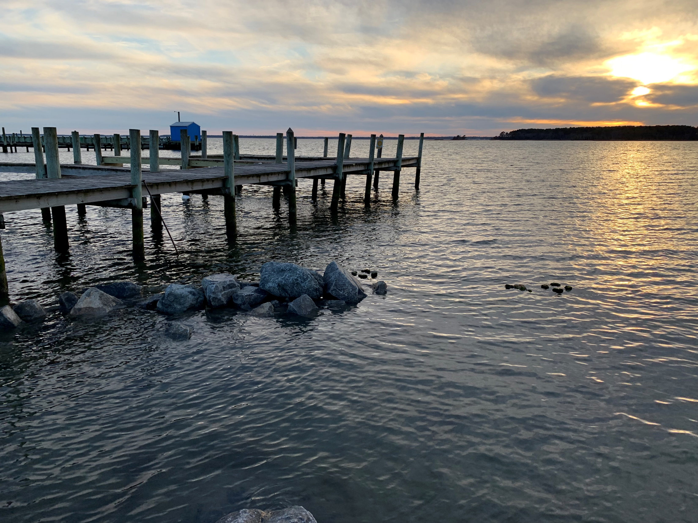
The red shows removal to help rebuild the canoe path. The green shows the riprap repair.
  Town of Dewey Beach

Slide 10
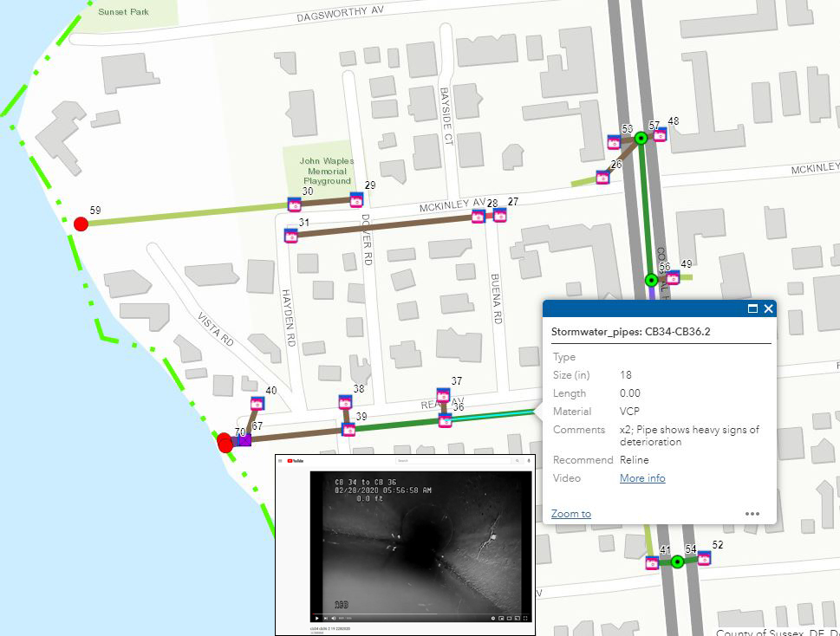
  Town of Dewey Beach

Slide 11
Stormwater System GIS Mapping
  Town of Dewey Beach

Slide 12
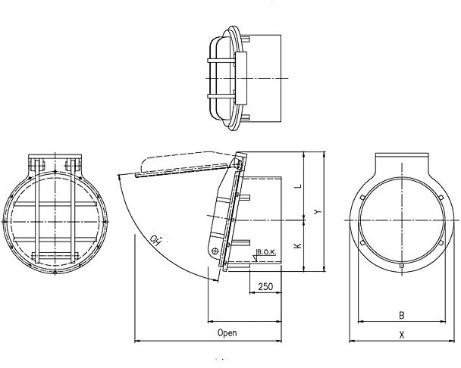
Westatlantic Tech Corporation
    Product:
    HDPE Flap valve type WA-PTK-BS
    Non-return flap valve suitable for permanent under water use suitable to connect to inside diameter of concrete / steel pipes.
    As a non return flap valve to be installed for regulating a water flow in a single direction and preventing back flow.
  Town of Dewey Beach

Slide 13
Read Avenue, Dewey Beach
    Project Tasks:
    Clean the line segments connecting to the outfall and to install 3 HDPE tide gates. Will not demobilize until all restoration work is complete and approved. Work may include an excavator, vac truck, Pickup truck and dump truck.
    Mobilization
    Cleaning efforts
    - 1) to clean the storm sewer segments connecting to the outfall.
    - 2) to clean the outfall area and remove excess sediment built up over past year.
    - 3) Move riprap out of the way for flapper gate installation.
    Flapper Gate Installation
    - 1) Install dam using sandbags.
    - 2) Cut existing HDPE to create a flat edge.
    - 3) Install 3 HDPE Westatlantic Tide Gates built for tidal conditions.
    - 4) Fuse Tide gates into place & attach stainless steel screws w/ Pin.
    - 5) Install rubber gasket between Gate & wall for soft close.
    - 6) Repair berm as necessary w/ grass from Dewey Beach
    - 7) Remove sandbags and replace any riprap previously removed.
  Town of Dewey Beach

Slide 14
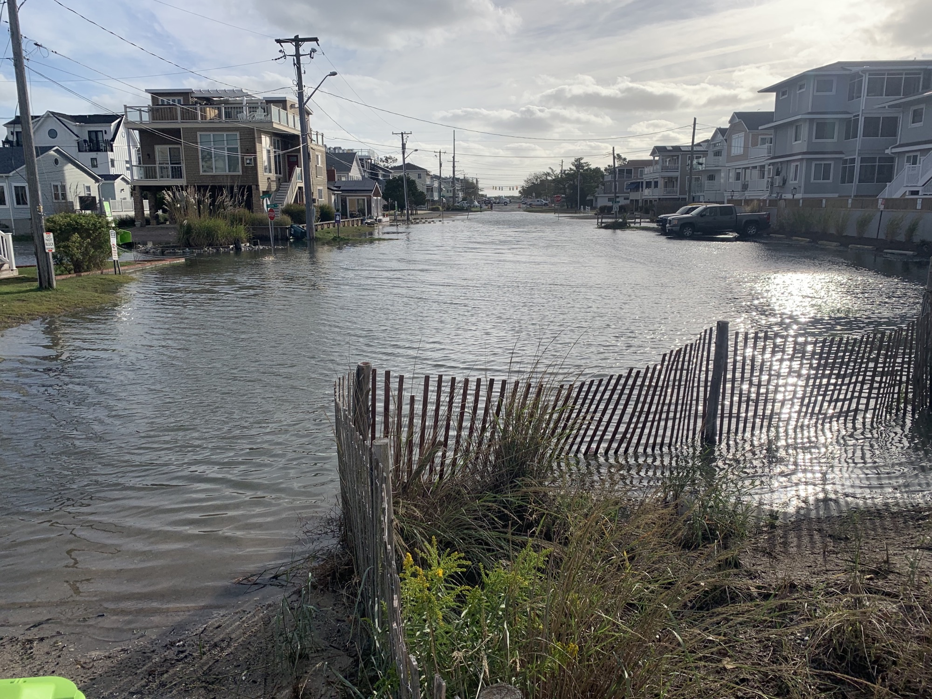
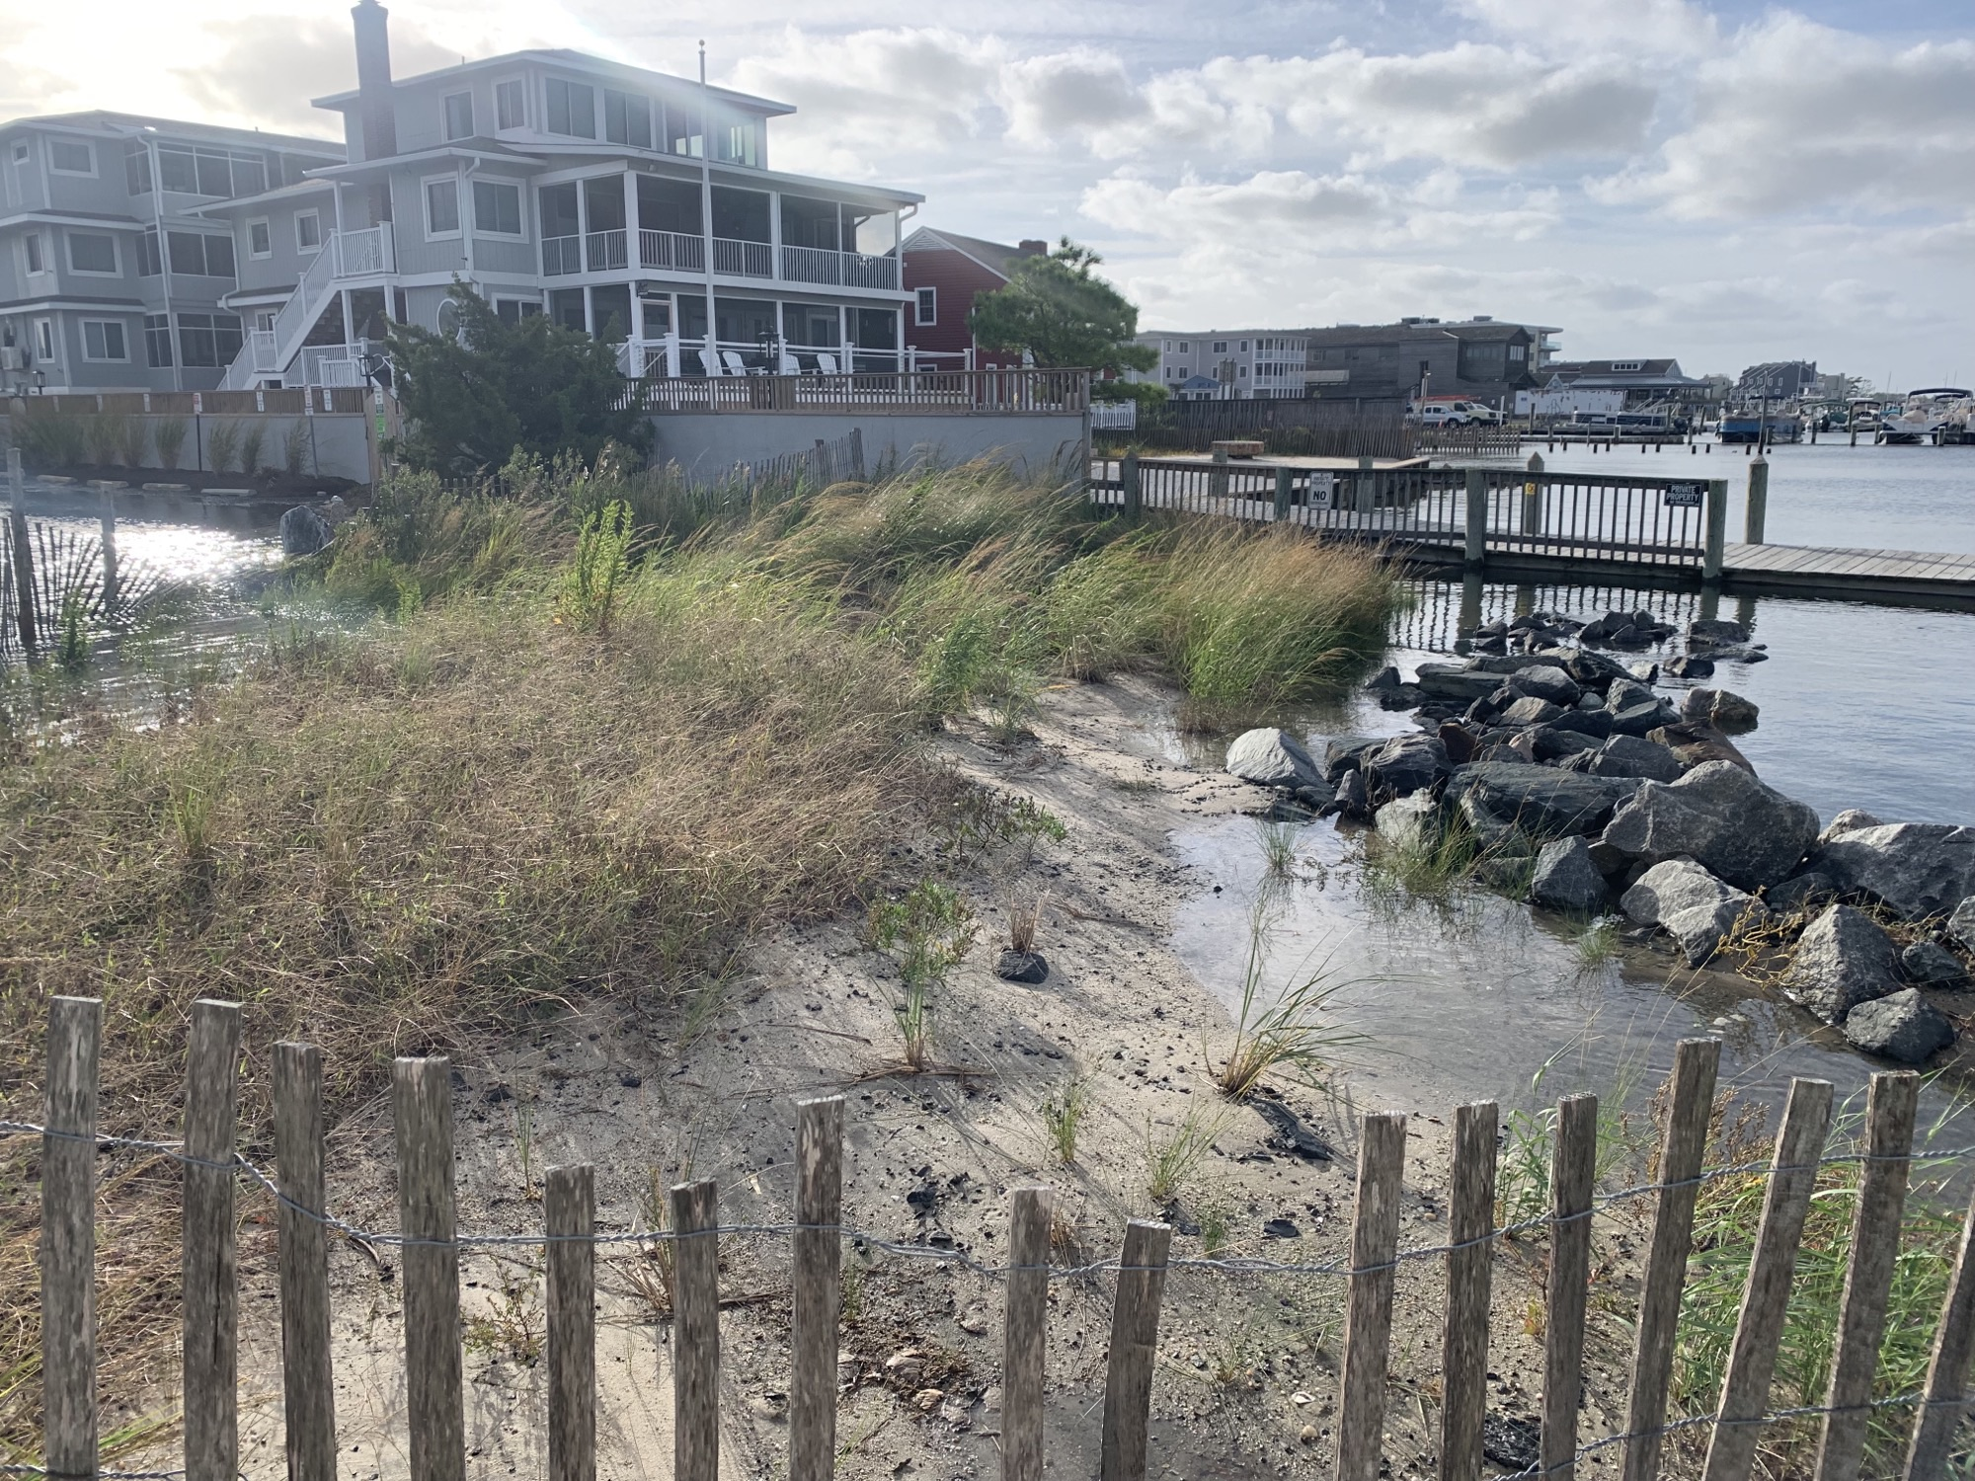
Read Avenue, Dewey Beach
  Town of Dewey Beach

Slide 15
Pre-project photo of flooding at the intersection of Pacific Ave and Rio Grande Ave after a light rain at high tide.
  Town of Dewey Beach

Slide 16
Assessment
    We understand that the Town continues to explore options to mitigate flooding on Read Avenue at its ending point at the bay.
    Over the past two plus years, the Town has experimented with several modifications to the existing drainage piping and structures in an attempt to reduce flooding, which occurs during high tide events in the bay that subsequently affect Read Avenue and has gone as far as Coastal Highway in extreme conditions.
    It is our opinion that there is no drainage pipe or structure modification that will adequately mitigate flooding to a great enough extent that both the Town and the local community will be satisfied with the flooding reduction effect.
    We believe that mechanical means, namely a pump station, is the only long-term viable solution that will effectively mitigate flooding to a great enough extent that significant flood mitigation can be achieved long term.
  Town of Dewey Beach

Slide 17
Recommendations
    While we strongly recommend exploration of the pumping option, we understand that the implementation of that option will require significant funding and time to assemble a bid package suitable for public bidding.
    We would like to present one short term option that will not significantly solve the issue but can reduce some of the flooding.
    The Town could consider placing flap valves at the end of each of the three (3) outfalls on Read Avenue and potentially installing additional gabions/rip-rap.
    The flap valves would remain open during low tide events allowing storm water to exit Read Avenue.
    During high tide events, the valves would close and prevent additional bay water from entering Read Avenue.
  Town of Dewey Beach

Slide 18
Recommendations
    We can also investigate closing off two (2) of the existing outfalls and leaving one (1), of the outfalls open with a flap valve as we believe the three (3) original outfalls were installed for redundancy purposes, which was observed to be allowing water flow and this could potentially save the Town additional expense as this is a short-term fix.
    The effectiveness of the valves will significantly diminish during moderate to major storm events, flood events, high tides, and periods where lunar effects are prevalent with the “worst case scenario” occurring when two or more of these conditions occur simultaneously.
    We are suggesting the addition of additional gabions/rip-rap in an attempt to restrain some of the sand and bay material that tends to wash onto Read Avenue.
  Town of Dewey Beach

Slide 19
Recommendations
    Again, this measure will not prevent this from occurring but will provide the Town Public Works Department with time to clean and maintain the area immediately after a significant tidal or storm event occurs.
    We would like to stress again that these measures will not mitigate flooding to a great enough extent that both the Town and the local community will be satisfied with the flooding reduction effect but will improve that situation to better enable the Town Public Works Department to maintain this area of Read Avenue.
  Town of Dewey Beach

Slide 20
Project Specification and Estimate
    We estimate the costs to implement these two measures is approximately $60,000.00.
    We would like to discuss the measures and costs associated with our recommended long-term flooding solution which is the implementation of a pumping station at the end of Read Avenue.
    Outlined tasks would include:
    Task 1 – Site Survey & Base Plan Generation
    Task 2 – Geotechnical Investigation
    Task 3 – Basis of Design & Pump Station Design
    Task 4 – Permitting Services
  Town of Dewey Beach

Slide 21
Questions & Answers
Thank you
  Town of Dewey Beach

