Slide 1

Extension Request
Moore Blue Water, LLC respectfully requests an extension of the time period to apply for a building permit under § 185-70 until December 31, 2024
Glenn Mandalas, Esq

Slide 2
Variance Extension Request
Variances Granted
  A special exception to construct an elevator bulkhead extending beyond the Town’s height limitation of 42’;
  A variance from the Zoning Code to permit the construction of a three-story pool enclosure over and around an existing pool and pool deck;
  A variance from yard setback restrictions to allow a set of proposed cabanas to extend outside the northernmost hotel room unit; and
  A variance from the Town’s one-foot freeboard requirement above FEMA’s six foot minimum above base flood elevation (7.2 inches).

Slide 3
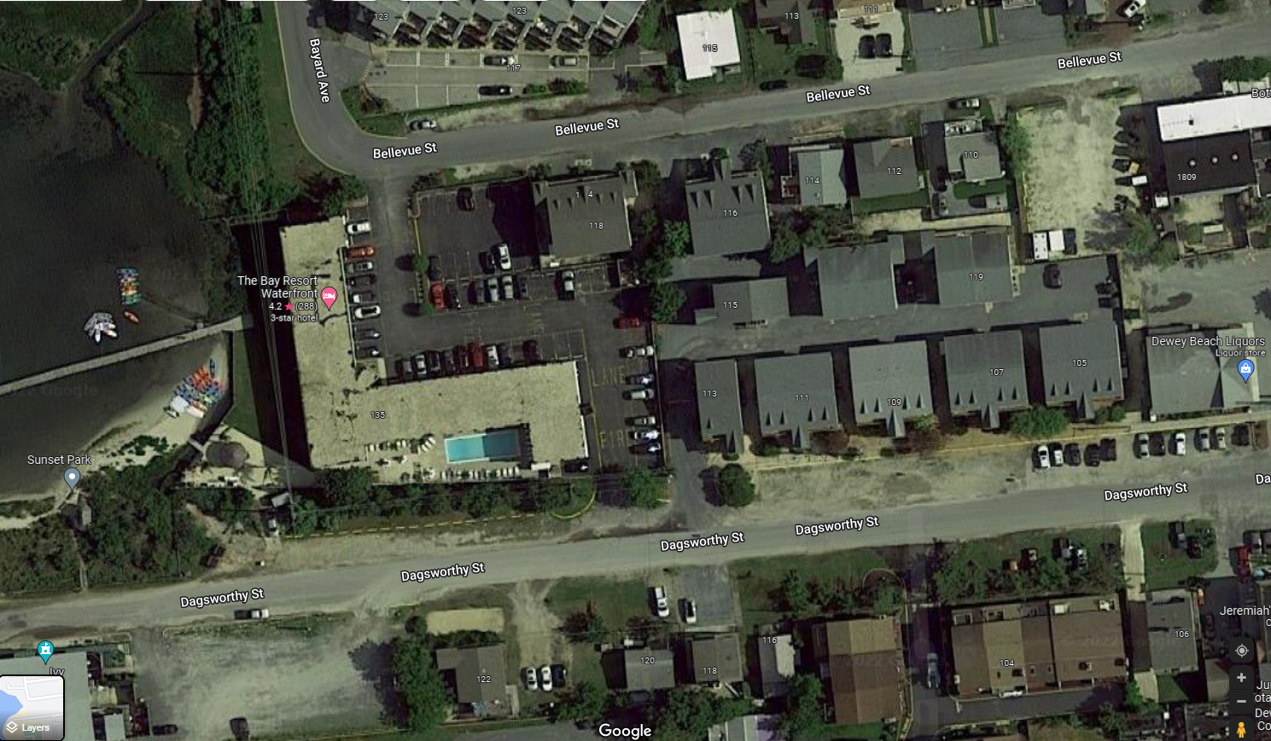
Cabana
front
side
Elevator
side
Pool Enc.
Deck
rear

Slide 4
Chronology
January 5, 2023 Written Board of Adjustment Decision
  Existing Code
  § 185-70 Lapse of special exception or variance.
    After the Board of Adjustment has approved a special exception or granted a variance, the special exception or variance so approved or granted shall lapse after the expiration of one year unless construction is completed or the use has taken place in accordance with the plans for which such special exception or variance was granted, or if the Board of Adjustment does not specify some longer period than one year for good cause shown, and the provisions of these regulations shall thereafter govern.
First Quarter 2023: New Chief Construction Officer
  Reviewed current scope of all projects

Slide 5
Chronology
April/May 2023: Finalizing Plan Submissions
  State Fire Marshal’s office required changes to the construction design, including adding a staircase on the south end of the building, and adding a sprinkler system to comply with emergency exit requirements.
  Based on these changes and rising construction costs, the Chief Construction Officer engaged in a cost analysis resulting in architectural changes to the construction plans including a modification to the elevator plans.
June 16, 2023: Ordinance 813 approved
  New Code
  § 185-70 Lapse of special exception or variance.
    A special exception or variance approved by the Board of Adjustment shall lapse after the expiration of one year unless . . . B. A building permit has been applied for before the expiration of one year after approval of the special exception or variance . . . . D. The Board of Adjustment has specified a period longer than one year for good cause shown. . . . Any special exception or variance that is valid as of June 16, 2023 shall be extended until December 31, 2023.

Slide 6
Chronology
September 22, 2023: Request time extension
September 28, 2023: Building Official reminds me that Ordinance 813 was approved, providing more flexibility
October 11, 2023: Withdraw request for extension
December 27, 2023: Request extension

Slide 7
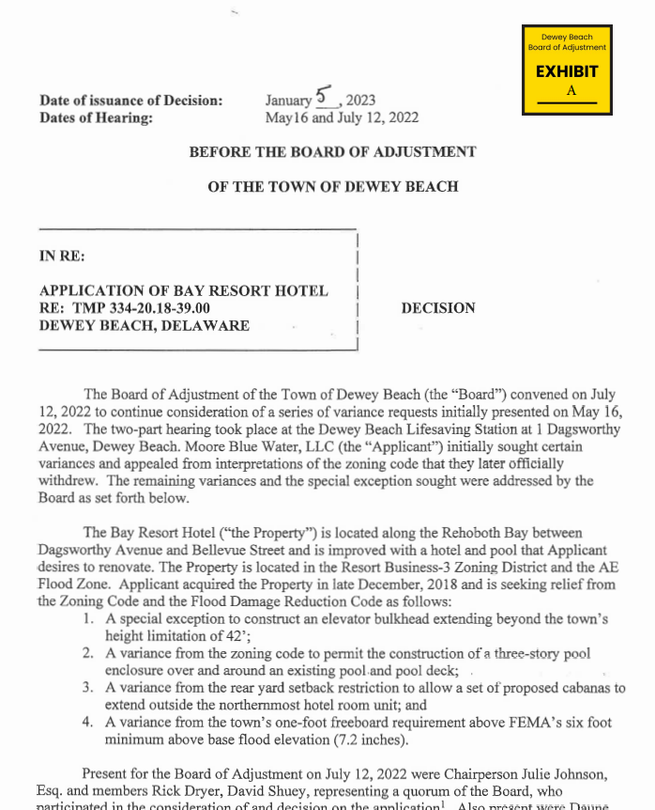

Slide 8
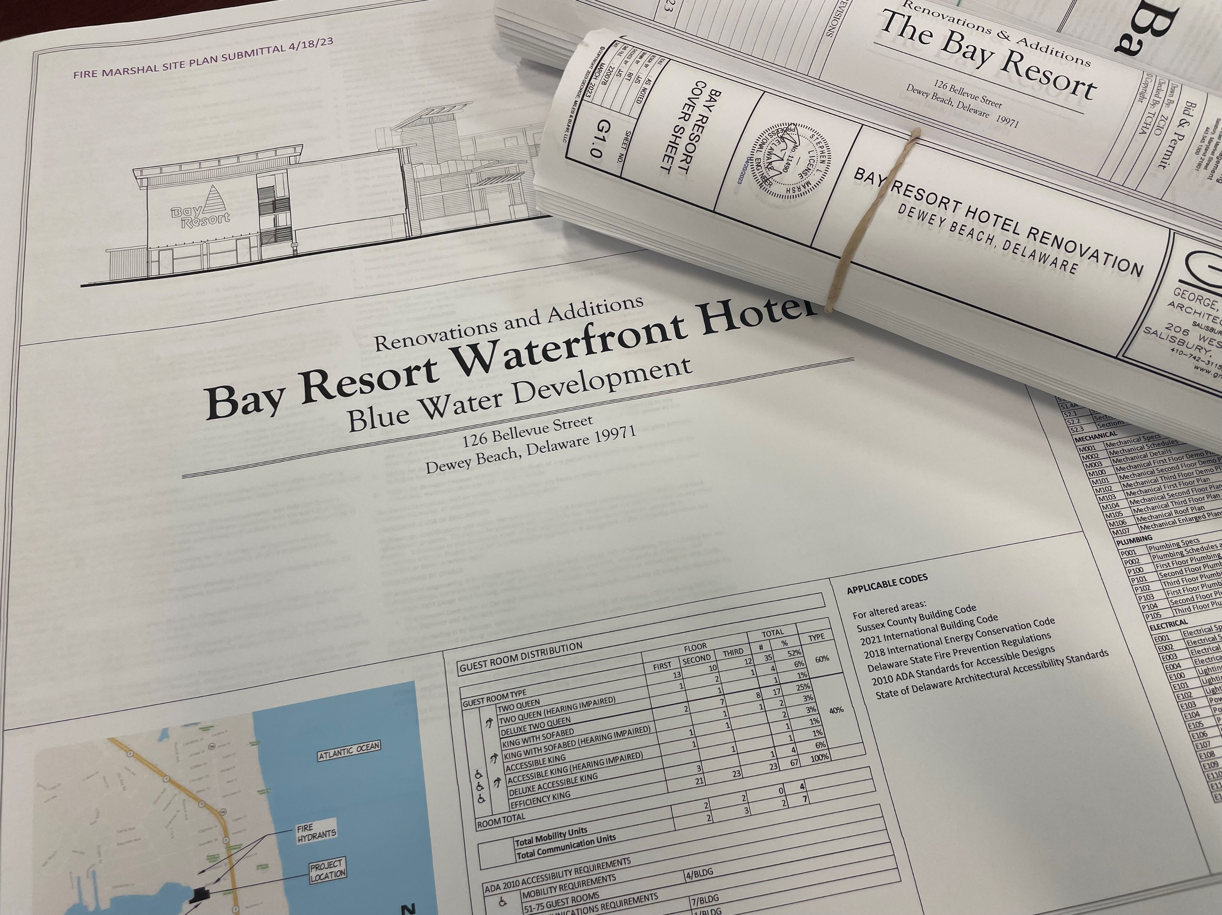

Slide 9
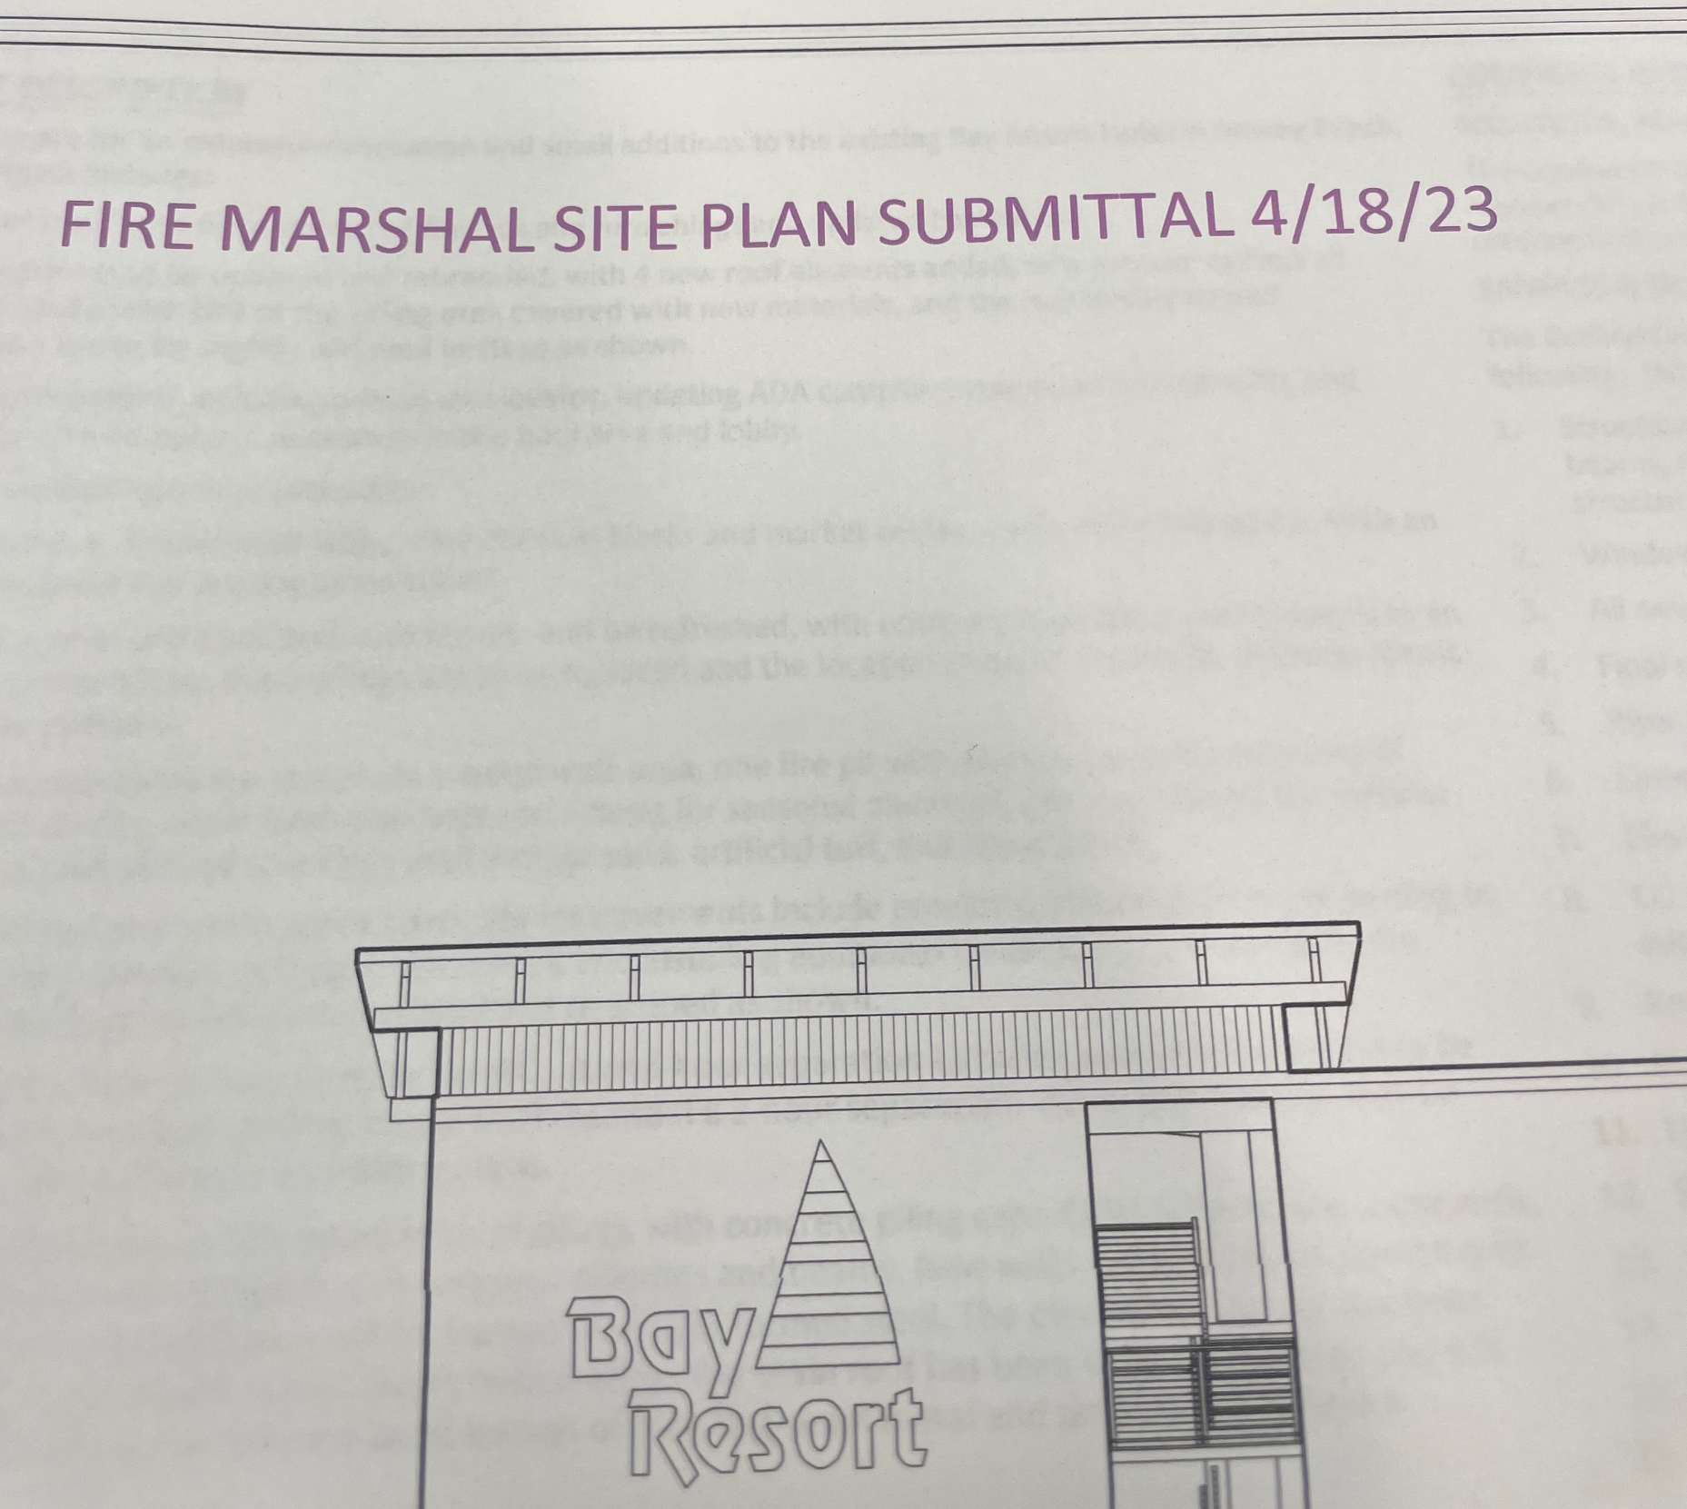

Slide 10
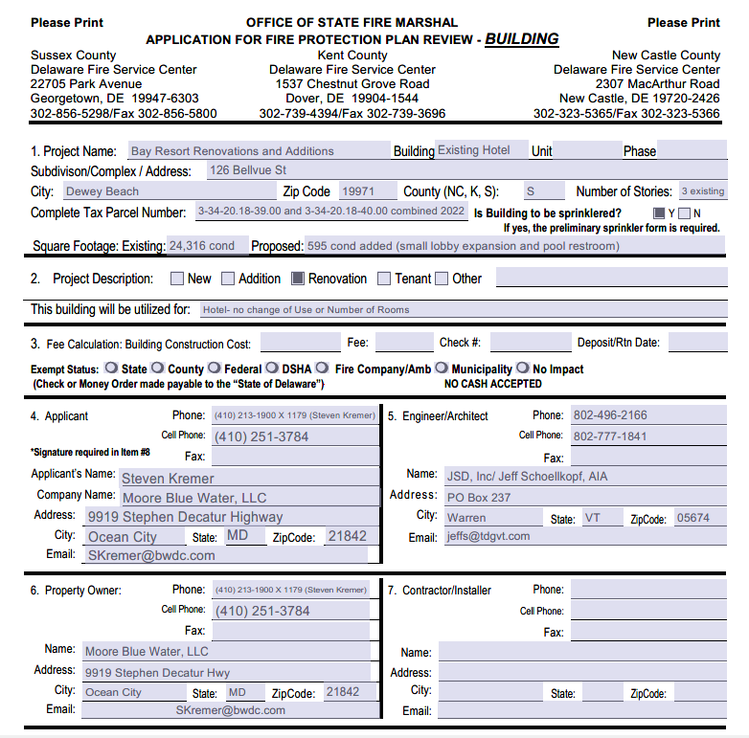

Slide 11


Slide 12
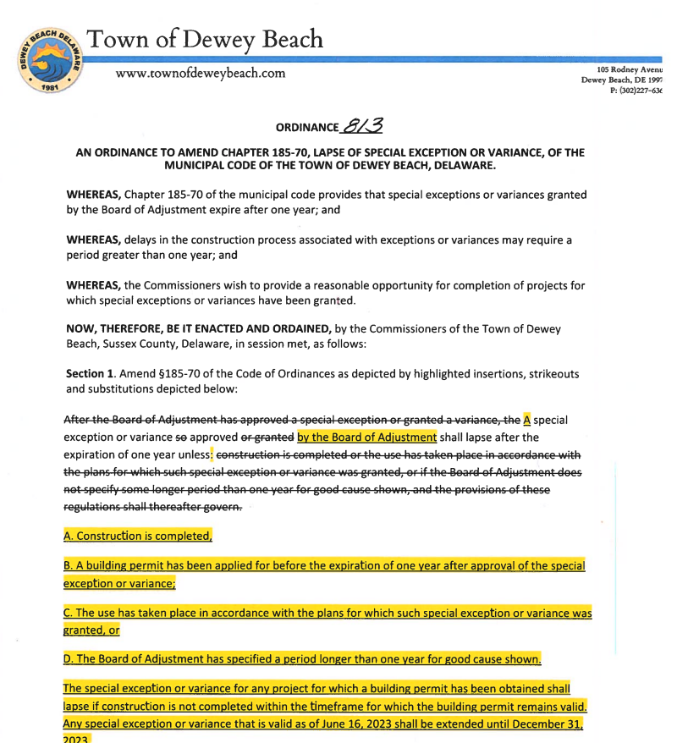

Slide 13
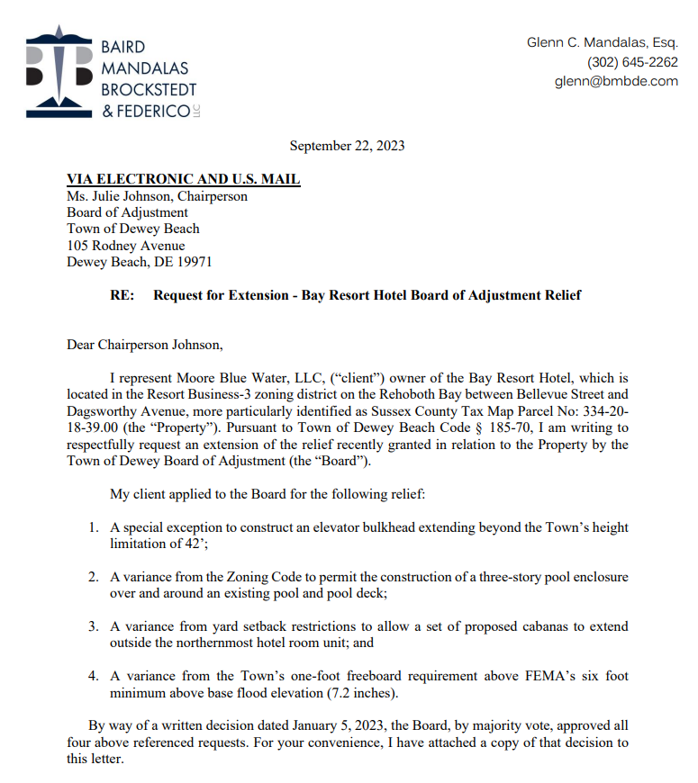

Slide 14
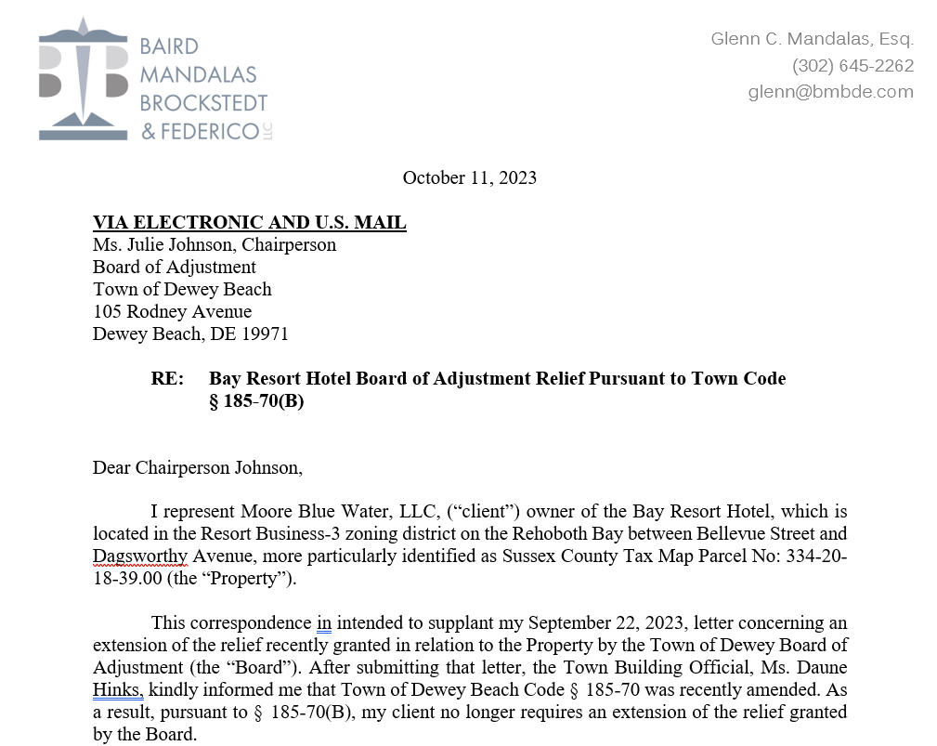

Slide 15
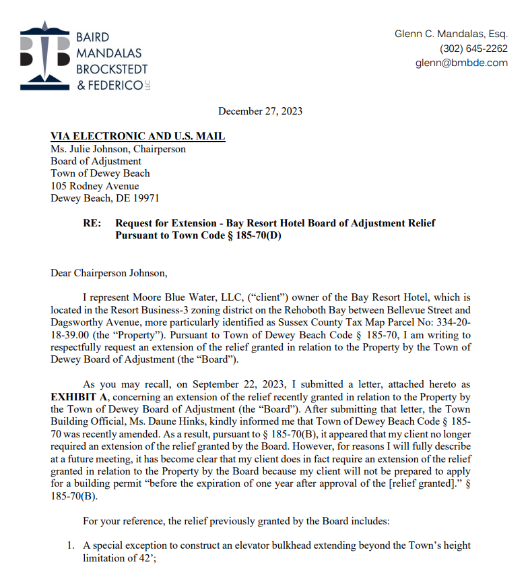

Slide 16
Extension Request
Moore Blue Water, LLC respectfully requests an extension of the time-period to apply for a building permit under § 185-70 until December 31, 2024
THANK YOU

