Slide 1



Dewey Beach
Board of Adjustment
Feb 21, 2024
Glenn Mandalas
Jennifer Biggs

Slide 2
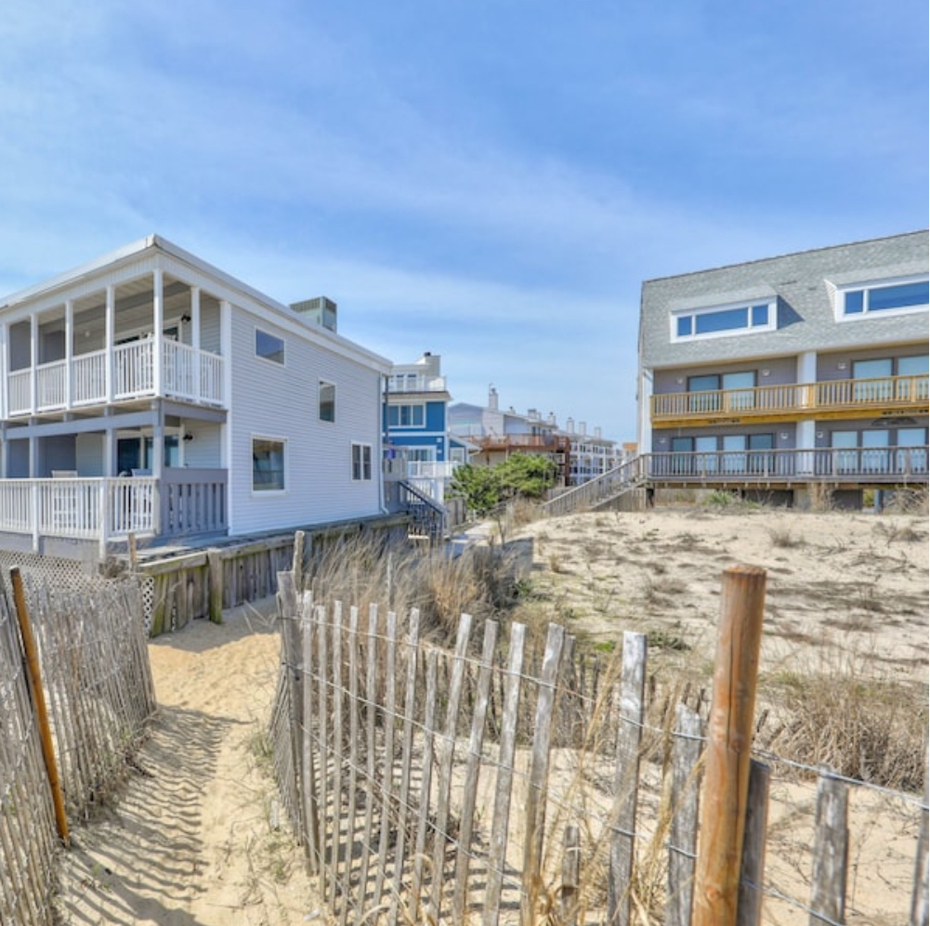
Agenda
Surfside Plaza Orientation
Improvement Plans
Variance Request
Exceptional Practical Difficulty
Conclusion

Slide 3
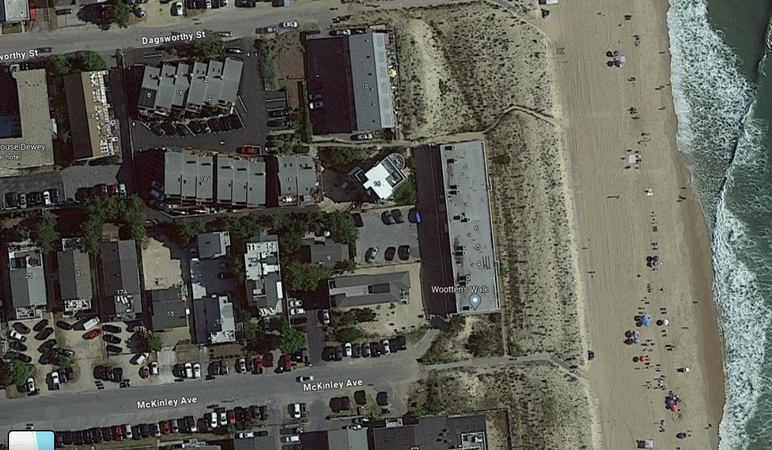
SURFSIDE PLAZA
Unit 11

Slide 4
THREE STORY STRUCTURES SHOWN IN BLUE
SURFSIDE PLAZA
Unit 11

Slide 5
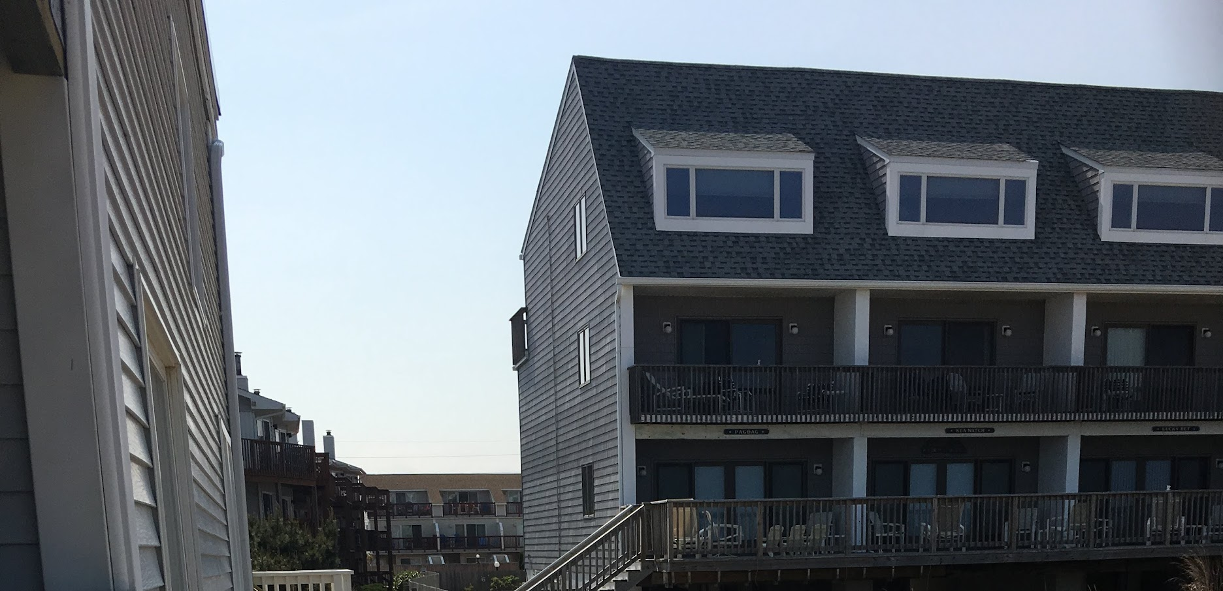

Slide 6

Planned Improvements
Construct a third floor to unit 11
Bring the stairs into compliance with the Building Code
Create decking

Slide 7
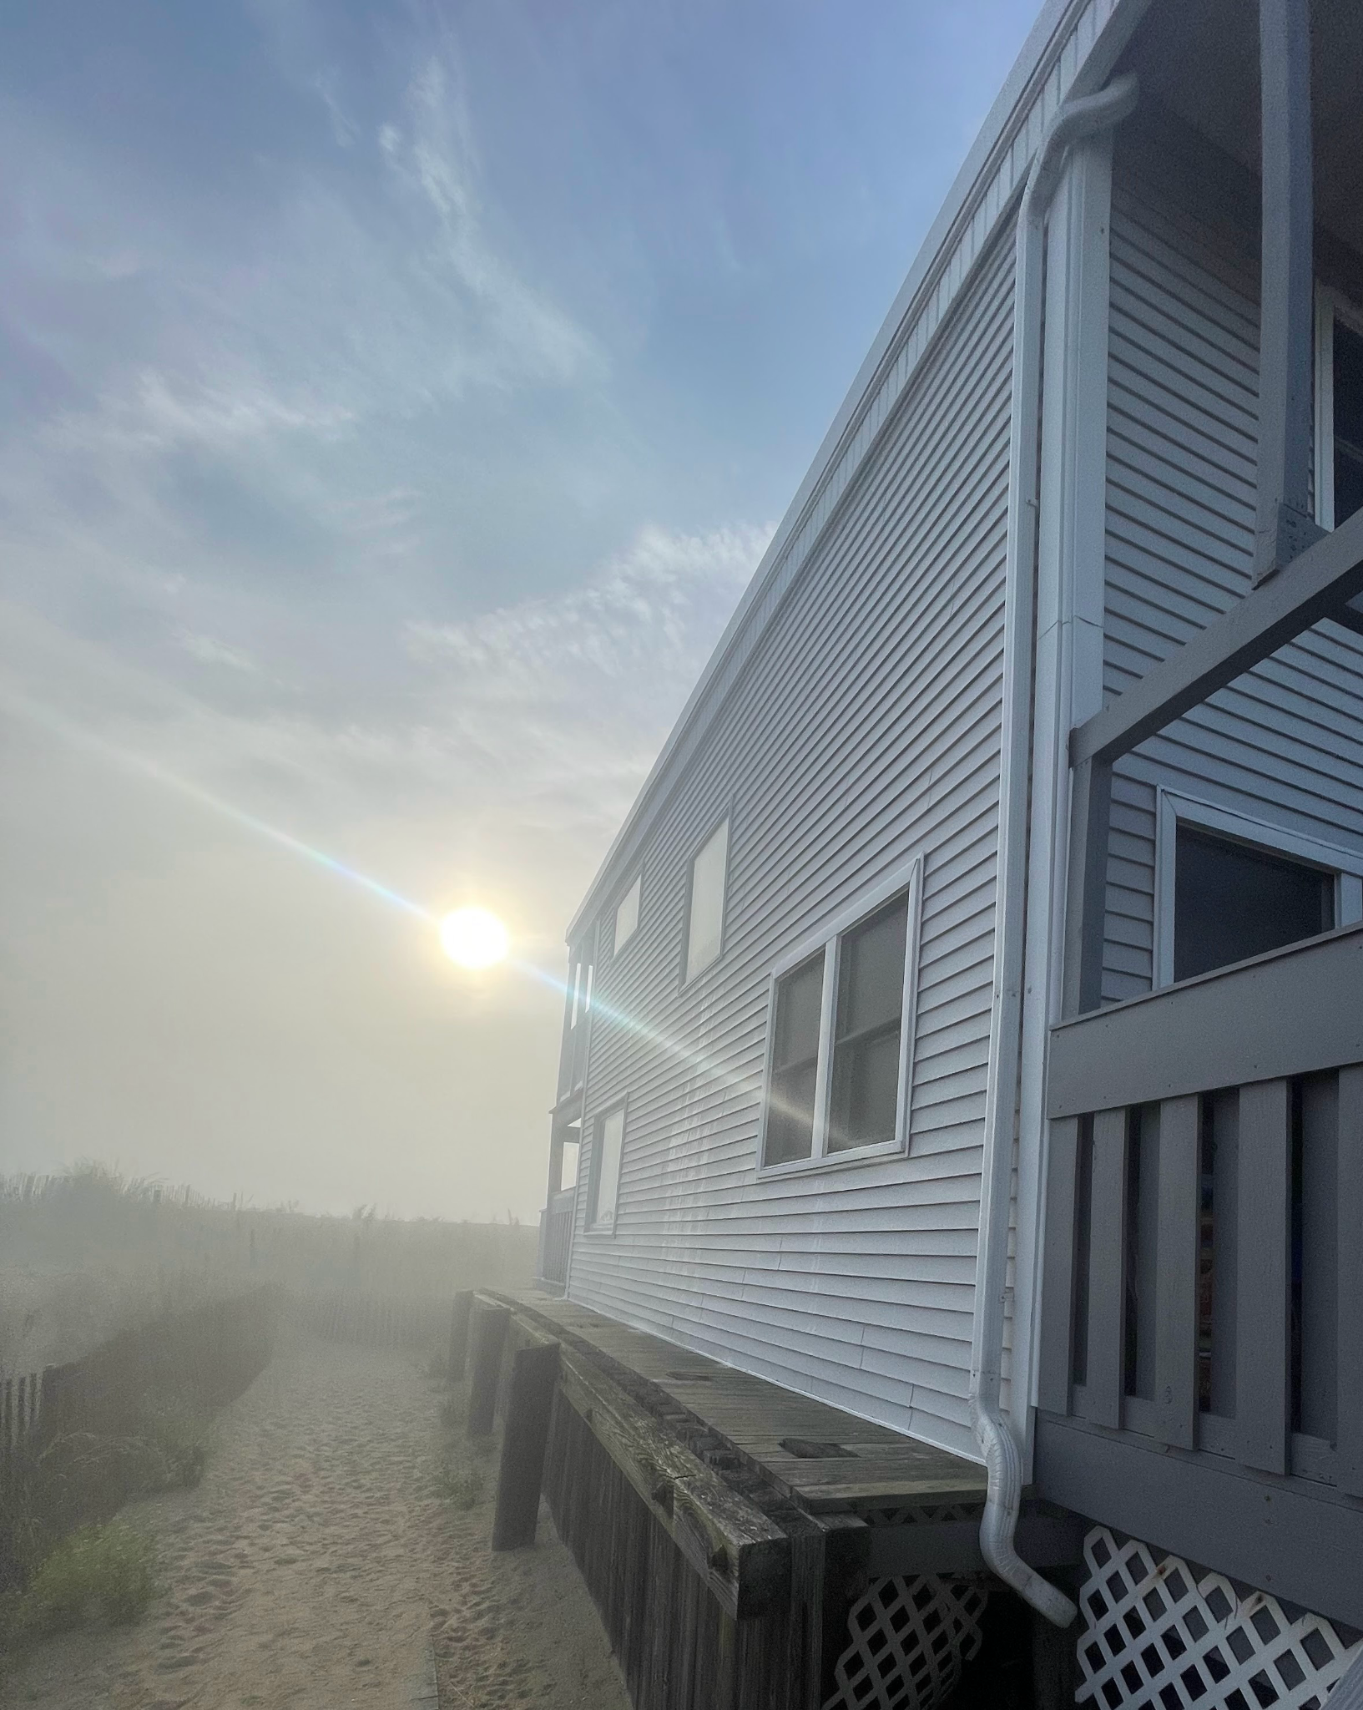
Our Variance Request
The owners request variances from the side yard and front yard setback requirements provided in Table 2 of the Zoning Code and, for completeness, a variance from Section 185-60(B), addressing extensions of nonconforming buildings, to permit a vertical addition within the 8-foot side yard setback and within the 22-foot front yard setback

Slide 8
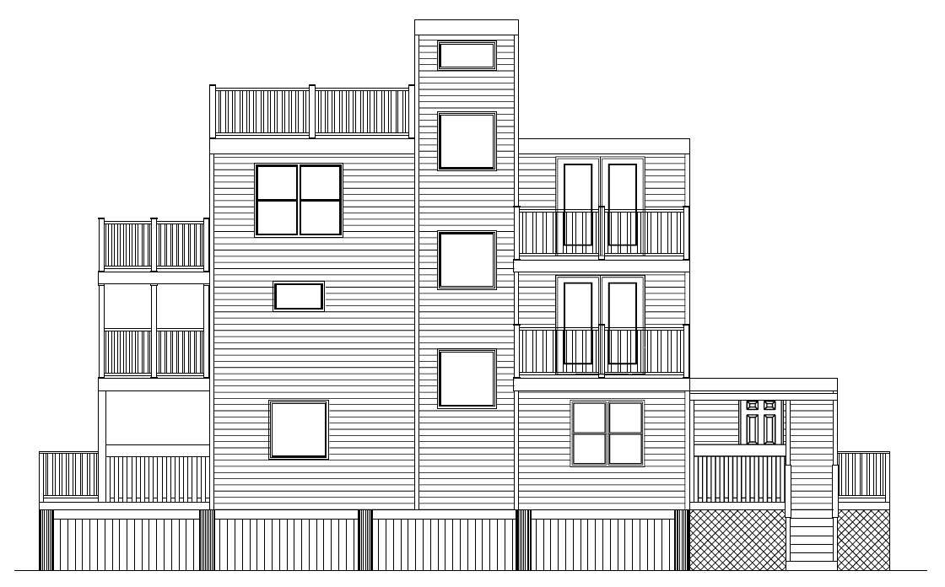
Approx 32’ height
2’-2” from existing wall
4’ from existing wall
Existing Retaining Wall
Approx 4’ from
existing wall
18’-7”
7’-1”

Slide 9
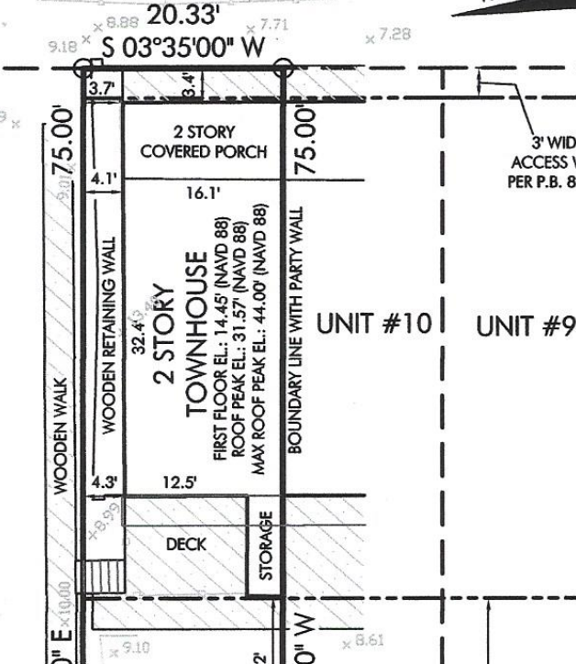

Slide 10
THREE STORY STRUCTURES SHOWN IN BLUE
SURFSIDE PLAZA
Unit 11

Slide 11
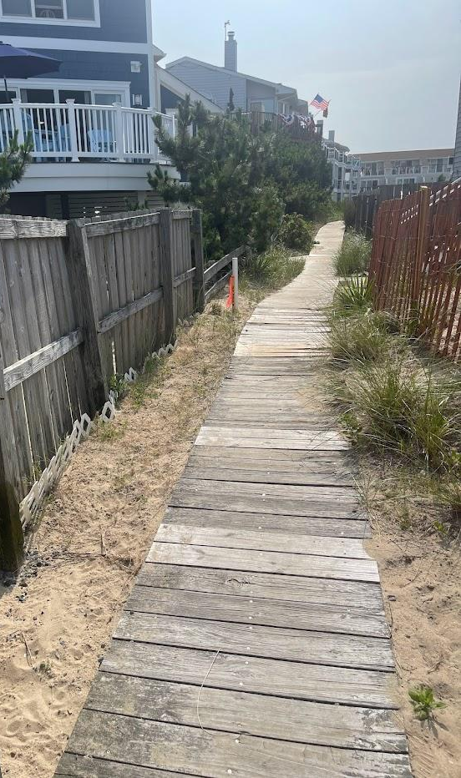

Slide 13
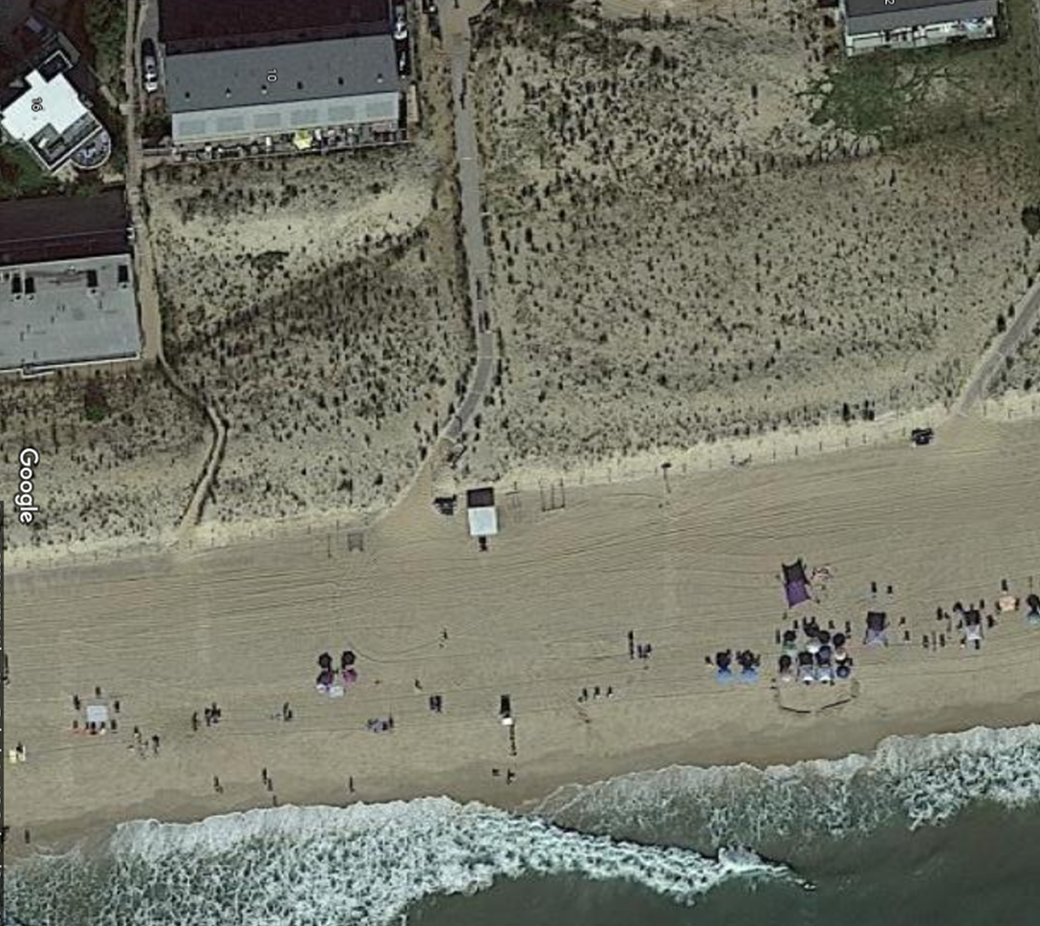

Exceptional Practical Difficulty
Bd. of Adjustment of New Castle Cty v. Kwik-Check Realty, Inc
Delaware Supreme Court: “[s]uch [exceptional] practical difficulty is present where the requested dimensional change is minimal and the harm to the applicant if the variance is denied will be greater than the probable effect on the neighboring properties if the variance is granted.”

Slide 14
Exceptional Practical Difficulty
Surfside Plaza was constructed as early as 1965—years before zoning laws were adopted
The Property does not conform to present-day zoning regulations.
As a result, it is exceptionally difficult to make normal improvements to the Property in compliance with current zoning requirements.
Many of the buildings surrounding Surfside Plaza are three-story units (Sea Watch Condominium to the north of the Property; the home to the west of the Property; McKinley Condominium to the southwest of the Property; and the Sunspot Condominium to the South of Surfside Plaza).
Because three story properties are prevalent in the immediate neighborhood, the harm to the applicant if the variance is denied will be greater than the probable effect on the neighboring properties if the variance is granted.

Slide 15
Exceptional Practical Difficulty
FACTOR 1: The nature of the zone in which the property lies
The property is in the Resort Residential (RR) Zoning District, where the residential use and certain multifamily residential structures are permitted uses.

Slide 16
Exceptional Practical Difficulty
FACTOR 2: The character of the immediate vicinity and the uses contained therein
Many of the buildings immediately surrounding Surfside Plaza consist of three-story units with decks. Consequently, the proposed addition is in character with the surrounding buildings and residential uses

Slide 17
Exceptional Practical Difficulty
FACTOR 3: Whether, if the restriction upon the applicant’s property were removed, such removal would seriously affect such neighboring property and uses
Granting of the requested variance would not seriously affect neighboring property.
Complies with the 35-foot height limitation - no indication it will hinder ocean views.

Slide 18
Exceptional Practical Difficulty
SURFSIDE PLAZA
Unit 11

Slide 19
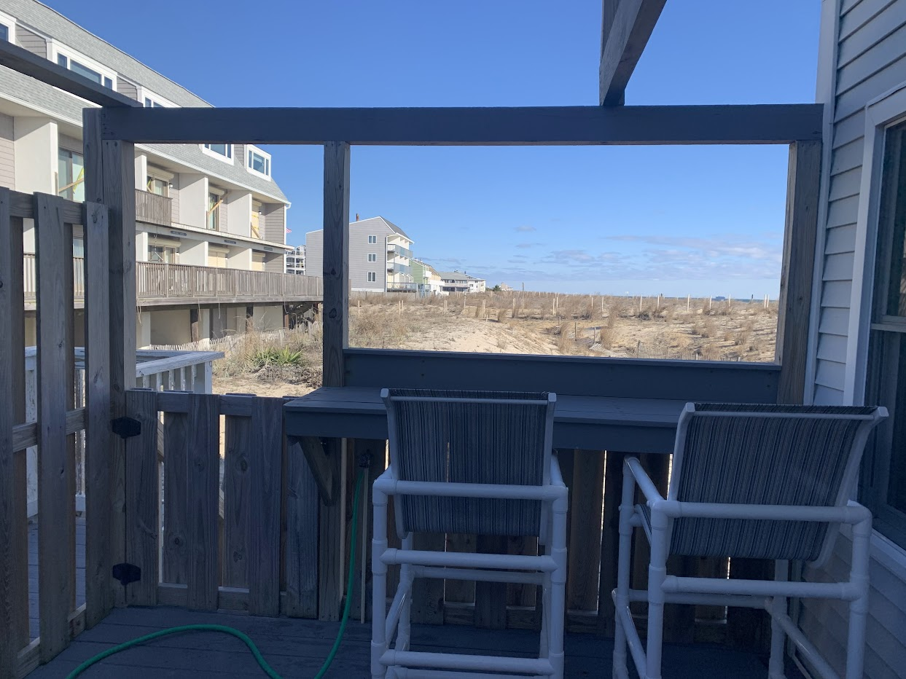
Exceptional Practical Difficulty

Slide 20
Exceptional Practical Difficulty
FACTOR 4: Whether, if the restriction is not removed, the restriction would create [hardship] for the owner in relation to his efforts to make normal improvements in the character of that use of the property which is a permitted use under the use provisions of the ordinance.
If the variance is not granted the owners will not be able to make normal improvements. The proposed expansion is clearly a “normal improvement,” as other buildings in the RR Zoning District have expanded vertically. If the variance were to be denied, the owners would have no ability to expand in the same way that their neighbors have expanded.

Slide 21
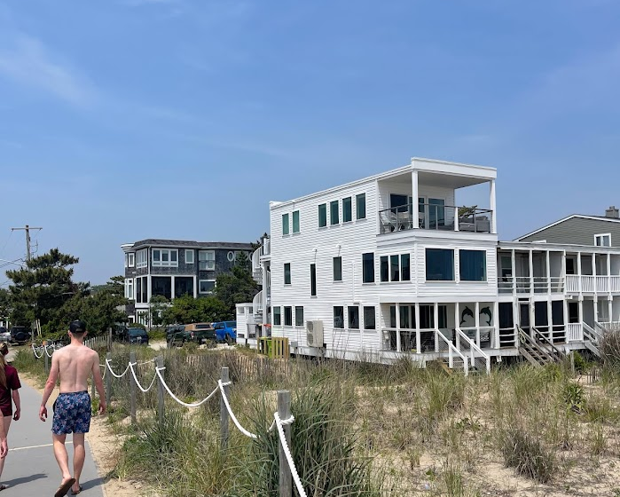
Exceptional Practical Difficulty
Saulsbury, Ocean Side

Slide 22
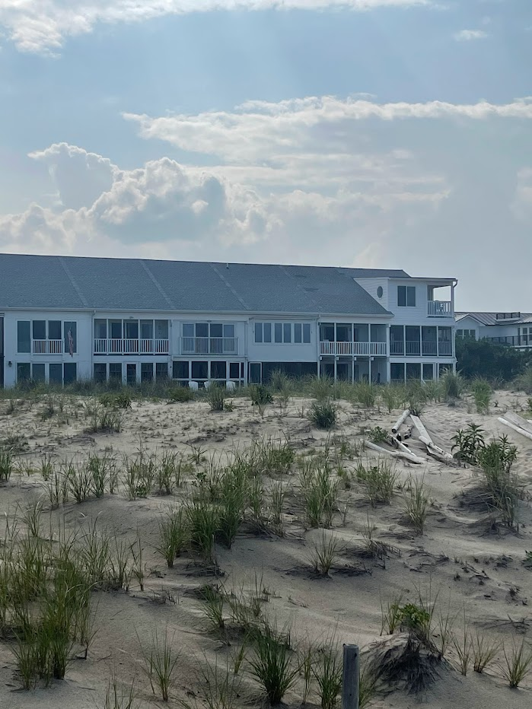
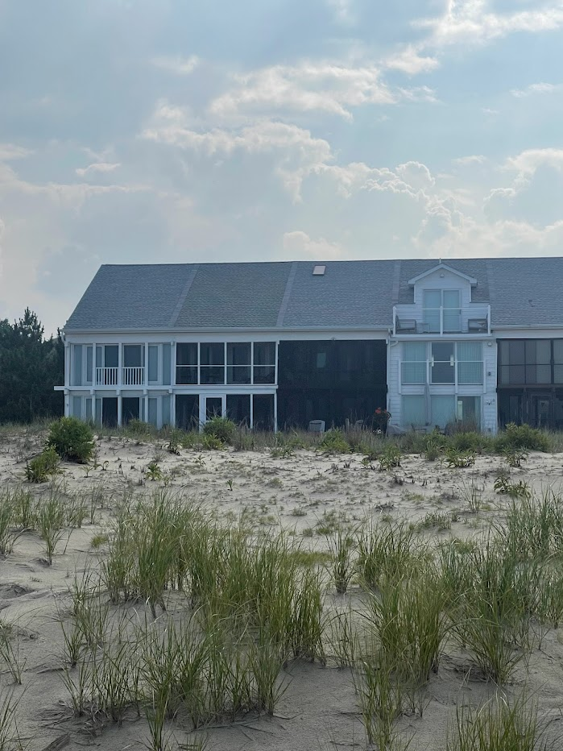
Sea Strand
Sea Strand

Slide 23
Opposition – Engineering Feasibility
Allyn E. Kilsheimer, P.E. (George Washington University trained, published, founder and CEO of KCE Structural Engineers)
Expressed concerns about the engineering feasibility of the proposed project
The evolution of a project:
Owner meets with builder
Survey
Prepare conceptual plans
Request relief from the Board of Adjustment *
Engineering review and preparation of construction plans
Engineer stamps and seals plans if approved
Submit plans for permitting by DNREC – DNREC Building Line
Submit plans for permitting by Dewey Beach and Sussex County

Slide 24
Opposition – Views / Encroachment
Proposal does NOT cross property line
Proposal does NOT hang over beach walkway
Much of what is proposed could be developed at three levels without need for Board of Adjustment approval
Ocean views are not obstructed
Many properties in the vicinity have north facing decks

Slide 25
THREE STORY STRUCTURES SHOWN IN BLUE
SURFSIDE PLAZA
Unit 11

Slide 26
THREE STORY STRUCTURES SHOWN IN BLUE
OPPOSITION CORRESPONDENCE SHOWN IN RED
SURFSIDE PLAZA
Unit 11

Slide 27
THREE STORY STRUCTURES SHOWN IN BLUE
OPPOSITION CORRESPONDENCE SHOWN IN RED
SUPPORTING CORRESPONDENCE SHOWN IN GREEN
SURFSIDE PLAZA
Unit 11
Note: units 1 through 10 of Surfside Plaza could build to three stories without relief from the Board of Adjustment

Slide 28
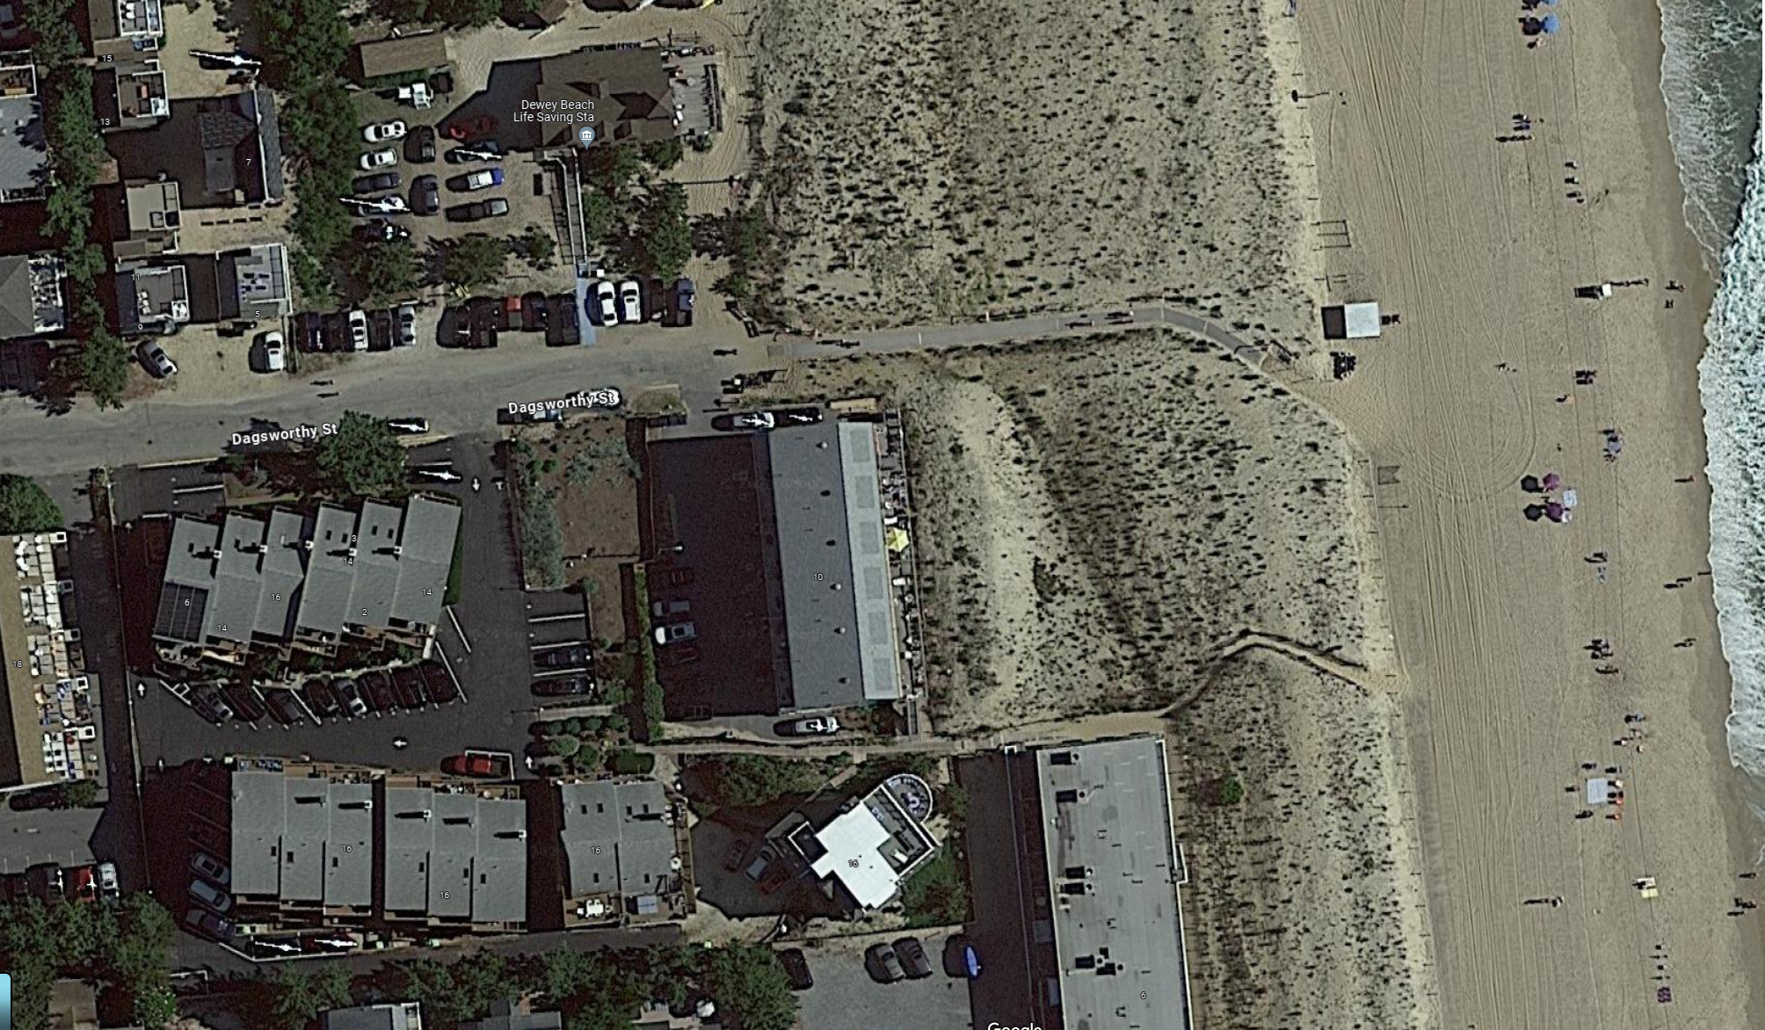

Opposition – Views / Encroachment

Slide 29
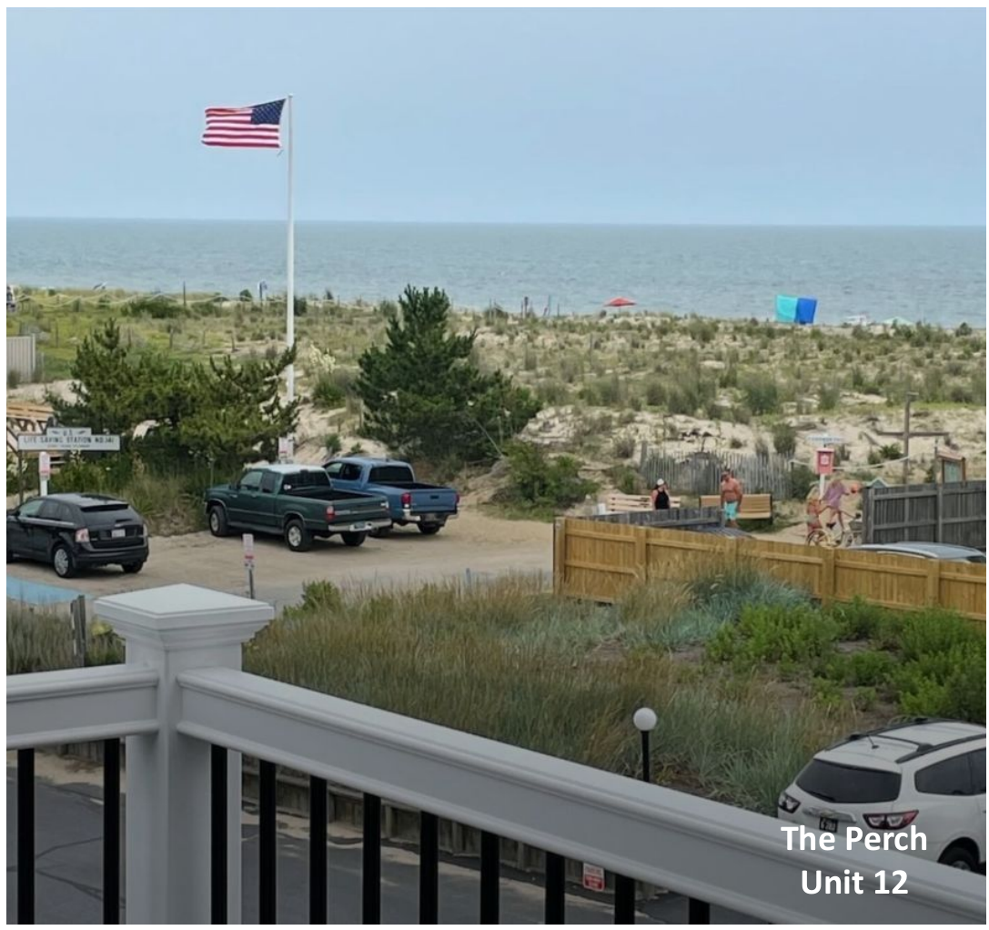
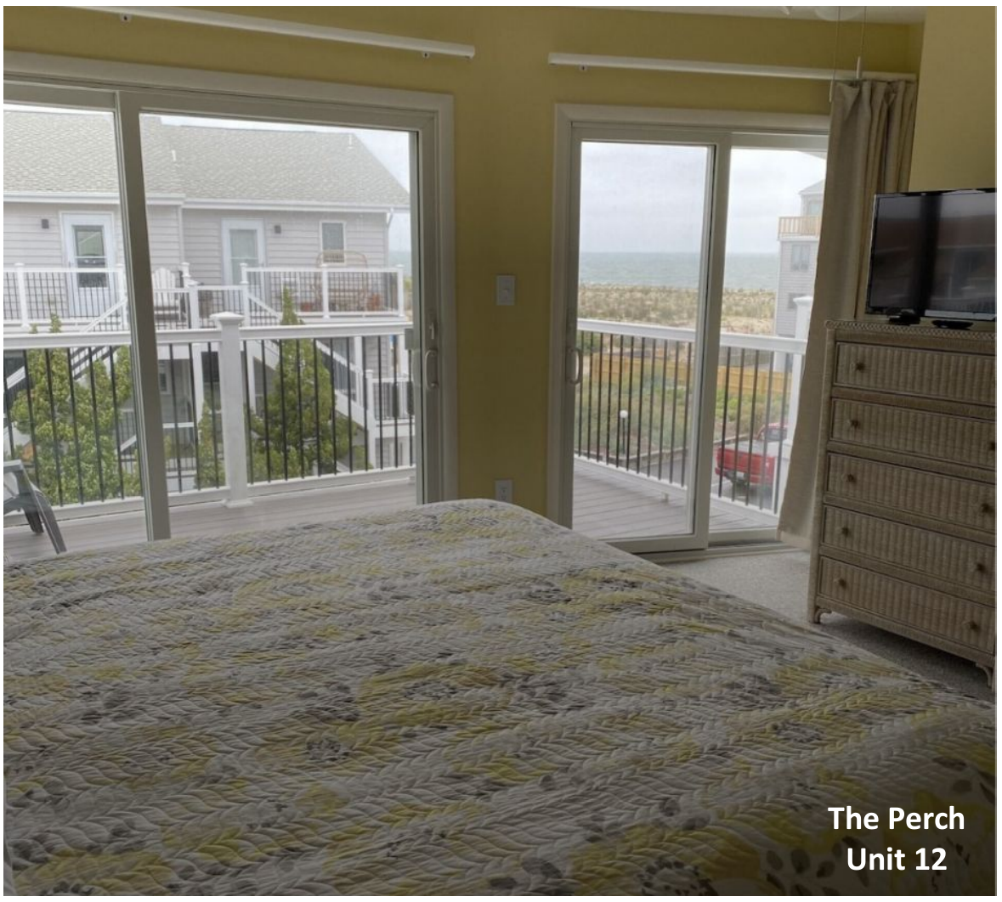
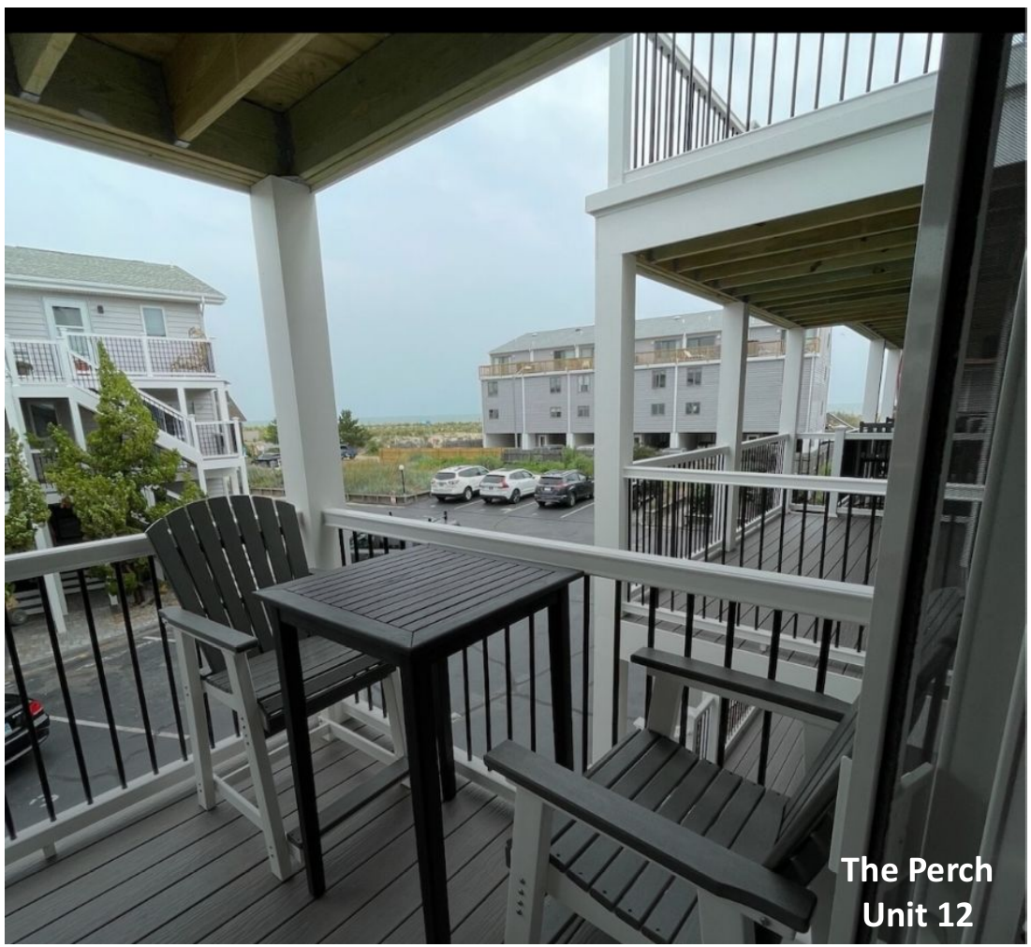
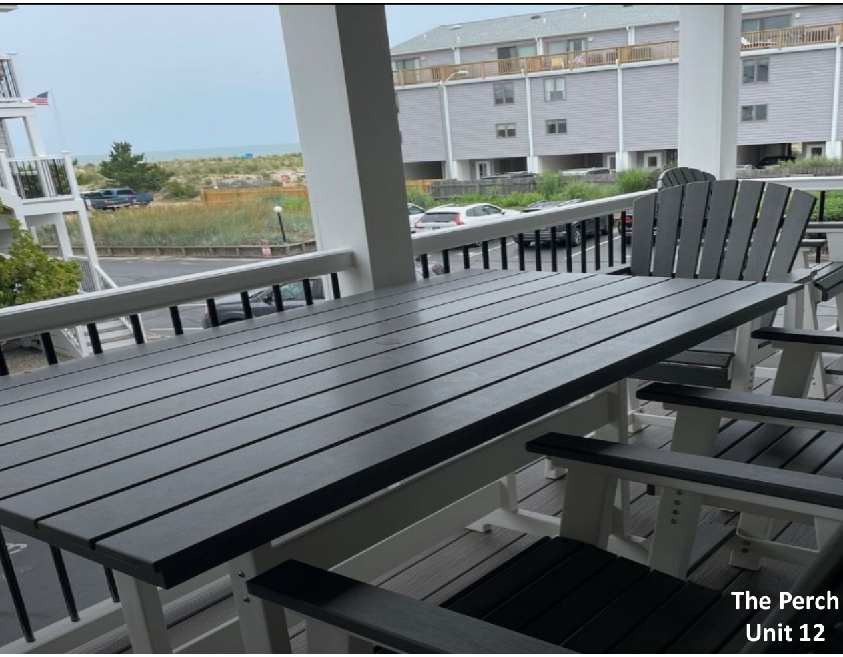
Opposition – Views / Encroachment

Slide 30
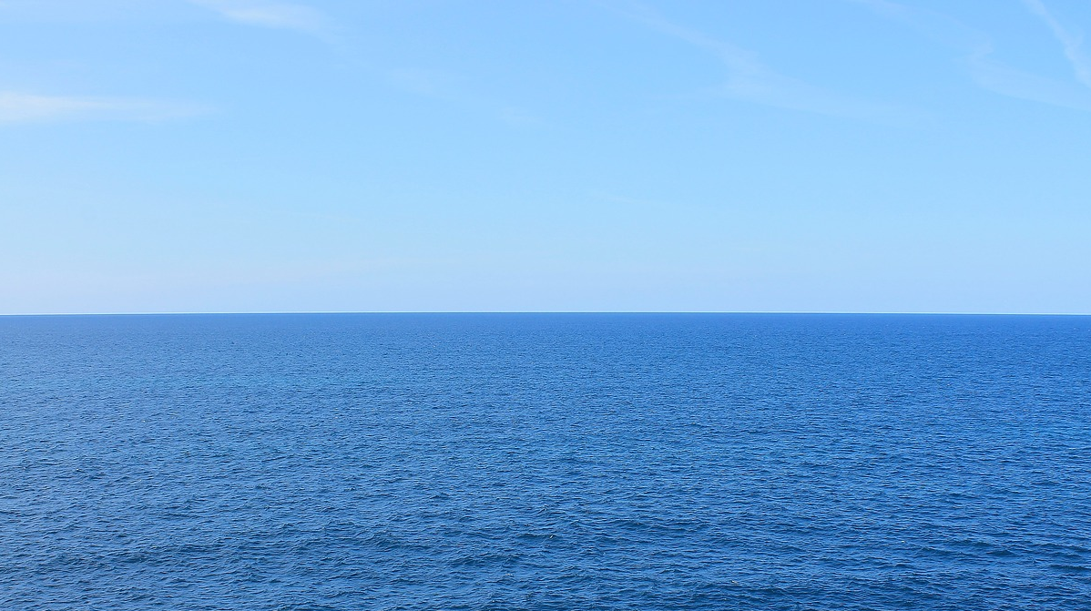
Conclusion
Balancing analysis: Harm to the applicant outweighs the probable effect on neighboring properties
“Exceptional practical difficulty” standard has been satisfied
Respectfully request that the variances be granted

Slide 31
Thank You

