Slide 1
Background
The National Flood Insurance Program (NFIP) was established in 1968 through the National Flood Insurance Act. It aims to reduce the socio-economic impact of floods by providing affordable insurance to property owners and encouraging communities to adopt and enforce floodplain management regulations
FEMA administers the NFIP by overseeing flood insurance provision, producing flood maps, enforcing floodplain management regulations, and offering technical assistance to reduce flood risks.
FEMA has identified special flood hazard area (SFHA’s) within the boundaries of Dewey beach (roughly all areas below Clayton St)
  High risk of flooding; 1% chance of flood events (100 year flood event)
  Owners of federally backed mortgages are required to carry flood insurance
Dewey Beach entered into the National Flood Insurance Program on 6/18/1982;
      Flood Damage Reduction Ordinance can be found in section 101 of town code adopted in 2014
Town also participates in the CRS (Community Reporting System); Complimentary to NFIP
  Provides for discounts for flood insurance promoting better flood plain management practices
Climate Change committee has recommended increasing town’s freeboard;
2018 Comprehensive Plan includes recommendation to consider higher freeboard;
Town commissioners unanimously voted that the first finished floor of the new town hall should not be below BFE +3 feet
Current town code requires Freeboard is +1 feet above BFE (base flood Elevation);

Slide 2
What is BFE – Base Flood Elevation?
The Base Flood Elevation (BFE) is the elevation above mean sea level to which floodwaters are expected to rise during a base flood. Essentially, BFE represents the height that floodwaters are projected to reach during a significant flood event.
The Base Flood Elevation (BFE) is the computed elevation to which floodwater is anticipated to rise during a base flood. A base flood is defined as a flood that has a 1% chance of occurring in any given year, also known as a 100-year flood¹². The BFE is crucial for floodplain management and insurance purposes, as it helps determine the necessary elevation for buildings to minimize flood risk¹.
Floor Insurance Rate Maps created by FEMA (FIRM) detail areas at risk of flooding; are defined by ‘zones’; geographic areas that further define flood risk
  Zone AE: Areas with a BFE determined. These are high-risk flood zones where detailed hydraulic analyses have been conducted.
  Zone AH: Areas with shallow flooding (usually ponding) where average depths are between 1 and 3 feet. BFEs are determined.
  Zones A1–A30: Similar to Zone AE, these are areas with BFEs determined through detailed analyses.
  Zone AR: Areas that are being restored to provide flood protection. BFEs are determined.
  Zone AR/A, AR/AE, AR/A1–A30, AR/AH, AR/AO: Combination zones where areas are being restored and have additional flood risks.
  Zones V1–V30 and VE: Coastal areas with a BFE determined and additional hazards due to storm waves.
Base Flood Elevation (BFE) does take wave actions into account, especially in coastal areas. FEMA’s flood hazard analysis includes factors such as storm surge, wave setup, and overland wave propagation when determining BFEs¹². This means that the BFE reflects not only the stillwater elevation but also the additional height contributed by wave action

Slide 3
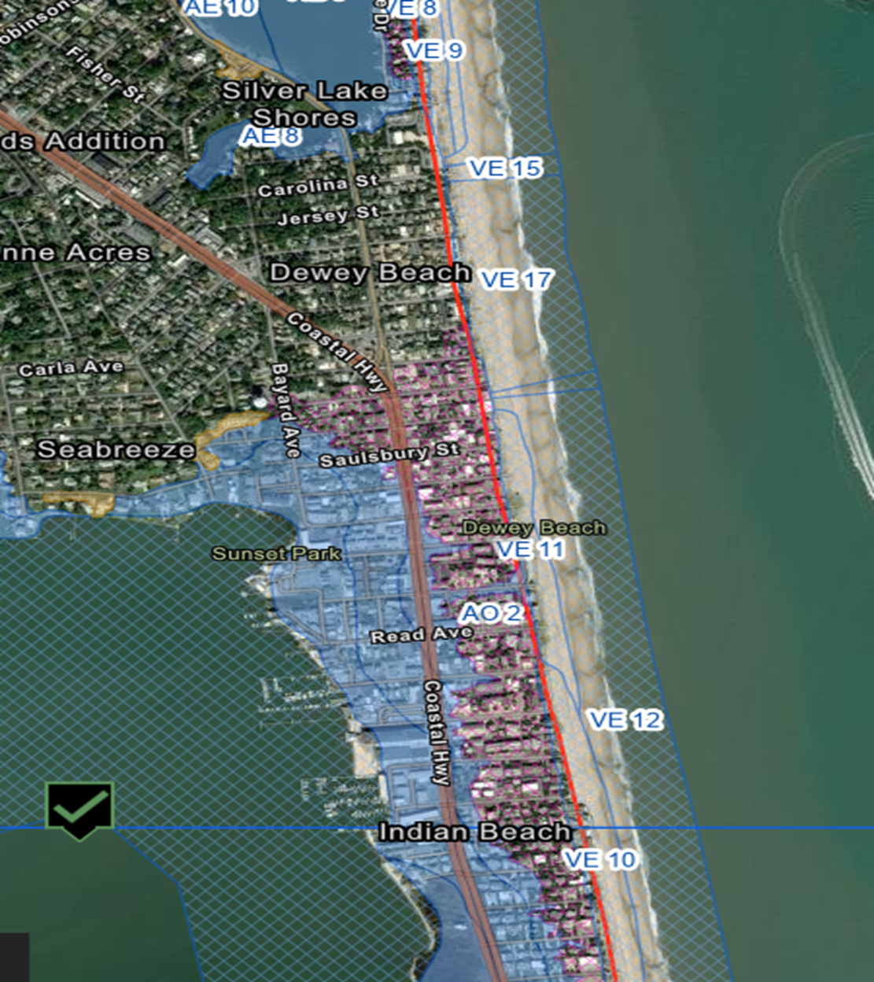
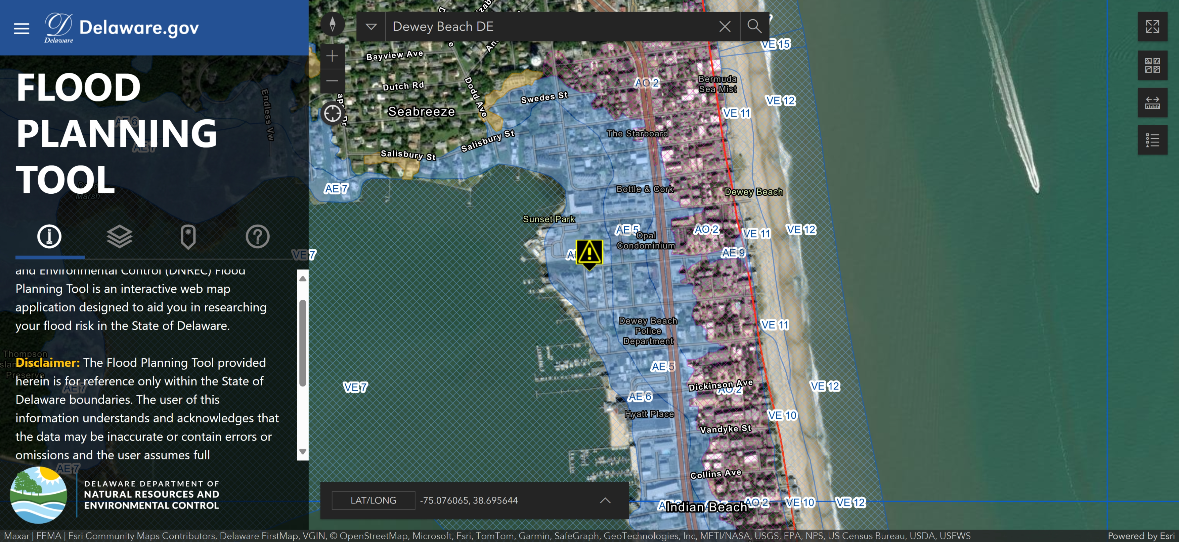
Dewey Beach
BFE Zones

Slide 4
What is Freeboard?
Freeboard is a factor of safety usually expressed in feet above a flood level for purposes of floodplain management. "Freeboard" tends to compensate for the many unknown factors that could contribute to flood heights greater than the height calculated for a selected size flood and floodway conditions, such as wave action, bridge openings, and the hydrological effect of urbanization of the watershed.

Slide 5
Local Municipalities Freeboard Requirements:
  Rehoboth +1 freeboard (most of the town is not in a SFHA)
  Lewes raised their freeboard to +3 feet from 18 inches; (expected sea level rise by 2100)
  Bethany Beach freeboard is 18 inches since 2018
  South Bethany has no freeboard requirement; voluntary 2 feet allows for an increase of 2 feet for the peak of the roof;
  Fenwick is 18 – 24 inches;
  Henlopen Acres is +3 Feet

Slide 6
Why Increase Freeboard?
Reduced Flood Risk
  Enhanced Protection – risk of flood waters reaching living space and causing damage is reduced
  Increased Safety – higher freeboards levels provide additional safety margins against storm surges, heavier than expected rainfall – can exceed BFE
Lower Flood Insurance Premiums
  Insurance Savings
  Long Term Cost Savings; initial cost is outweighed by lower insurance premiums and lower cost of flood damage repairs
Increased Property Value & Marketability
Compliance & Incentives
  Higher points in CRS = insurance discounts
Environmental & Community Benefits
  Reduced Flood plain development – preserve national flood plains
  Community Resilience – eliminate economic and social impacts

Slide 7
Benefit of increased freeboard:
There was a recent report published by the U.S. Chamber of Commerce that indicates that there is a $13 return on investment for each $1 invested in implementation of resilience strategies. This report can be found at this link: New report finds investing in resilience saves jobs and incomes | U.S. Chamber of Commerce (uschamber.com)
  https://www.uschamber.com/climate-change/new-report-finds-investing-in-resilience-saves-jobs-and-incomes#:~:text=%E2%80%93%20Every%20%241%20spent%20on%20climate%20resilience%20and,Commerce%20and%20the%20U.S.%20Chamber%20of%20Commerce%20Foundation

Slide 8
Why increase FBE to three feet?
Enhanced Flood Protection
  Reduces risk of flood damage by providing a safety margin
Cost Effectiveness
  Balances safety and affordability
  Additional height (four or five feet) increases cost with limited benefit
  Substantial savings on flood insurance; better ROI
Regulatory Compliance and Community Standards
  IBC requires freeboard of 1 – 2 BFE (residential; 3 ft critical facilities)
  Earns more points in the CRS; reduced flood premiums
Practical Considerations
  Structural Integrity – too high may pose structural challenges and increased damage from wind
  Enhances flood resilience without compromising the building structural integrity or requiring extensive engineering modifications
  Accessibility – too high complicates entry with mobility issues;

Slide 9
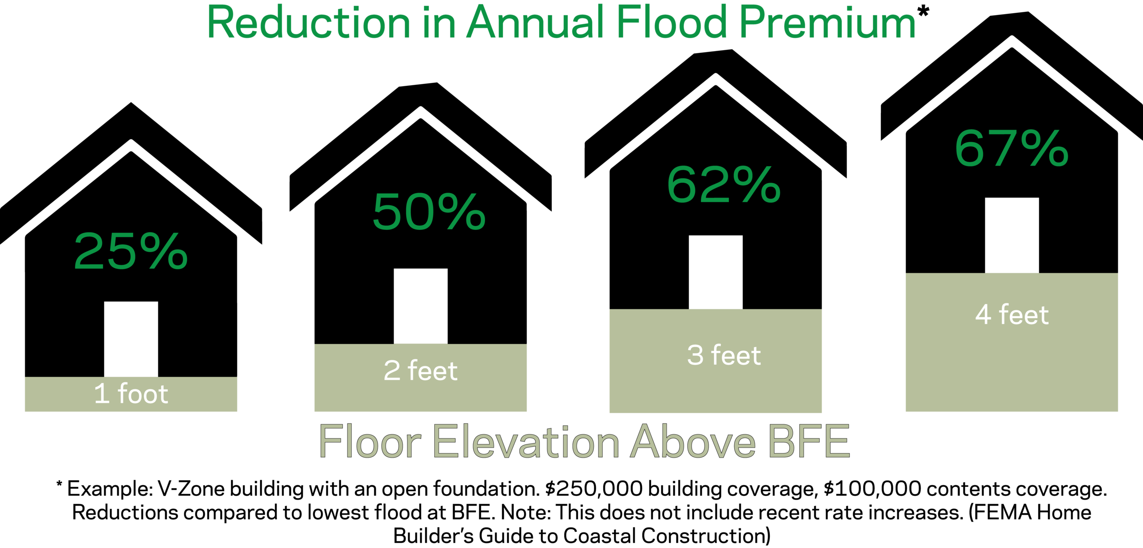

Slide 10
Example of Insurance Cost Savings

Slide 11
Considerations for Freeboard
Increasing Freeboard will not impact building height; but Height is different from Elevation!
Buildings may ‘tower’ when compared to ground level
Requires FEMA and DNREC approval; once we increase, we will not be able to decrease
Applies to only new construction and ‘substantial improvement’ of property:
The 50% substantial improvement rule is a key regulation under the National Flood Insurance Program (NFIP). It states that if the cost of reconstruction, rehabilitation, addition, or other improvements to a structure equals or exceeds 50% of the market value of the structure before the start of construction, the entire structure must be brought into compliance with current NFIP standards¹².
  Here are some important points about this rule:
  Applicability: This rule applies to structures located in Special Flood Hazard Areas (SFHAs), which are typically designated as flood zones beginning with the letters A or V².
  Substantial Improvement: Any work that meets or exceeds the 50% threshold is considered a substantial improvement. This includes not only renovations but also additions and repairs¹.
  Compliance Requirements: Structures undergoing substantial improvement must comply with current floodplain management regulations. This often means elevating the building to or above the Base Flood Elevation (BFE) and meeting other local building codes¹².
Consider eliminating additional foot granted to Buildings in VE Zone: Currently allow one additional foot for these buildings:

Slide 12
Height and Elevation have distinct meaning
Height
  Definition: Height refers to the vertical distance from the base of an object to its top.
  Context: It is commonly used to describe the size of buildings, trees, mountains, and other objects. For example, the height of a building might be 50 feet from the ground to the roof.
Elevation
  Definition: Elevation refers to the vertical distance of a point or object above a reference level, usually sea level.
  Context: It is often used in mapping and geography to describe the altitude of landforms. For example, the elevation of a mountain peak might be 2,000 feet above sea level.
Key Differences
  Reference Point: Height is measured from the base of the object to its top, while elevation is measured from sea level to a specific point.
  Usage: Height is typically used for objects and structures, whereas elevation is used for geographic locations and landforms.

Slide 13
Building Height is not the same as Elevation
Buildings not in a SFHA
  Maximum height is 35 feet measured from grade
    Grade or Grade Elevation – elevation of the crown of the roadway or alley accessway abutting the property taken at the center point of the lot frontage

Slide 14
Building Height is not the same as Elevation
IN A SPECIAL FLOOD HAZARD AREA (SFHA) THE BUILDING HEIGHT IS:
the measured / vertical distance between the Base Flood Elevation (BFE) point and the highest point on the building.
measured in feet and inches.
must be drawn on construction plans / drawings.
to be shown on all final as-built surveys.
Maximuim Building Height Allowed in SFHA Flood Zones AE and AO:
32 feet measured FROM the height of BFE – (FEMA’s flood water prediction) PLUS the Town mandatory Freeboard*
Maximuim Building Height Allowed in SFHA Flood zone VE:
32 feet measured FROM the height of BFE – (FEMA’s flood water prediction) PLUS the Town mandatory Freeboard* PLUS one additional foot is permitted.
* Current mandatory Freeboard is one foot.

Slide 15
Difference between building Height and Elevation (SFHA)
BUILDING ELEVATION (NAVD) is different from Building Height
is measured from (roughly above sea level)
is NOT MEASURED FROM the elevation of the crown of the roadway or alley accessway abutting the property from the center point of the lot frontage.
is measured in feet.
elevation must be drawn on construction plans / drawings.
NAVD is to be shown on all final as-built surveys.
ELEVATION CERTIFICATES FOR SPECIAL FLOOD HAZARD AREAS
‘Construction Drawings’, ‘Building Under Construction’ and ‘Finished Construction’ Elevation Certificates are required BEFORE construction, DURING construction and AFTER construction.

Slide 16
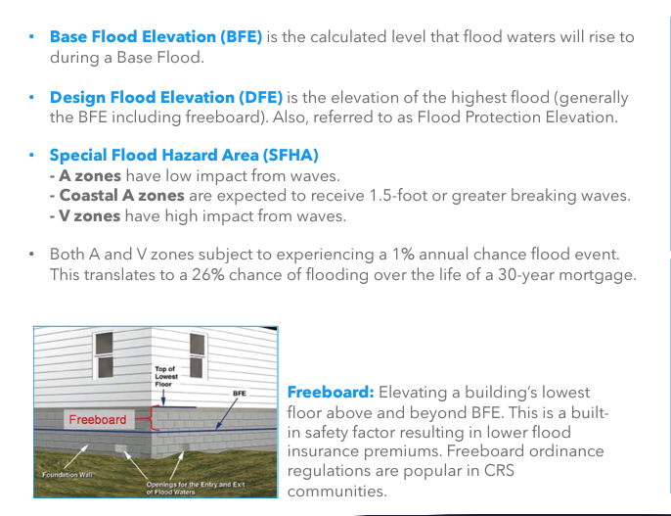
Grade or Grade Elevation Level is not BFE

Slide 17
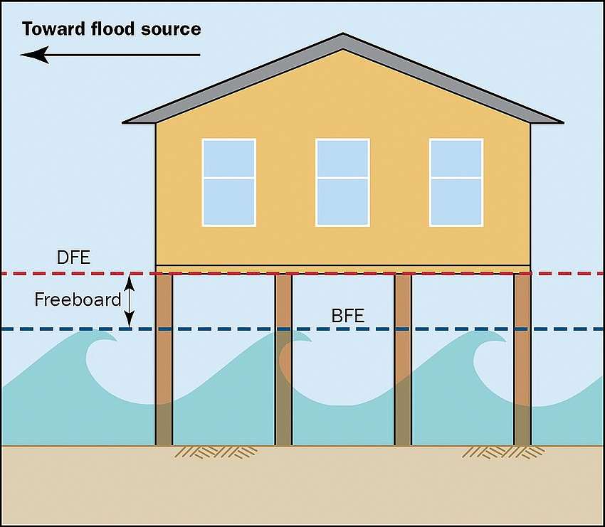
Freeboard Illustration; house on pilings
DFE – Designated Flood Elevation
https://www.fema.gov/sites/default/files/documents/fema_mat-hurricane-ian-recovery-advisory-1.pdf

Slide 18
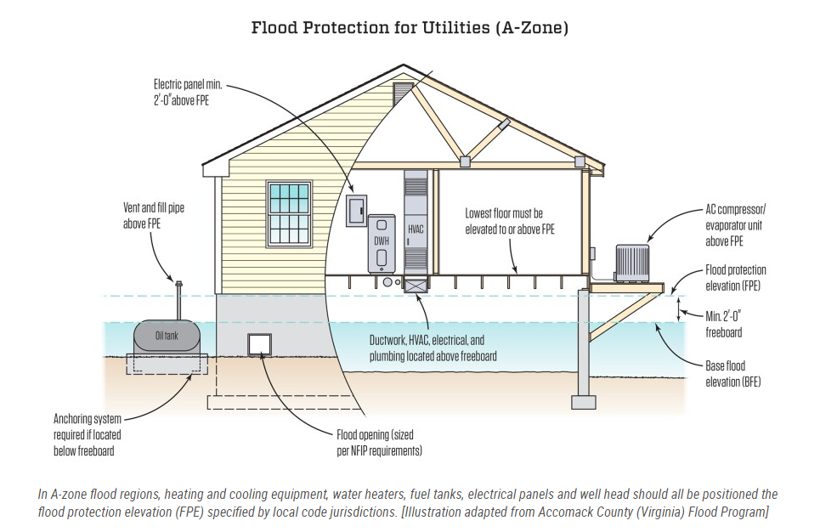
Utilities Protection with 2 ft Freeboard
JLC Online: https://www.jlconline.com/projects/disaster-resistant-building/flood-resilient-buildings_o

Slide 19
Unintended Consequences
Increased Construction Costs: Elevating a building higher than the BFE can increase construction costs, particularly for foundations and structural supports².
Accessibility Issues: Higher elevations can create challenges for accessibility, requiring additional design considerations for ramps, stairs, and elevators¹.
Aesthetic and Design Constraints: Higher freeboard can affect the aesthetic appeal and design of buildings, potentially leading to conflicts with local architectural styles or homeowner preferences¹.

Slide 20
Case Study:
The community responses to increased freeboard requirements have generally been positive, though they vary depending on the specific context and implementation:
Hull, Massachusetts: Residents appreciated the financial incentives provided by the town, which helped offset the costs of elevating their homes. The program was well-received as it not only reduced flood risk but also potentially lowered flood insurance premiums.
Norfolk, Virginia: The community in Norfolk has shown strong support for the city’s resilience initiatives, including the freeboard requirement. Many residents recognize the importance of these measures in protecting their homes and businesses from future flooding. However, there have been some concerns about the increased construction costs associated with the higher freeboard.
Black River Falls, Wisconsin: After the 1993 flood, the community was highly supportive of incorporating freeboard into the levee reconstruction. The successful avoidance of further flood damage in subsequent years has reinforced the community’s trust in these measures.
Overall, while there can be initial resistance due to cost concerns, the long-term benefits of reduced flood risk and potential insurance savings often lead to positive community responses.

Slide 21
Discussion:
Increase Freeboard?
What is the right amount of Freeboard?
How do we educate the public?

Slide 22
Backup Slides

Slide 23
How are flood zones determined?
Flood zones are determined by the Federal Emergency Management Agency (FEMA) using Flood Insurance Rate Maps (FIRMs). These maps are created based on a variety of physical and geographical factors to assess the flood risk of different areas. Here are the key steps involved:
Hydrologic and Hydraulic Studies: FEMA conducts detailed studies to analyze water flow, rainfall, and storm surge data. These studies help predict how water will behave during different flood events¹.
Topographic Data: Elevation data is collected to understand the landscape and how water will move across it. This includes identifying natural and man-made features that can affect flooding¹.
Historical Flood Data: Past flood events are analyzed to understand patterns and the likelihood of future floods. This includes looking at previous flood extents, depths, and durations¹.
Proximity to Water Bodies: The distance to rivers, lakes, oceans, and other significant water bodies is considered. Areas closer to these bodies are typically at higher risk².
Land Use and Development: The type of land use (e.g., residential, commercial, agricultural) and the level of development can influence flood risk. Urban areas with more impervious surfaces may have higher flood risks due to reduced natural drainage².
Climate and Weather Patterns: Current and projected climate data, including precipitation patterns and sea level rise, are factored into the flood risk assessment¹.
These factors are combined to create FIRMs, which categorize areas into different flood zones based on their risk levels. These zones help determine flood insurance requirements and inform building regulations to mitigate flood damage.

Slide 24
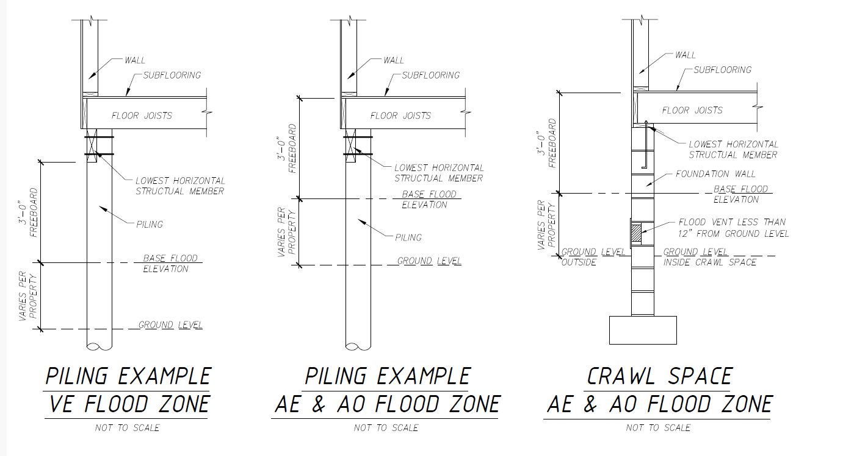
Piling Example

Slide 25
Building Height – Table 2 Bulk Ordinance
For buildings not in any special flood hazard area:
  Maximum building height 35 feet measured from grade.
  Maximum number of stories: 3.
  Roof decks are permitted with all decks and railings subject to this height standard. All above ground deck railing must be the higher of: 42 inches above the deck surface or in compliance with the most current Town Building Code.
For buildings in any special flood hazard area (SFHA):
  Maximum building height 32 feet measured from the elevation of the 1% annual flood level on the appropriate effective FEMA Flood Insurance Rate Map plus appropriate Town mandatory freeboard except in any VE SFHA where one additional foot of height shall be permitted due to the difference in base building elevation reference points for AO and AE SFHAs versus VE SFHAs.
  Maximum number of stories: 3.
  Roof decks are permitted with all decks and railings subject to this height standard. All aboveground deck railing must be the higher of: 42 inches above the deck surface or in compliance with the most current Town Building Code

Slide 26
Flood Zone determine Insurance Requirement and building standards to mitigate flood risk
High-Risk Zones
A Zones: Areas with a 1% annual chance of flooding (100-year floodplain). Includes:
  AE, A1-A30: Areas with detailed flood studies and Base Flood Elevations (BFEs).
  AO: Areas with shallow flooding, usually sheet flow, with average depths between 1 and 3 feet.
  AH: Areas with shallow flooding, usually ponding, with average depths between 1 and 3 feet.
  A99: Areas protected by levees that are still under construction.
  AR: Areas with increased flood risk due to the restoration of a levee system.
V Zones: Coastal areas with a 1% or greater chance of flooding and an additional hazard from storm waves. Includes:
  VE, V1-V30: Areas with detailed flood studies and BFEs.
  VO: Areas with additional hazards like velocity wave action from storms or seismic sources.
Moderate- to Low-Risk Zones
B and X (shaded): Areas with a 0.2% annual chance of flooding (500-year floodplain).
C and X (unshaded): Areas with minimal flood risk, outside the 500-year floodplain.
Undetermined Risk Zones
D Zones: Areas where flood hazards are possible but have not been determined by detailed studies¹².

