Slide 1
Background
The National Flood Insurance Program (NFIP) was established in 1968 through the National Flood Insurance Act. It aims to reduce the socio-economic impact of floods by providing affordable insurance to property owners and encouraging communities to adopt and enforce floodplain management regulations
FEMA administers the NFIP by overseeing flood insurance provision, producing flood maps, enforcing floodplain management regulations, and offering technical assistance to reduce flood risks.
FEMA has identified special flood hazard area (SFHA’s) within the boundaries of Dewey beach (roughly all areas below Clayton St)
High risk of flooding; 1% chance of flood events (100 year flood event)
Owners of federally backed mortgages are required to carry flood insurance
Dewey Beach entered into the National Flood Insurance Program on 6/18/1982;
Flood Damage Reduction Ordinance can be found in section 101 of town code adopted in 2014
Town also participates in the CRS (Community Reporting System); Complimentary to NFIP
Provides for discounts for flood insurance promoting better flood plain management practices
Climate Change committee has recommended increasing town’s freeboard;
2018 Comprehensive Plan includes recommendation to consider higher freeboard;
Town commissioners unanimously voted that the first finished floor of the new town hall should not be below BFE +3 feet
Current town code requires Freeboard is +1 feet above BFE (base flood Elevation);
Notes:
Recall this issue was referred to us by commissioners before, we could not come up with conscensus to move forward – by the time we did that our recommendation would have been moot as we need to respond within four months
So commissioners have referred the issue back to us again for discussion
Goal
Present information so we can have an informed discussion and hopefully make a recommendation to the commissioners
First a little background:
NFIP – established in 1968 with a goal to Reduce the soci- economic impact of flooding by:
provide Affordable insurance to property owners
encourage communities to adopt and enforce flood plain management regulations
FEMA administers the NFIP ahd evaluated flood areas and develops SFHA – special Flood hazard areas – purpose is to:
Crease Risk awareness,
Define insurance requirements;
guide for building standards, and
help communities manage Flood Plain practices to reduce risk fo flood
I am sure you know that ¾ of dewey beach is in a SFHA area; roughly ¾ of the town - all buildings below clayton st
Dewey beach signed into the NFIP in 1982; our flood damage reduction ordinance can be found in section 101 of our code. It was updated in 2014, but has existence for some time.
Town also chooses to participate in the CRS (Community Rating System) – compliments the NFIP: provides disounts for flood insurance through better flood plain management practices
Town drivers
Climate Change Committee recommended increased freeboard
Town Charter suggested evaluating increased freeboard
Commissioners approved the new town hall to be built with a freeboard of =3 feet
Note: our current freeboard is =1 foot

Slide 2
What is BFE – Base Flood Elevation?
The Base Flood Elevation (BFE) is the elevation above mean sea level to which floodwaters are expected to rise during a base flood. Essentially, BFE represents the height that floodwaters are projected to reach during a significant flood event.
The Base Flood Elevation (BFE) is the computed elevation to which floodwater is anticipated to rise during a base flood. A base flood is defined as a flood that has a 1% chance of occurring in any given year, also known as a 100-year flood¹². The BFE is crucial for floodplain management and insurance purposes, as it helps determine the necessary elevation for buildings to minimize flood risk¹.
Floor Insurance Rate Maps created by FEMA (FIRM) detail areas at risk of flooding; are defined by ‘zones’; geographic areas that further define flood risk
Zone AE: Areas with a BFE determined. These are high-risk flood zones where detailed hydraulic analyses have been conducted.
Zone AH: Areas with shallow flooding (usually ponding) where average depths are between 1 and 3 feet. BFEs are determined.
Zones A1–A30: Similar to Zone AE, these are areas with BFEs determined through detailed analyses.
Zone AR: Areas that are being restored to provide flood protection. BFEs are determined.
Zone AR/A, AR/AE, AR/A1–A30, AR/AH, AR/AO: Combination zones where areas are being restored and have additional flood risks.
Zones V1–V30 and VE: Coastal areas with a BFE determined and additional hazards due to storm waves.
Base Flood Elevation (BFE) does take wave actions into account, especially in coastal areas. FEMA’s flood hazard analysis includes factors such as storm surge, wave setup, and overland wave propagation when determining BFEs¹². This means that the BFE reflects not only the stillwater elevation but also the additional height contributed by wave action
Notes:
Let’s identify some terms to frame the discussion”
The terms Special Flood Hazard Area (SFHA), Base Flood Elevation (BFE), Flood Insurance Rate Map (FIRM), and Zones are all interconnected in the context of flood risk management. Here’s how they relate:
Special Flood Hazard Area (SFHA):
SFHAs are areas identified by FEMA as having a high risk of flooding, with a 1% annual chance of flood (100-year flood) or greater¹.
These areas are depicted on FIRMs and include various flood zones such as A, AE, AO, and VE¹.
Base Flood Elevation (BFE): The BFE is the computed elevation to which floodwaters are anticipated to rise during a base flood event¹.
BFEs are used to determine the required elevation for buildings and structures within SFHAs to minimize flood damage¹.
Flood Insurance Rate Map (FIRM):
FIRMs are official maps created by FEMA that show SFHAs, BFEs, and flood zones².
These maps are used for floodplain management, insurance rating, and to inform property owners about flood risks².
Zones:
Flood zones are specific areas within SFHAs that indicate the level and type of flood risk¹.
Common zones include:
Zone A: Areas with a 1% annual chance of flooding, no BFE determined.
Zone AE: Areas with a 1% annual chance of flooding, with BFEs determined.
Zone AO: Areas with a 1% annual chance of shallow flooding, with average depths of 1 to 3 feet¹.
Zone VE: Coastal areas with a 1% annual chance of flooding and additional hazards due to storm-induced velocity wave action¹.
These elements work together to help communities and property owners understand and manage flood risks effectively

Slide 3
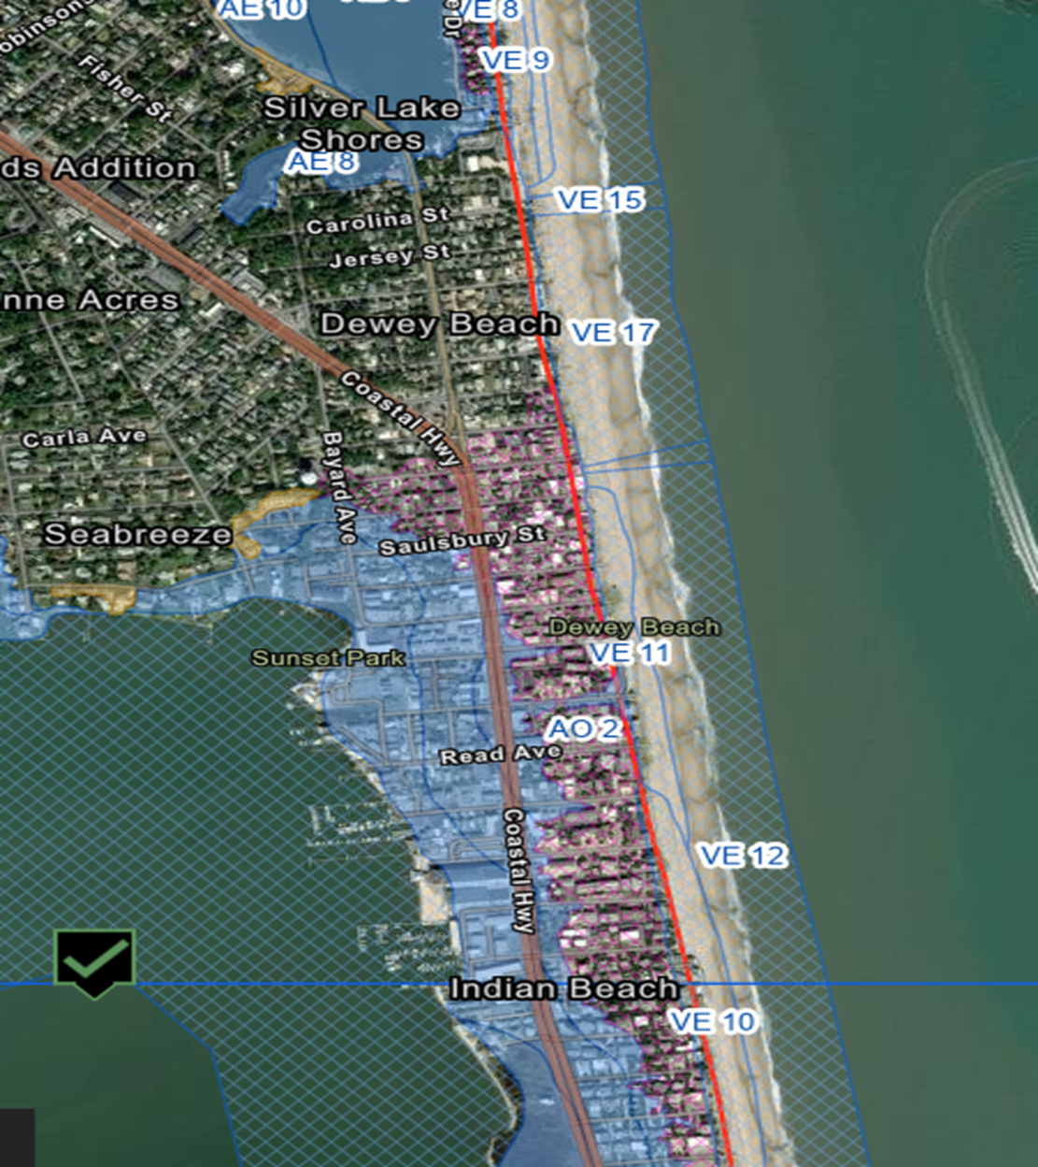
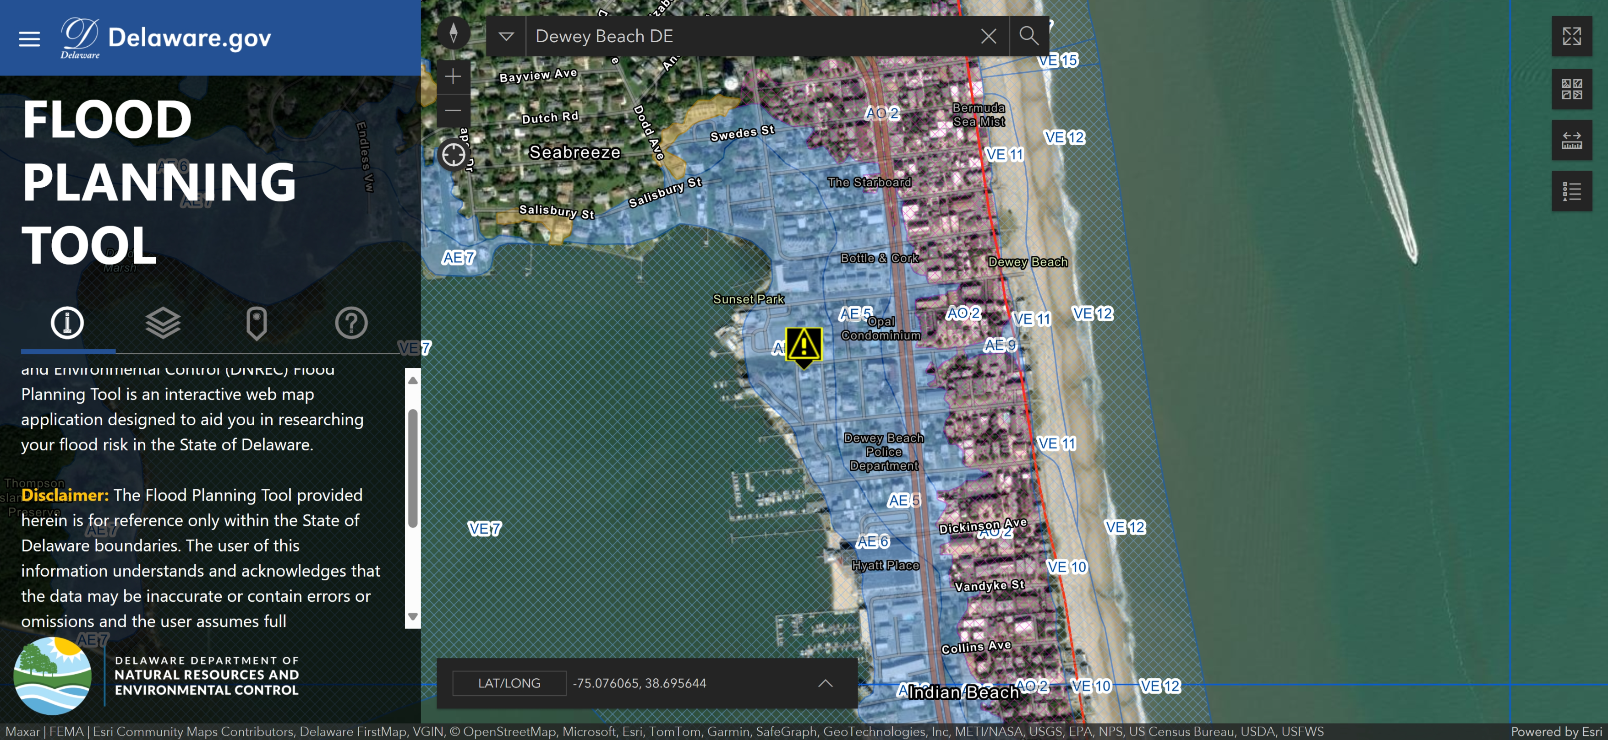
Dewey Beach BFE Zones
Notes:
Image that detail the FIRM that detail the BFE and zones established by FEMA for Dewey Beach
AO – Sheet Flow rise – happens in heavy rainfall; ground cannot absorb the water fast enough
AE – High Flood risk due to proximity of flood plains, rivers lakes or other bodies of water – in this case Rehoboth bay
V zones – high risk of flooding as a result of wave action
The NUMBER with the zone along with the zone becomes the BFE –

Slide 4
What is Freeboard?
Freeboard is a factor of safety usually expressed in feet above a flood level for purposes of floodplain management. "Freeboard" tends to compensate for the many unknown factors that could contribute to flood heights greater than the height calculated for a selected size flood and floodway conditions, such as wave action, bridge openings, and the hydrological effect of urbanization of the watershed.
Notes:
Freeboard – a safety factor: contribute to flood heights grater than the calculated height;
BFE – is a calculation – freeboard provides for additional safety in addition to BFE

Slide 5
Local Municipalities Freeboard Requirements:
Rehoboth +1 freeboard (most of the town is not in a SFHA)
Lewes raised their freeboard to +3 feet from 18 inches; (expected sea level rise by 2100)
Bethany Beach freeboard is 18 inches since 2018
South Bethany has no freeboard requirement; voluntary 2 feet allows for an increase of 2 feet for the peak of the roof;
Fenwick is 18 – 24 inches;
Henlopen Acres is +3 Feet
Notes:
Just some background on what other communities have adopted in terms of freeboard:

Slide 6
Why Increase Freeboard?
Reduced Flood Risk
Enhanced Protection – risk of flood waters reaching living space and causing damage is reduced
Increased Safety – higher freeboards levels provide additional safety margins against storm surges, heavier than expected rainfall – can exceed BFE
Lower Flood Insurance Premiums
Insurance Savings
Long Term Cost Savings; initial cost is outweighed by lower insurance premiums and lower cost of flood damage repairs
Increased Property Value & Marketability
Compliance & Incentives
Higher points in CRS = insurance discounts
Environmental & Community Benefits
Reduced Flood plain development – preserve national flood plains
Community Resilience – eliminate economic and social impacts
Notes:
Reasons to increase Freeboard:
I mentioned that Freeboard is a safety factor over BFE– increasing it brings enhanced protection against storm surges, heaver expected rainfall – which can EXCEED BFE; so one reason to increase freeboard is to reduce risk to the property owner as a result of floods
Provide for insurance savings both annually and over time,
cost of increased construction for freeboard is offset by the insurance savings
Should Increase property value and marketability – better preservationi in the face of climate change
Freeboard also is recognized by the CRS – community rating system
Lastly it is beneficial to the Environment and the community
reducing developinet in flood plains
eliminate economic and social impacts to the community

Slide 7
Benefit of increased freeboard:
There was a recent report published by the U.S. Chamber of Commerce that indicates that there is a $13 return on investment for each $1 invested in implementation of resilience strategies. This report can be found at this link: New report finds investing in resilience saves jobs and incomes | U.S. Chamber of Commerce (uschamber.com)
https://www.uschamber.com/climate-change/new-report-finds-investing-in-resilience-saves-jobs-and-incomes#:~:text=%E2%80%93%20Every%20%241%20spent%20on%20climate%20resilience%20and,Commerce%20and%20the%20U.S.%20Chamber%20of%20Commerce%20Foundation
Notes:
Recent report authoried by US chamber of commerece, Allstate and
Allstate Insurance and US Commerce Foundation
The study, “The Preparedness Payoff,” models 25 disaster scenarios ranging in damage and cleanup costs from $1 billion to $130 billion in communities across the country. Each model revealed substantial economic savings resulting from upfront investment in disaster resiliency programs and resources, preserving millions of jobs and household incomes, reducing the number of people displaced from their homes and maintaining production to help local economies rebound faster.

Slide 8
Why increase FBE to three feet?
Enhanced Flood Protection
Reduces risk of flood damage by providing a safety margin
Cost Effectiveness
Balances safety and affordability
Additional height (four or five feet) increases cost with limited benefit
Substantial savings on flood insurance; better ROI
Regulatory Compliance and Community Standards
IBC requires freeboard of 1 – 2 BFE (residential; 3 ft critical facilities)
Earns more points in the CRS; reduced flood premiums
Practical Considerations
Structural Integrity – too high may pose structural challenges and increased damage from wind
Enhances flood resilience without compromising the building structural integrity or requiring extensive engineering modifications
Accessibility – too high complicates entry with mobility issues;
Notes:
Let’s evaluate the concept of increasing to three feet:
Primary reason:
Balances safety and affordability – moving to four or five feet is too expensive and creates structural integrity issues (like wind); it is also mitigates engineering of accessibility
Achieve savings on insurance with a balance on cost of increasing height of building
CRS benefits – discounts for greater freeboard

Slide 9
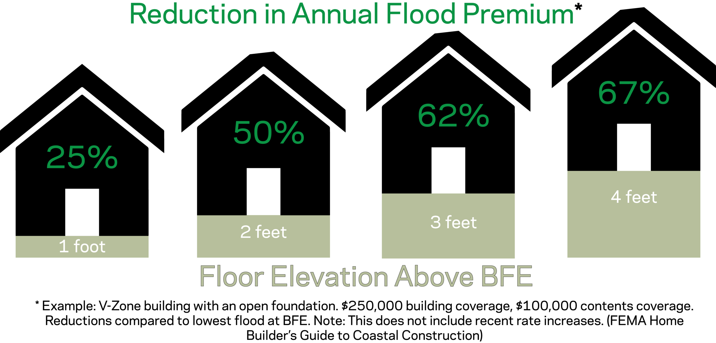
Notes:
1 foot of freeard yields 25%; two feet – 50% for another additional foot, you get a 62 percent discount; whereas at four, the discount doesn’t outweigh the increased cost of building

Slide 10
Considerations for Freeboard
Increasing Freeboard will not impact building height; but Height is different from Elevation!
Buildings may ‘tower’ when compared to ground level
Requires FEMA and DNREC approval; once we increase, we will not be able to decrease
Applies to only new construction and ‘substantial improvement’ of property:
The 50% substantial improvement rule is a key regulation under the National Flood Insurance Program (NFIP). It states that if the cost of reconstruction, rehabilitation, addition, or other improvements to a structure equals or exceeds 50% of the market value of the structure before the start of construction, the entire structure must be brought into compliance with current NFIP standards¹².
Here are some important points about this rule:
Applicability: This rule applies to structures located in Special Flood Hazard Areas (SFHAs), which are typically designated as flood zones beginning with the letters A or V².
Substantial Improvement: Any work that meets or exceeds the 50% threshold is considered a substantial improvement. This includes not only renovations but also additions and repairs¹.
Compliance Requirements: Structures undergoing substantial improvement must comply with current floodplain management regulations. This often means elevating the building to or above the Base Flood Elevation (BFE) and meeting other local building codes¹².
Consider eliminating additional foot granted to Buildings in VE Zone: Currently allow one additional foot for these buildings:

Slide 11
Height and Elevation have distinct meaning
Height
Definition: Height refers to the vertical distance from the base of an object to its top.
Context: It is commonly used to describe the size of buildings, trees, mountains, and other objects. For example, the height of a building might be 50 feet from the ground to the roof.
Elevation
Definition: Elevation refers to the vertical distance of a point or object above a reference level, usually sea level.
Context: It is often used in mapping and geography to describe the altitude of landforms. For example, the elevation of a mountain peak might be 2,000 feet above sea level.
Key Differences
Reference Point: Height is measured from the base of the object to its top, while elevation is measured from sea level to a specific point.
Usage: Height is typically used for objects and structures, whereas elevation is used for geographic locations and landforms.

Slide 12
Building Height is not the same as Elevation
IN A SPECIAL FLOOD HAZARD AREA (SFHA) THE BUILDING HEIGHT IS:
the measured / vertical distance between the Base Flood Elevation (BFE) point and the highest point on the building.
measured in feet and inches.
must be drawn on construction plans / drawings.
to be shown on all final as-built surveys.
Maximuim Building Height Allowed in SFHA Flood Zones AE and AO:
32 feet measured FROM the height of BFE – (FEMA’s flood water prediction) PLUS the Town mandatory Freeboard*
Maximuim Building Height Allowed in SFHA Flood zone VE:
32 feet measured FROM the height of BFE – (FEMA’s flood water prediction) PLUS the Town mandatory Freeboard* PLUS one additional foot is permitted.
* Current mandatory Freeboard is one foot.

Slide 13
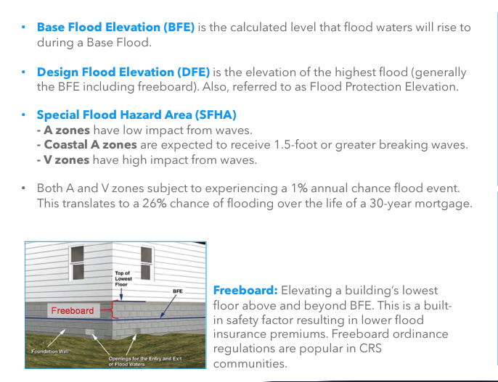
Grade or Grade Elevation Level is not BFE
Notes:
When you look at a building your visual point of reference is the ground – which is not necessarily BFE. Older buildings were constructred from the ground, but BFE could be higher than the ground and freeboard is added to the BFE to determine the starting point for a building;
So buildings will appear to be ‘higher’ and ‘taller’ when comparing to the ground

Slide 14
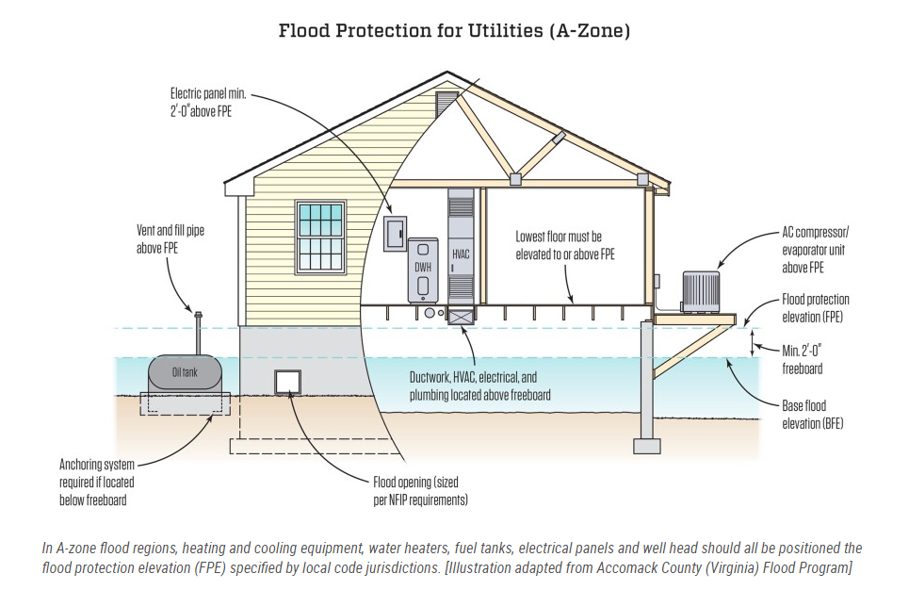
Utilities Protection with 2 ft Freeboard
JLC Online: https://www.jlconline.com/projects/disaster-resistant-building/flood-resilient-buildings_o
Notes:
Freeboard requires that all utilities be located ‘up’

Slide 15
Unintended Consequences
Increased Construction Costs: Elevating a building higher than the BFE can increase construction costs, particularly for foundations and structural supports².
Accessibility Issues: Higher elevations can create challenges for accessibility, requiring additional design considerations for ramps, stairs, and elevators¹.
Aesthetic and Design Constraints: Higher freeboard can affect the aesthetic appeal and design of buildings, potentially leading to conflicts with local architectural styles or homeowner preferences¹.
Notes:
I would like to ask Daune for her opinion on these items:
Summary –
Increased Consturion costs Stairs might extend into setbacks
Buildings will appear much higher than before

