Slide 1
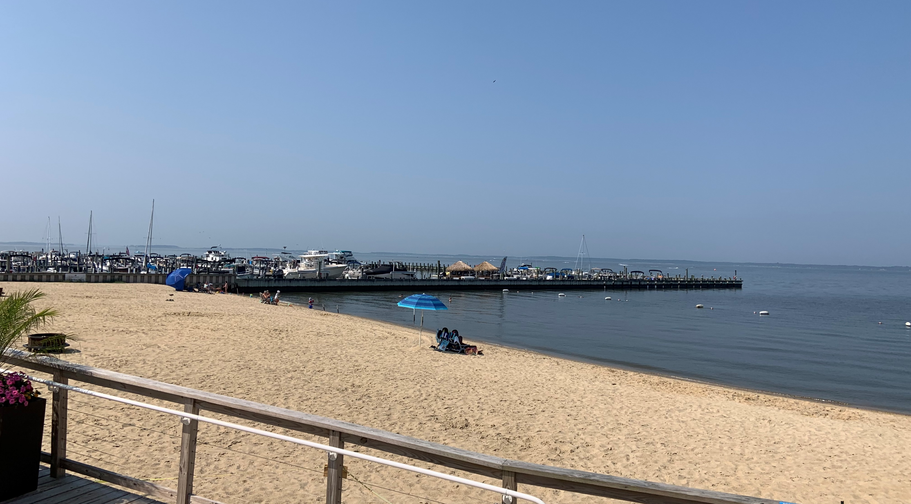

Van Dyke Street Stormwater Quantity Improvements
February 21, 2025
Presented to: Town of Dewey Beach

Slide 2
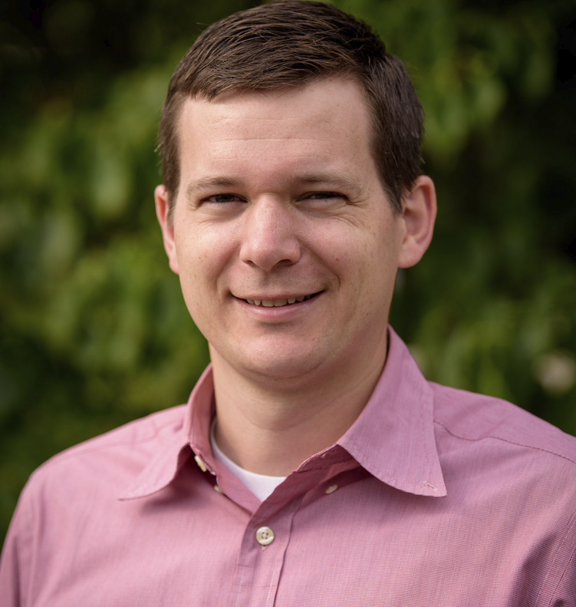
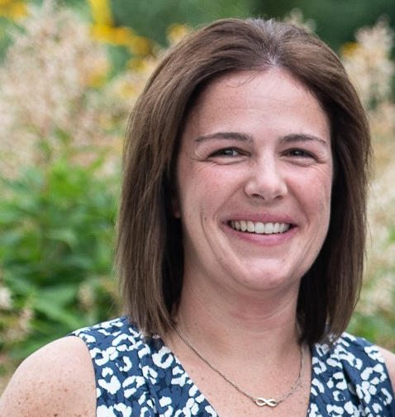
Christopher Brendza, PE Water/Wastewater Division Leader - Delaware
Amy
Fitzgerald, PE
Stormwater Division Leader - Delaware

Slide 3
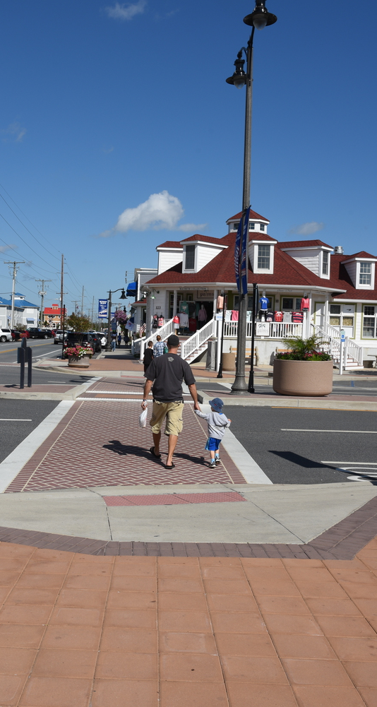

JMT Overview
OUR SERVICES
Water Resources
Planning
Roadway & Highway Engineering
Traffic Engineering
Right-of-Way
Wastewater
Program & Construction Management
Environmental & Sustainable Solutions
Structural Engineering
Surveys & Mapping
Landscape Architecture
Engineering News-Record (ENR)
OUR MARKETS
Transportation
Buildings & Facilities
Water, Wastewater & Utilities
Energy
Federal Programs
Information Technology
NATIONAL FOOTPRINT
We have a national footprint with offices in 51 states, including Washington, DC.
OUR DELAWARE OFFICES
Newark and Dover
#9
Highways
#15
Transportation
#24
Bridges
#46
Top 100 Pure Designers
#61
Top 500 Design Firms
2,400+ Employee Owners
52 YEARS
in Business

Slide 4





Presentation Agenda
Project Goals
SWMP Grant
Project Tasks
Schedule
Concept Plan

Slide 5
Project Goals

Slide 6
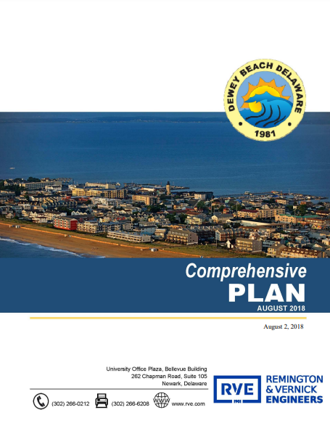


…a comprehensive solution should both reduce the flooding from rising tides and storm driven waters from the Bay, as well as treat flood waters – from Bay flooding and increasingly intense rain events – to remove particulates and pollutants prior to returning to the Rehoboth Bay.
Town of Dewey Beach Comprehensive Plan (2018)

Slide 7

Project Goals
Provide water quantity control to alleviate flooding along Van Dyke Street
Relocate existing outfall to improve public safety at the Van Dyke Street outfall
Enhance the water quality of the Rehoboth Bay Watershed by implementing targeted measures at the point of discharge

Slide 8
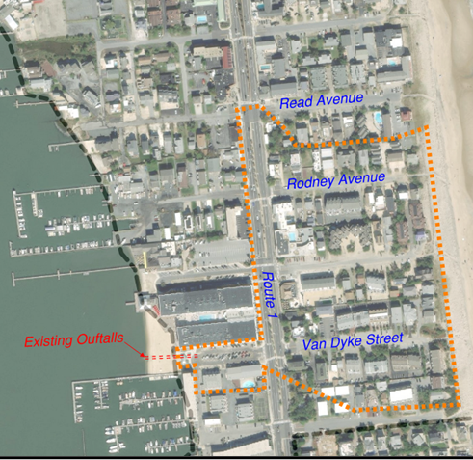
Our Agenda
Project Location
21-acre drainage area
77% impervious
Notes:
According to 2017 Phase II Stormwater Planning Report (completed in 2017)

Slide 9
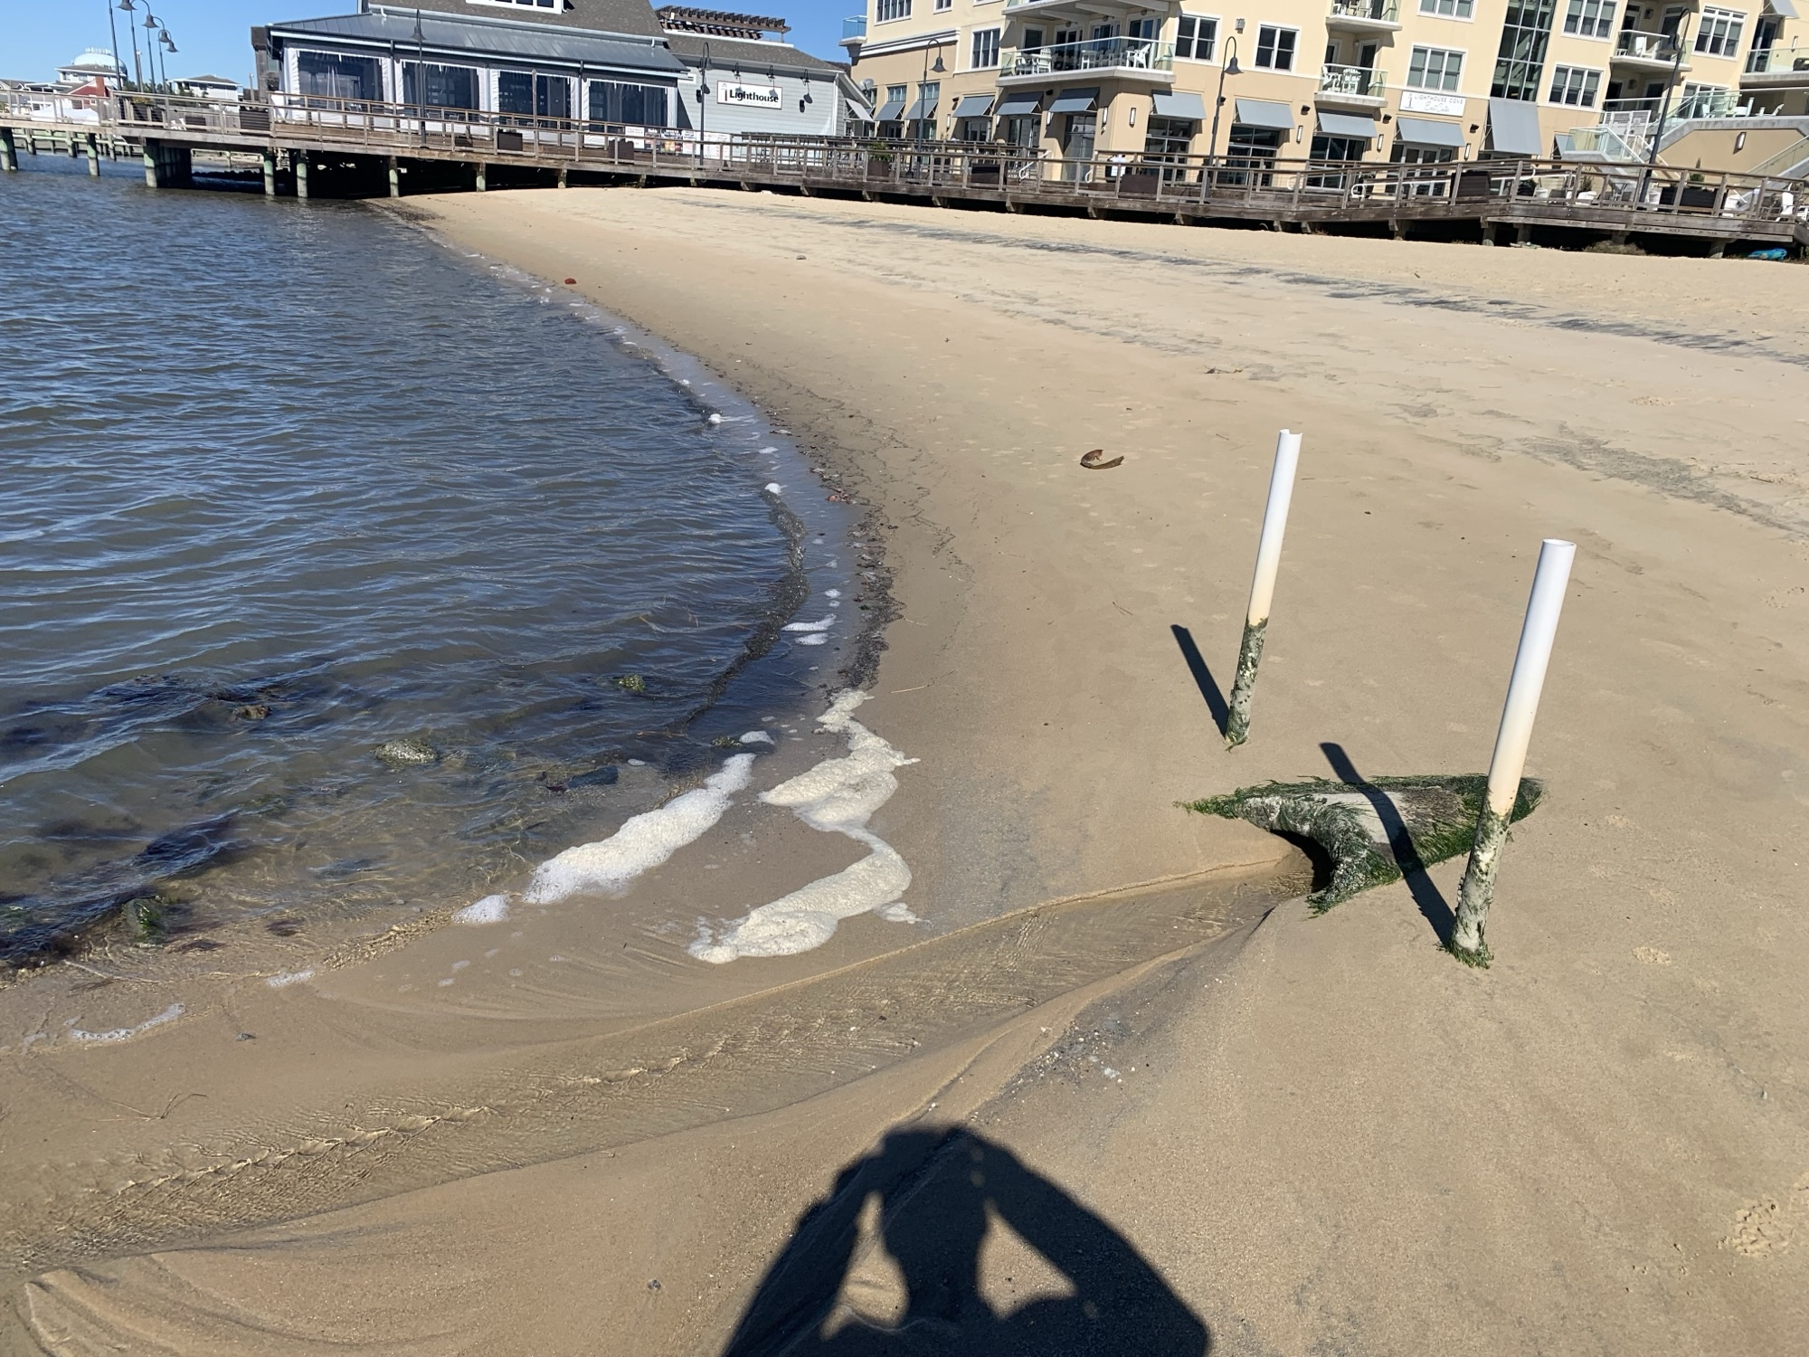
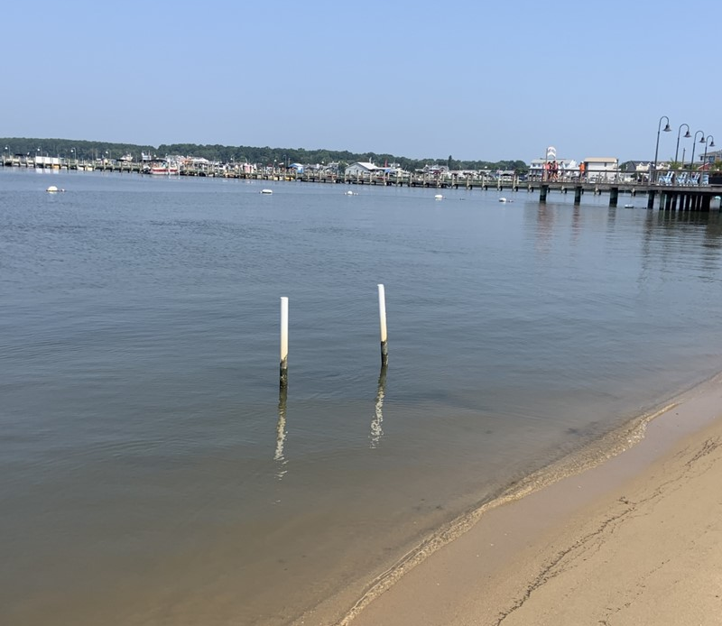

Project Goals
Outfall photos
Low Tide
High Tide
Notes:
Eliminate safety concern: Current outfall pipe is exposed and a risk to beach-goers at increasingly popular Beach in all tide conditions.
Outfall pipe is prone to clogging with sand, backing up water and flooding the public parking lot on Van Dyke Ave and RT 1 – current maintenance plan: Dewey Beach Enterprises employee goes out with a shovel at low tide and cleans this out.

Slide 10
Surface Water Matching Planning Grant

Slide 11

SWMP Grant
Stormwater Matching Planning Grant is a set aside in the Clean Water State Revolving Fund Non-Federal Administrative Account:
The grant is intended to assist Delaware municipalities to continue the process of updating stormwater/drainage plans, conduct planning studies and feasibility analysis for surface water planning in general, and to prepare preliminary engineering reports for specific project planning and designs.
Notes:
Alleviate flooding by realigning the stormwater outfall pipe and/or installing a stormwater pumping station to reduce frequency of flooding along Van Dyke Street back to the intersection with RT 1
Improve safety by relocating outfall away from the beach access. Outfall pipes are currently exposed and pose a risk to swimming and people using the beach. Add aesthetic value
Improve WQ with targeted improvements at the discharge of this outfall – Economic and social impact to Town of DB
* Improved quality of life aspects influence the desire of businesses to relocate to and remain in Dewey Beach.

Slide 12

Project Tasks

Slide 13
Project Tasks
Site Survey
Conduct field survey
Hydraulic Analysis
Perform H&H analysis and modeling
Conceptual Designs
Develop design concepts, coordinating with Town of Dewey Beach, Center for Inland Bays, and Delaware Sea Grant
Consider drainage routing & pump station sizing
Concept Selection
Obtain input through public discussion
Further refine concepts based on resident feedback
Ultimate concept selection by Town
Gather data on topography, land use, hydrology
Delineate drainage basin
Notes:
Site Survey:
Field Survey - storm sewer inlets, manholes, storm pipes – confirm connectivity within storm sewer network and exactly what drains to outfall
Hydraulic Analysis
Data gathered on inputs that affect water movement to understand how the water within the drainage basin behaves. Analyze to understand baseline scenarios and assess flows under varying conditions and storm events. To determine the discharge flows at the outfall as well as potential areas of inundation, backwater effects, and timing.
Conceptual Designs
The H&H analysis will lend itself to understanding whether we can rely on gravity flow methods or if a pump station will be required to adequately get the water from the roadways to the Rehoboth Bay and keep it there!
Will develop (3) conceptual designs including renderings, cost estimate, and applicable permitting requirements for each.
Concept Selection
Public meetings to be held to discuss options with town residents; gather input and feedback. Incorporate relevant suggestions into final analysis and design. Town to select alternative to continue to refine with desire to eventually design, permit, and construct.

Slide 14
Project Costs
Tasks 1, 3, & 4 – Funded 50% By DNREC
Tasks 2 – Funded 100% By Town
Task 1 – Site Survey and Basin Delineation
Field Survey of Basin $6,500
Basin Delineation and Field Verification $3,500
Sub-total $10,000
Task 2 – Hydraulic Analysis
Hydraulic Analysis & Modeling $18,000
Routing and Pump Station Sizing $8,000
Sub-total $26,000
Task 3 – Conceptual Designs
Development of Three Concepts $31,000
Meetings $5,000
Finalization of Concepts $8,000
Sub-total $44,000
Task 4 – Public Input and Concept Selection
Public Meetings $10,000
Refining of Concepts $5,000
Selection of Final Concept $5,000
Sub-total $20,000
Total Project Cost $100,000
Total Town Contribution = $63,000
Total DNREC Contribution = $37,000

Slide 15
Project Costs – Revised and Reduced
Tasks 1, 3, & 4 – Funded 50% By DNREC
Tasks 2 – Funded 100% By Town
Task 1 – Site Survey and Basin Delineation
Field Survey of Basin $6,500
Basin Delineation and Field Verification $3,500
Sub-total $10,000
Task 2 – Hydraulic Analysis
Hydraulic Analysis & Modeling $15,000
Routing and Pump Station Sizing $5,000
Sub-total $20,000
Task 3 – Conceptual Designs
Development of Three Concepts $26,000
Meetings $5,000
Finalization of Concepts $6,000
Sub-total $37,000
Task 4 – Public Input and Concept Selection
Public Meetings $5,000
Refining of Concepts $5,000
Selection of Final Concept $5,000
Sub-total $15,000
Total Project Cost $82,000
Total Town Contribution = $51,000
Total DNREC Contribution = $31,000

Slide 16
Schedule

Slide 17
Detailed Project Schedule
TASKS | Mar 2025 | Apr 2025 | May 2025 | Jun 2025 | July 2025 | Aug 2025 | Sept 2025 | Oct 2025 | Nov 2025 | Dec 2025 | Jan 2026 | Feb 2026
Task 1 – Site Survey and Basin Delineation
Site Survey
b. Basin Delineation / Field Work
Task 2 – Hydraulic Analysis
Hydraulic Analysis & Modeling
b. Routing and Pump Station Sizing
Task 3 – Conceptual Designs
Develop Concepts
b. Meetings with Partners
c. Finalization of Concepts
Task 4 – Public Input and Concept Selection
Public Meetings
b. Refining of Concepts
c. Selection of Final Concept
Notes:
Target dates for completion.

Slide 18

Concept Plan

Slide 19
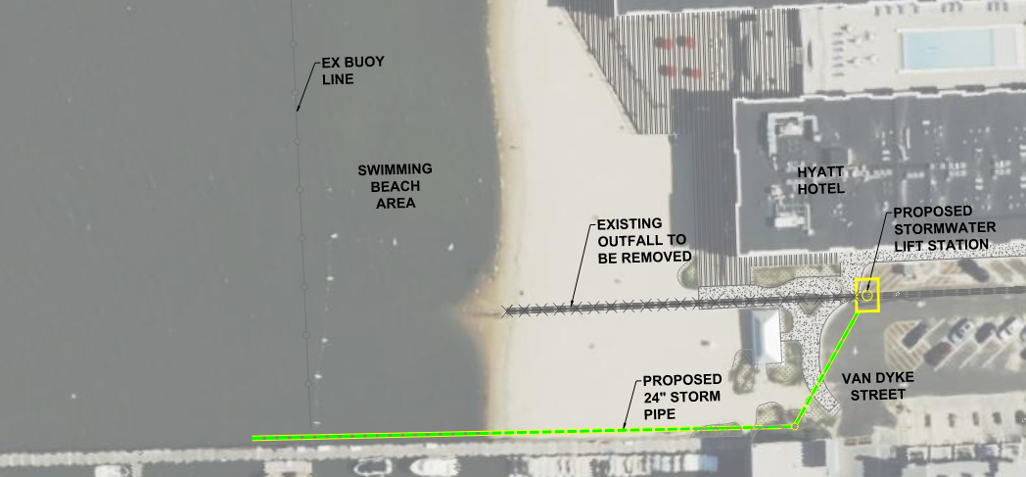
Notes:
Concept Provided by Sussex County

Slide 20
Thank You!

Slide 21
Contact us:
Christopher Brendza
302.533.3972
cbrendza@jmt.com
Amy Fitzgerald
302.533.3970
afitzgerald@jmt.com
Contact us:

