Slide 1
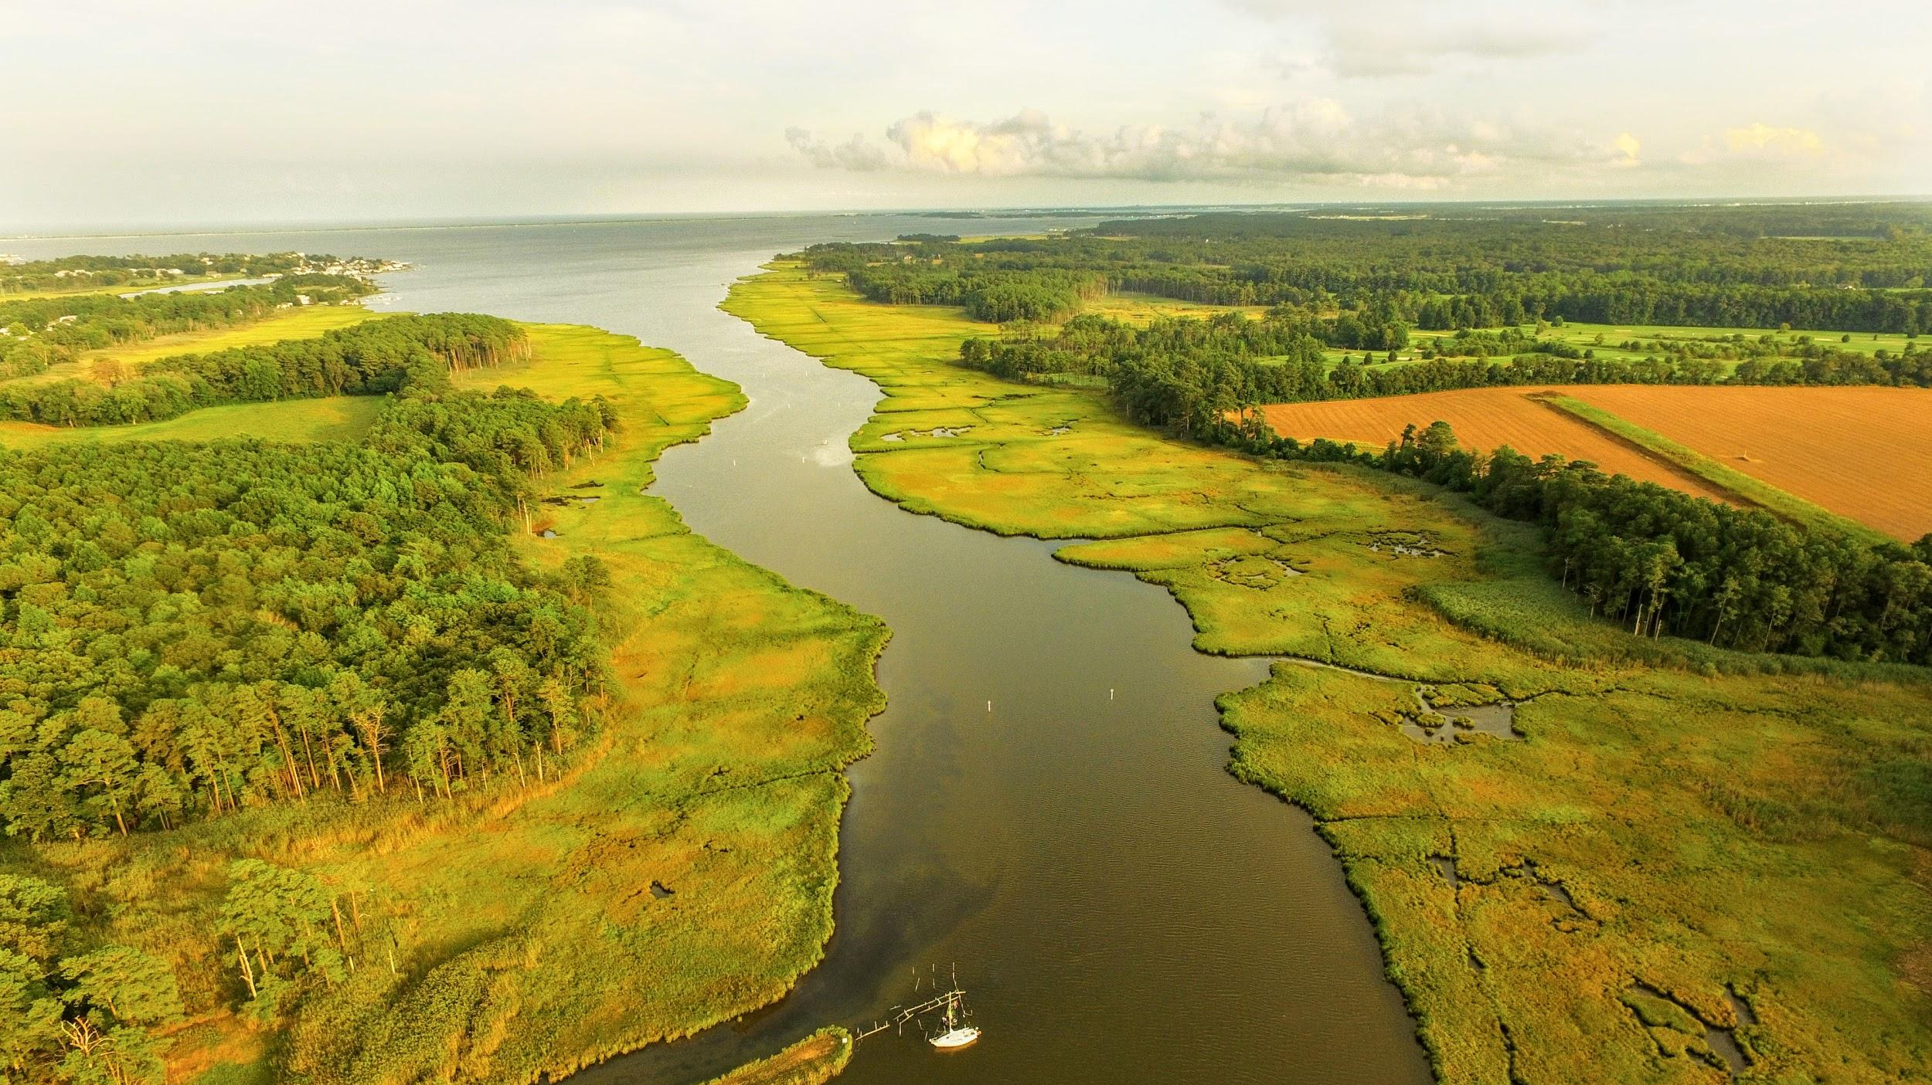
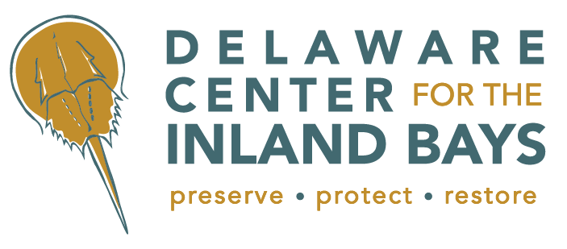
Sunset Park Living Shoreline
Dewey Beach, Delaware
March 21, 2025
Bob Collins, Manager of Programs and Facilities

Slide 2
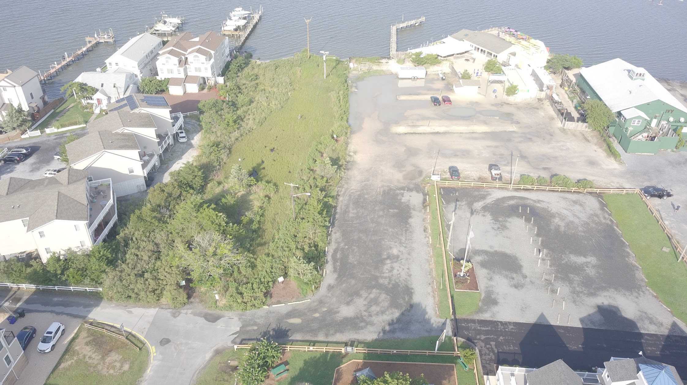
Introduction / Outline
Problem/ Existing Conditions
Proposed Solution
Overall
Phase 1

Slide 3
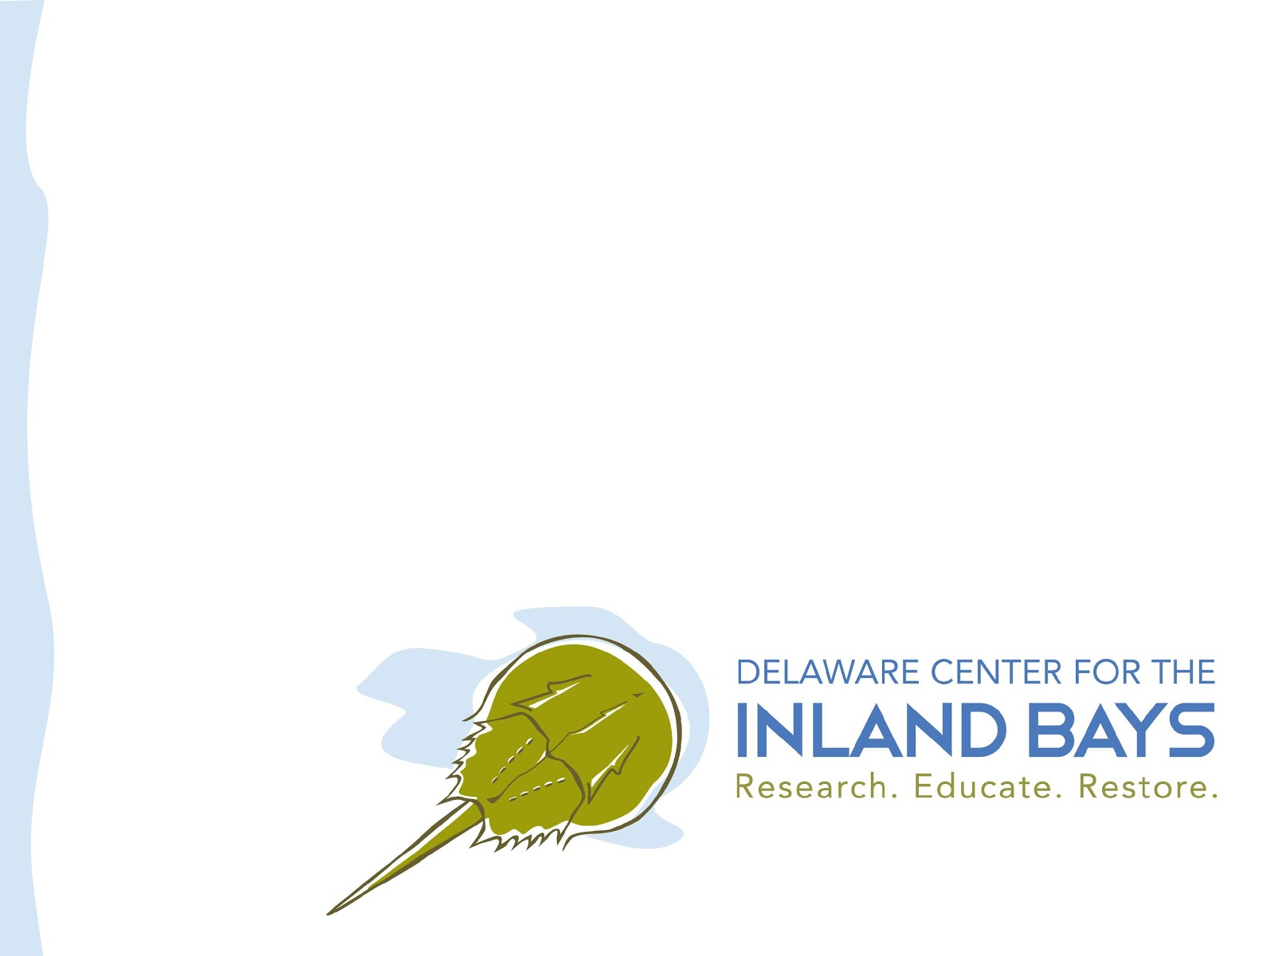
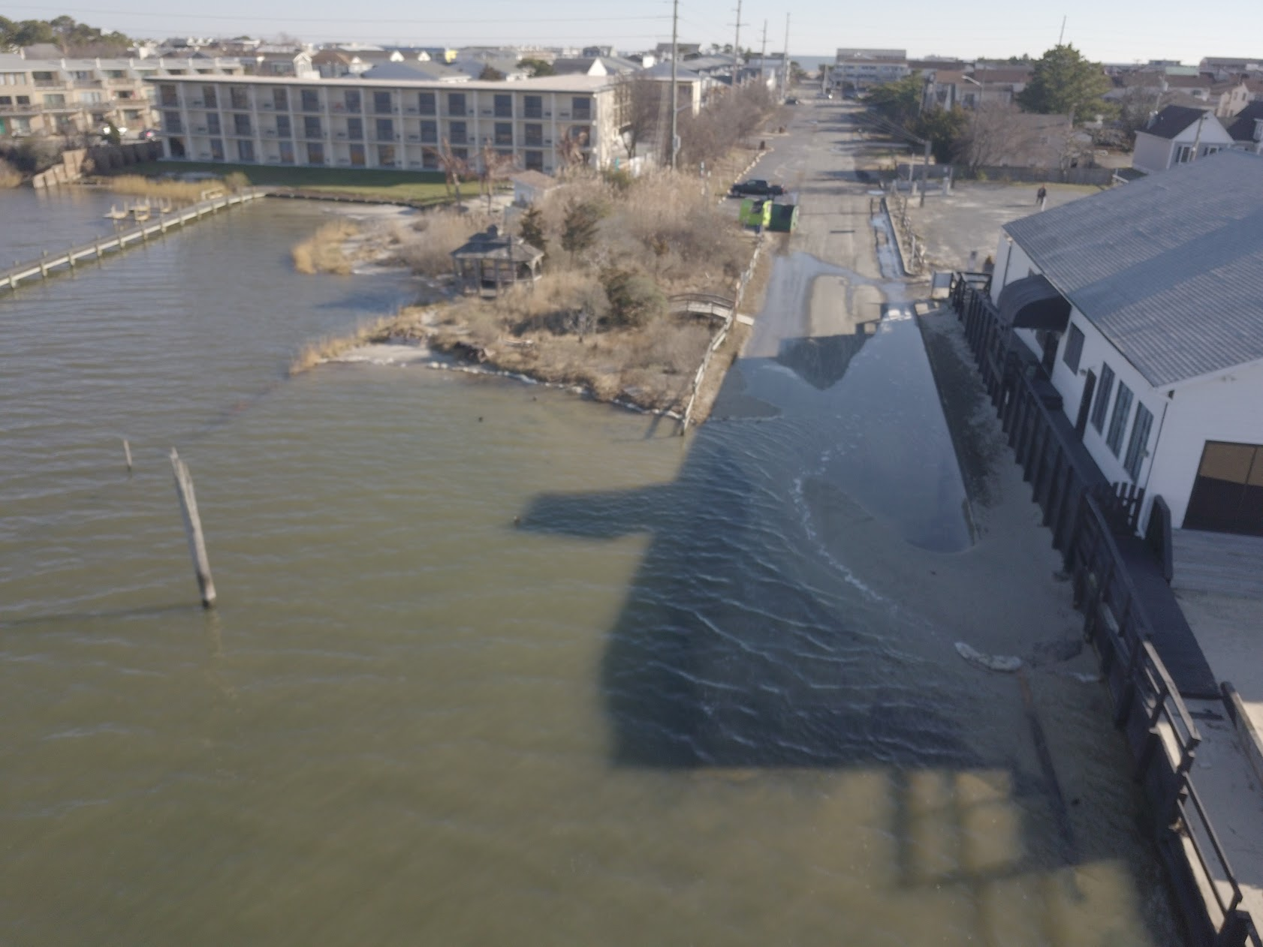

Slide 4
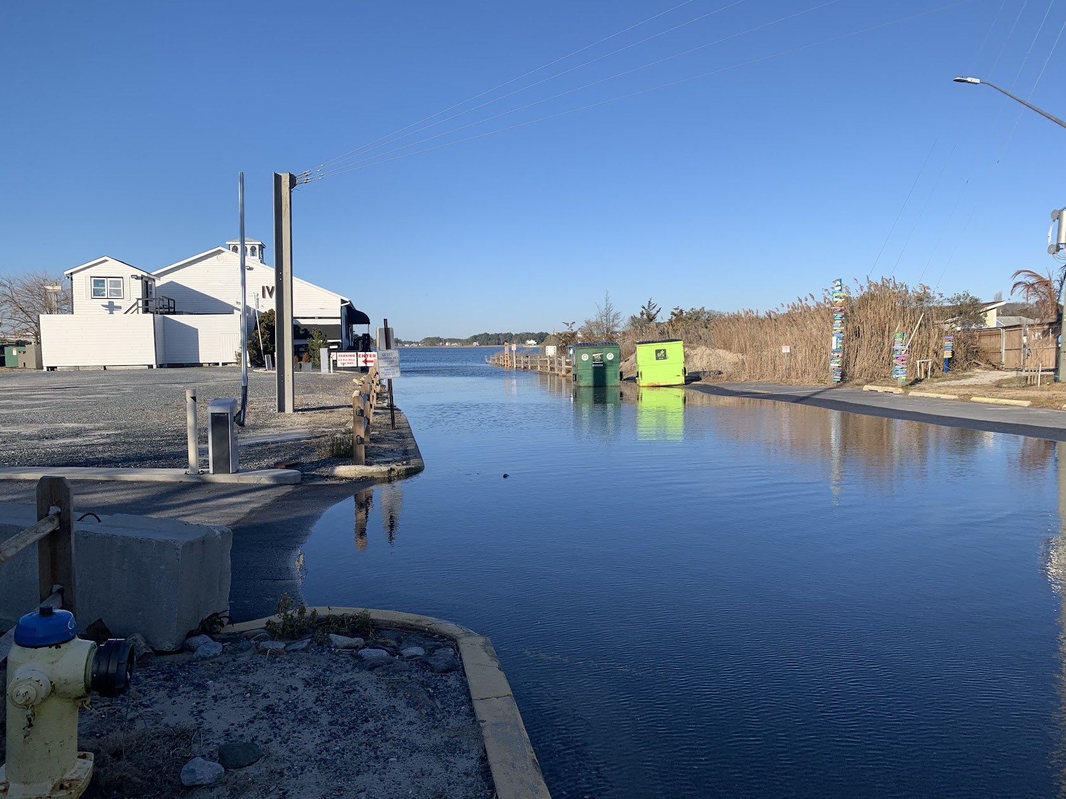
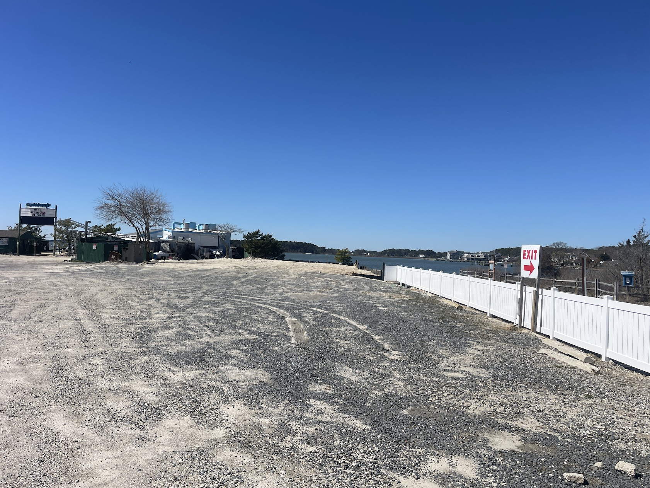

Slide 5
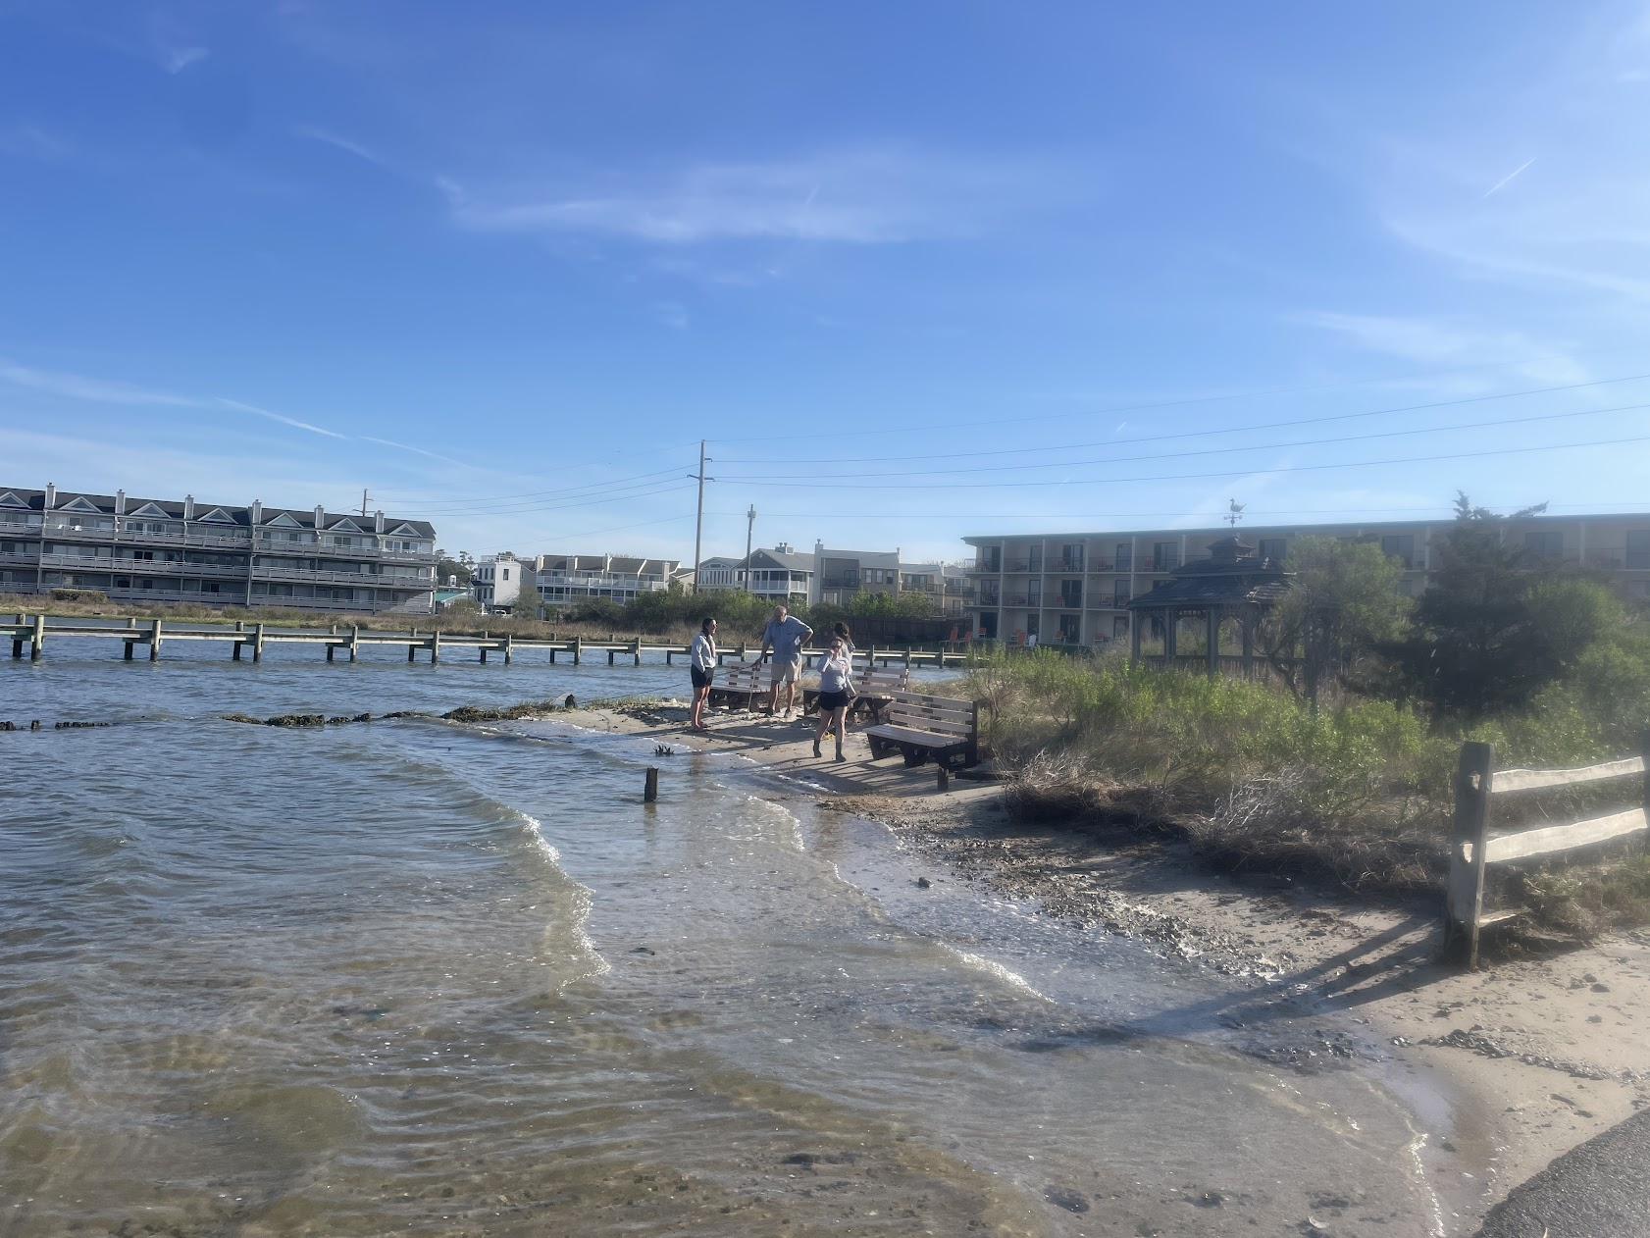
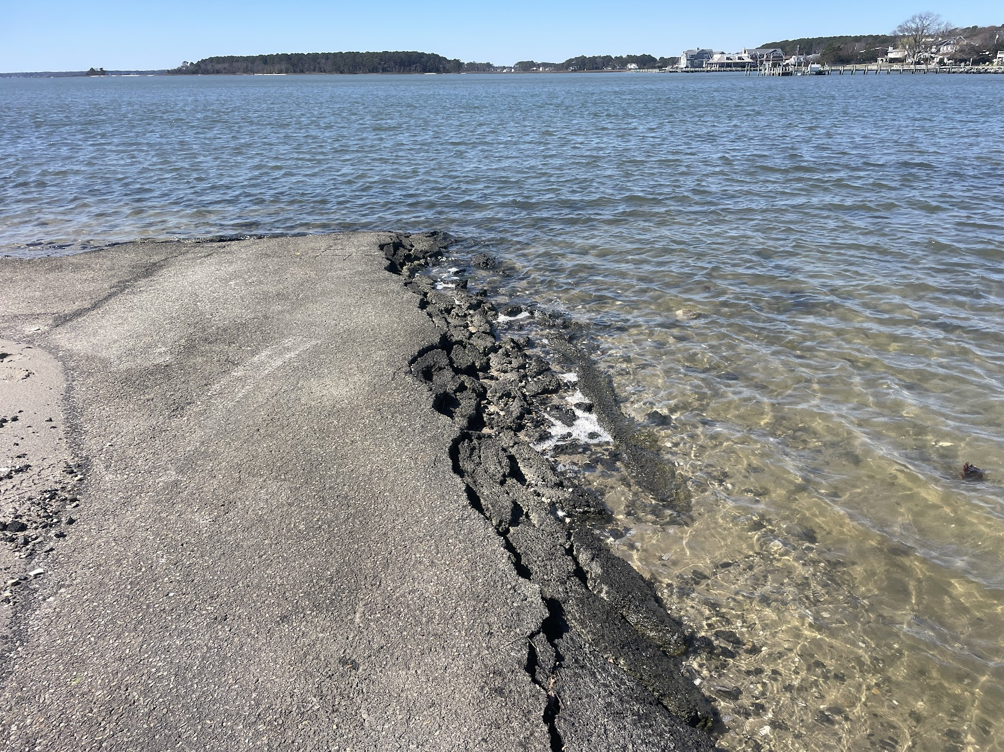
Text

Slide 6
Problems:
Flooding
  Tidal
  Stormwater
  Sunny Day Flooding
Erosion
  Sediment
  Nutrients

Slide 7
Living Shorelines
Uses Natural of Nature-based tactics to address flooding and erosion
Center for the Inland Bays:
  Founding member of the Delaware Living Shoreline Committee
  Policy initiatives in siting, technical approaches and monitoring
  Installed six living shorelines (w/ two in planning)

Slide 8
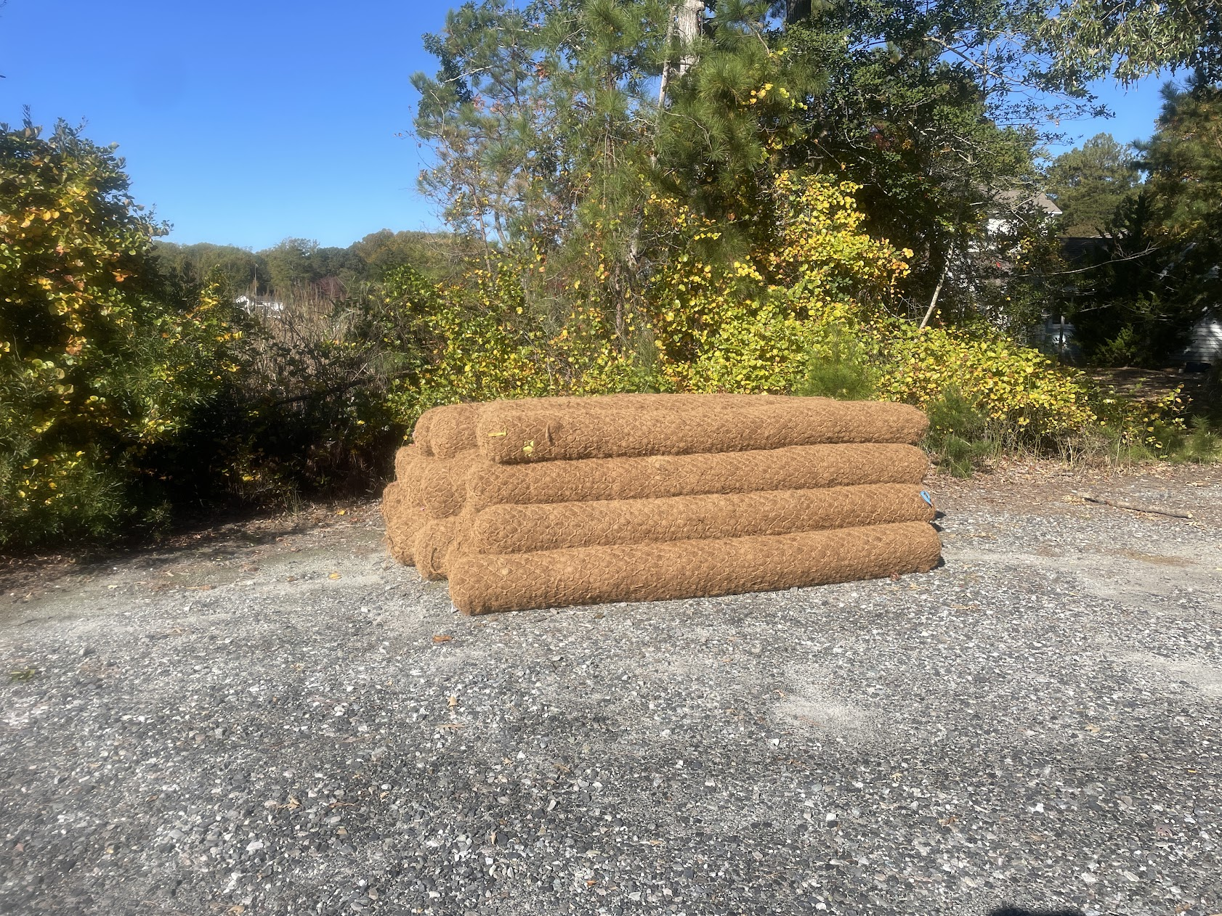
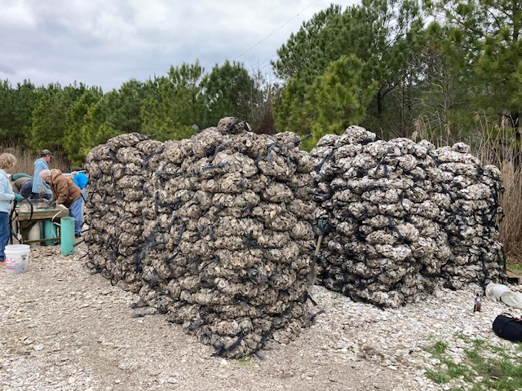
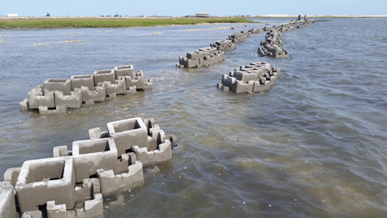
Text

Slide 9
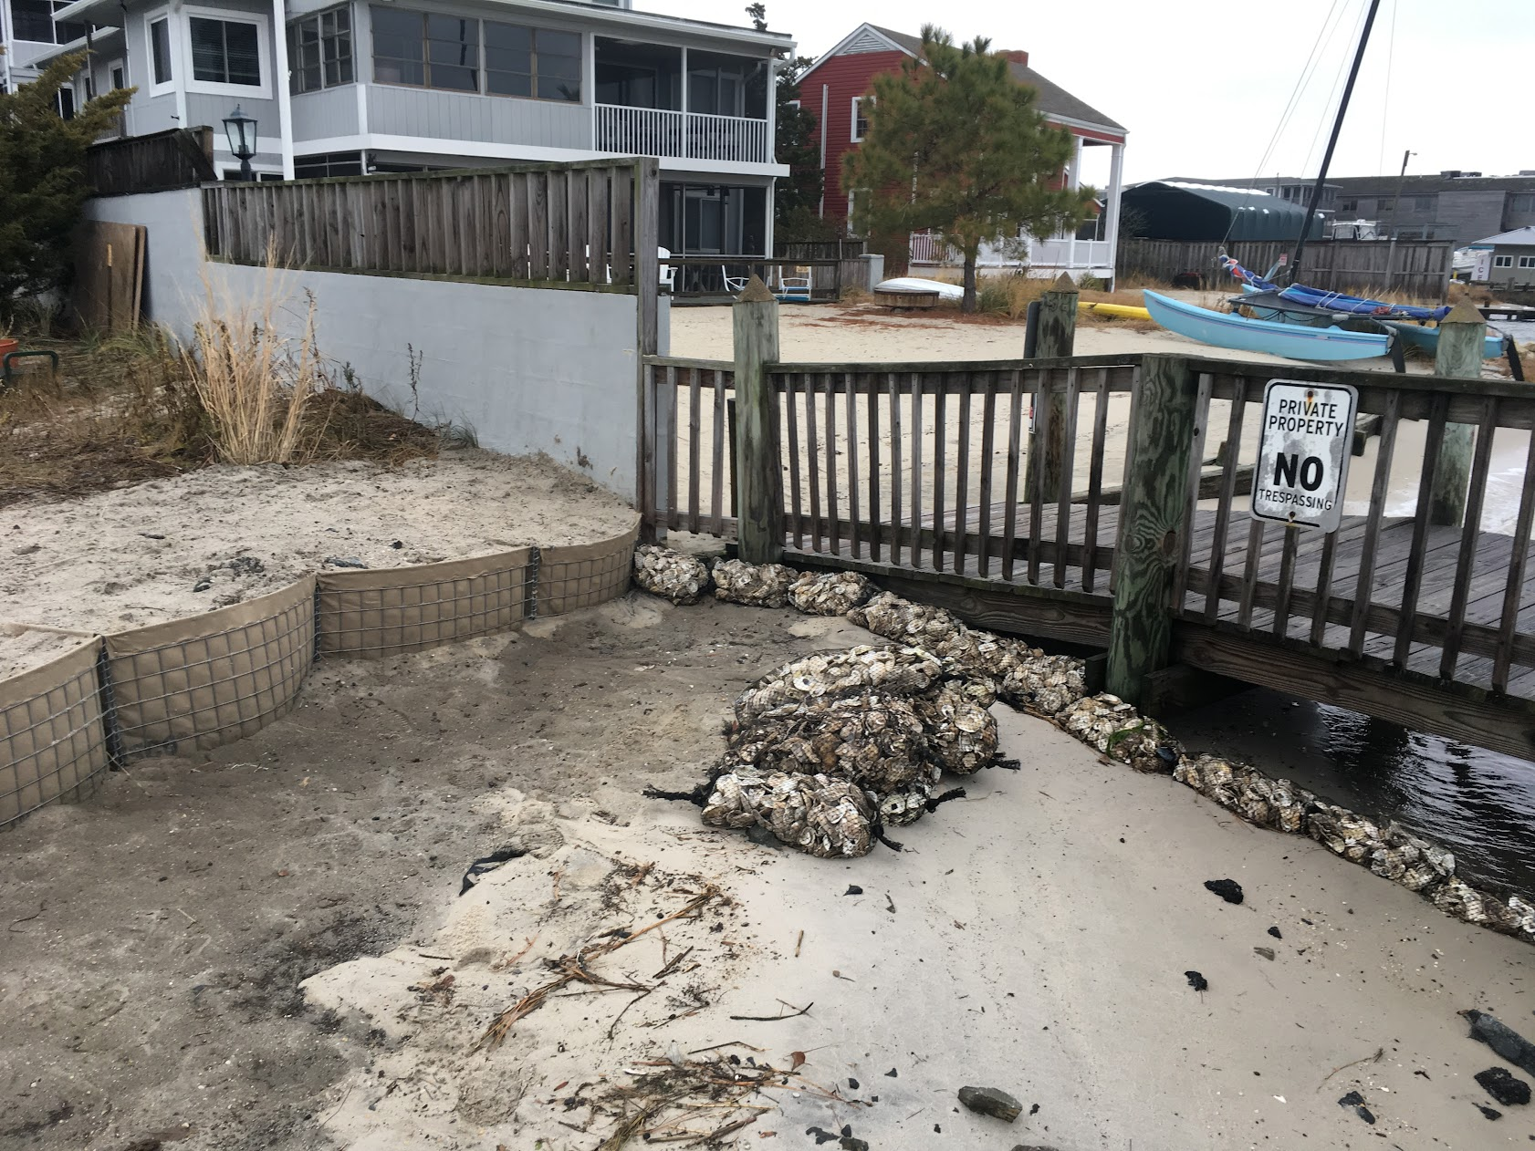
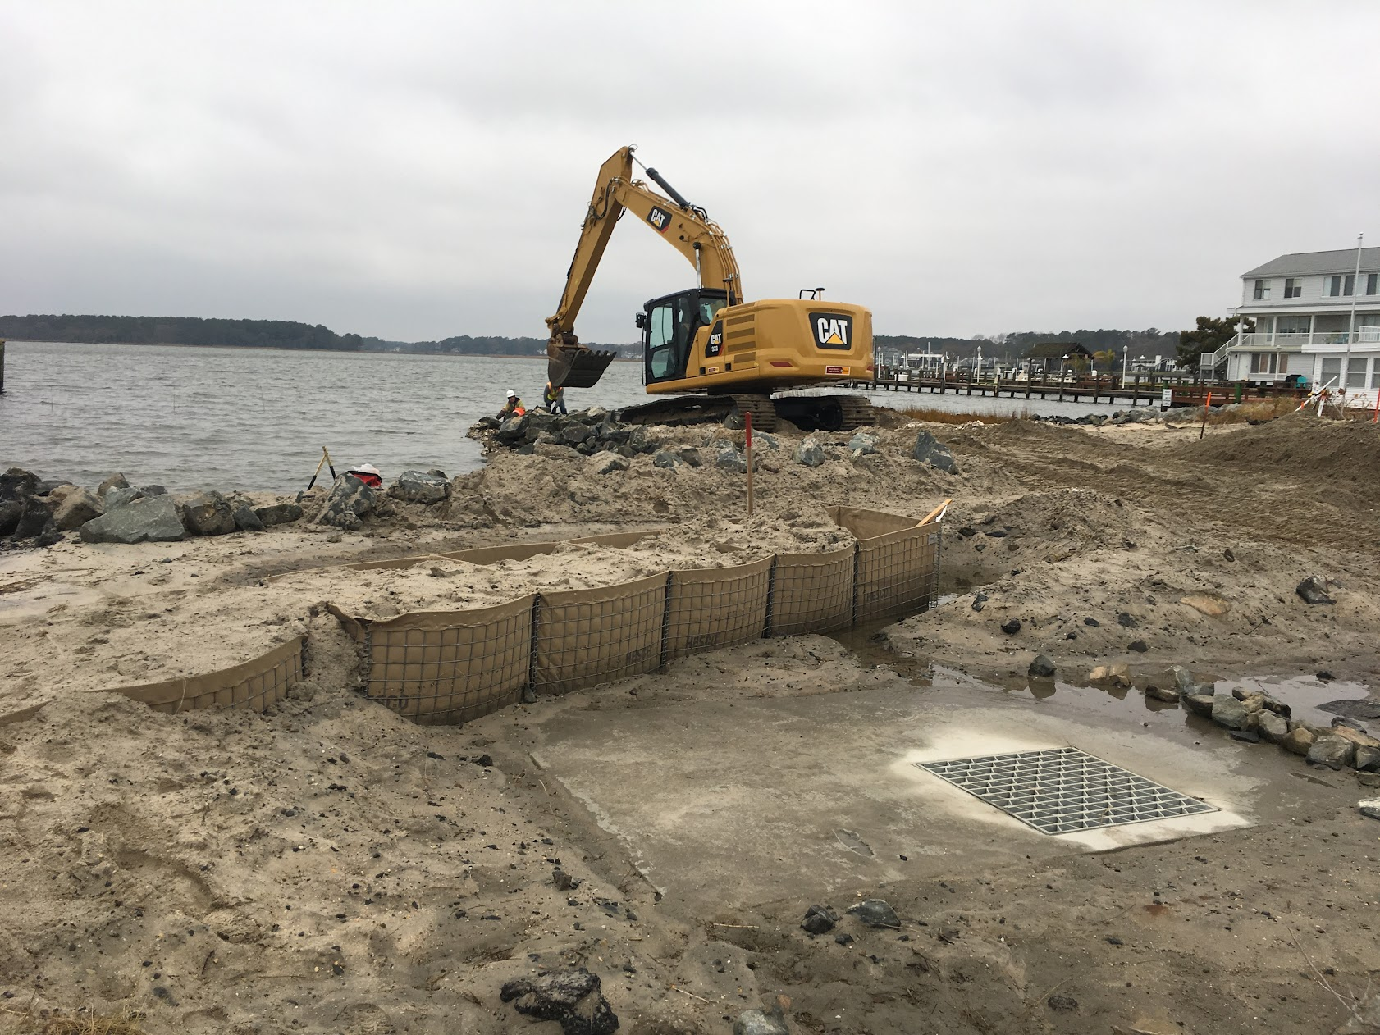
Text

Slide 10
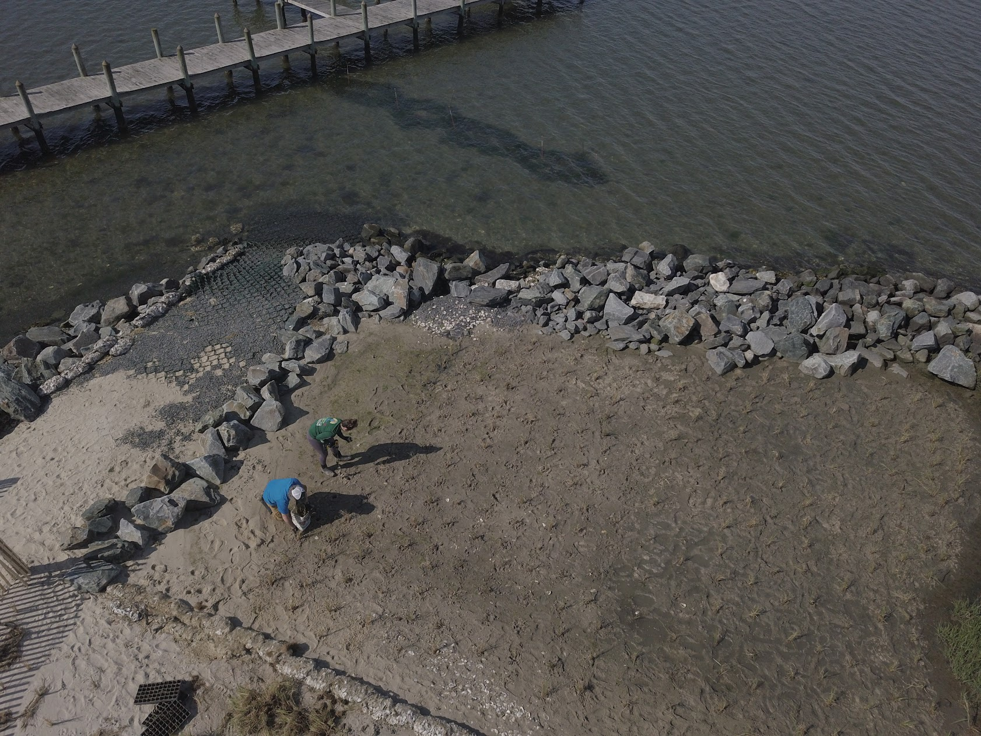

Slide 11
Living Shorelines tactics at Sunset Park
Core Logs
“Oyster Castles”
Shell Bags
Marsh Creation
  Sand fill
  Plant marsh grass
Dune Creation
  Hesco Barriers
  Plant Dune Grass
Modification of Lions Club Marsh
Repair of McKinley St. drainage structures

Slide 12
Project split into two phases
Phase 1
Reach 3
  Lions Club Marsh and shoreline
Reach 2 (partial)
  Oyster Castle breakwater
Phase 2
End of Dagsworthy
Sunset Park proper

Slide 13
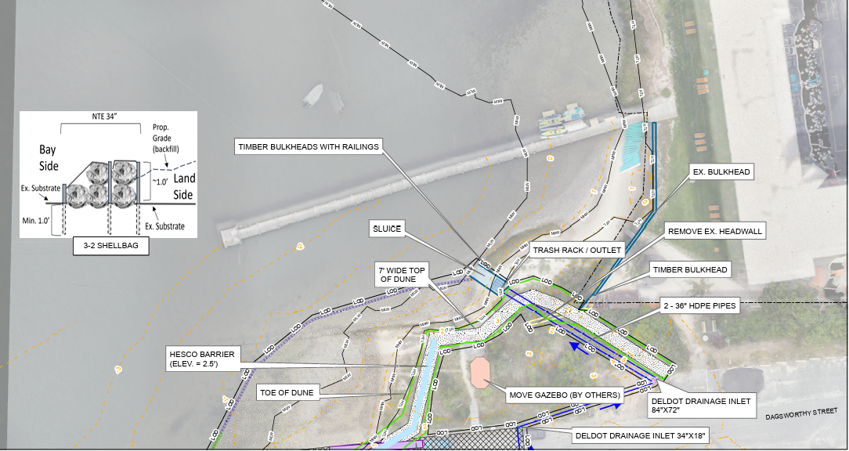
Reach 1
(Phase 2)
Text

Slide 14
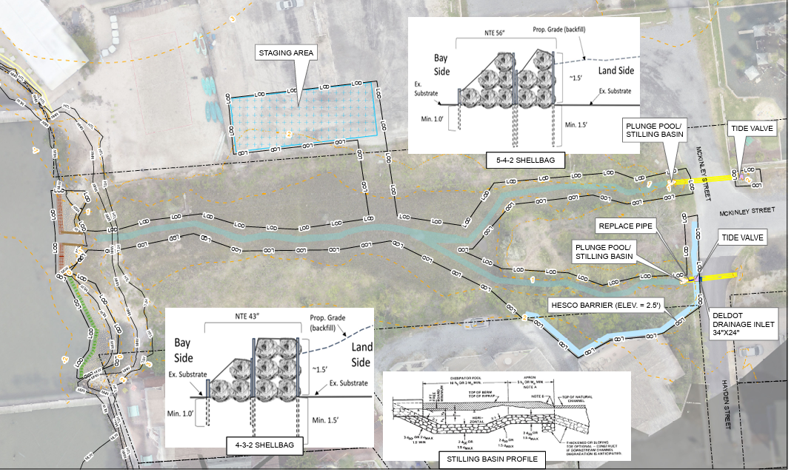
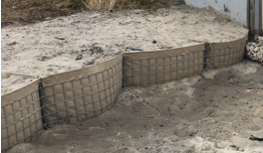
Phase 1
(Reach 3)
Text

Slide 15
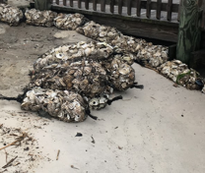
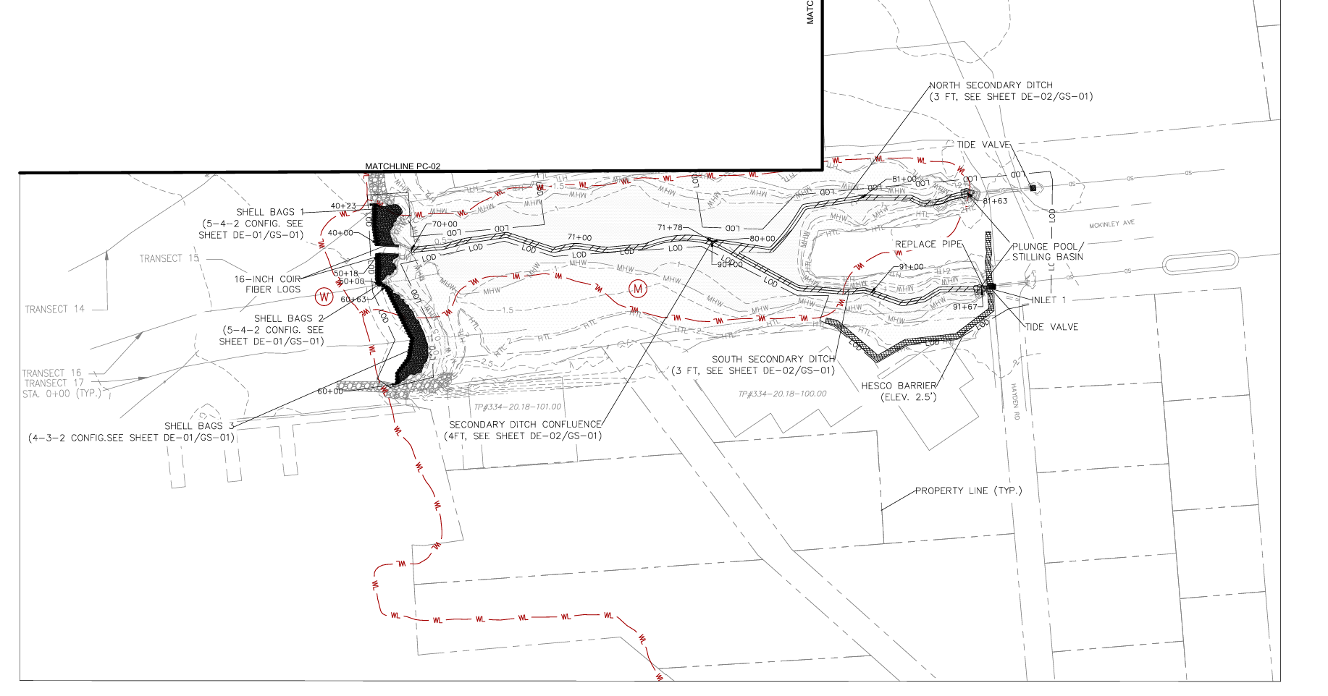
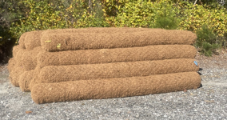
Reach 3

Slide 16
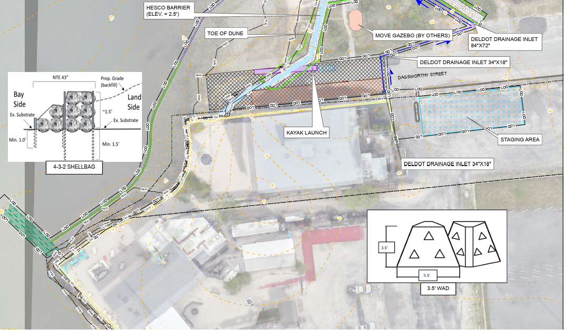
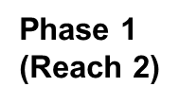

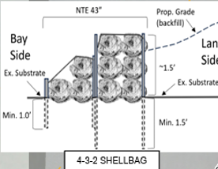
Text
Former Ivy
site

Slide 17
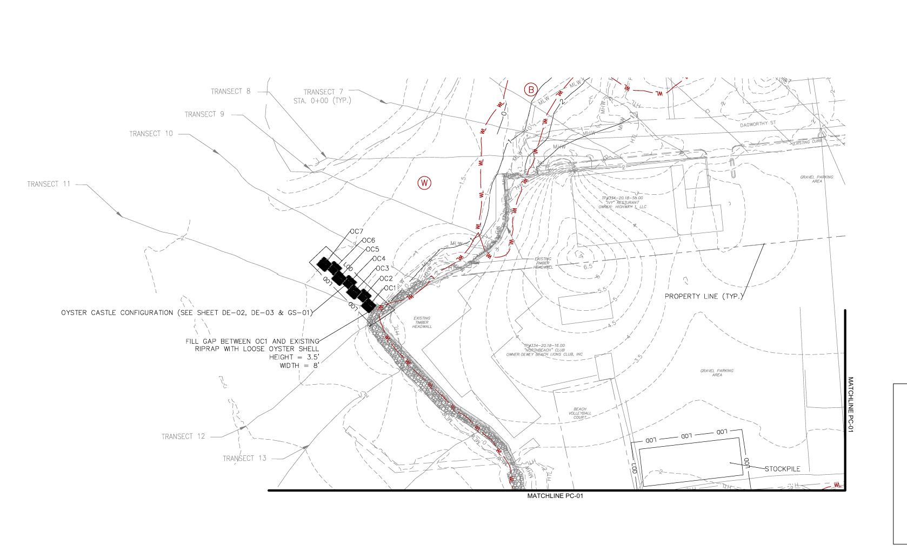
Reach 2

Slide 18
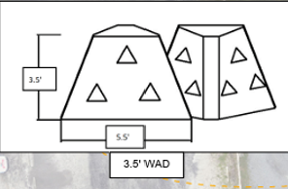
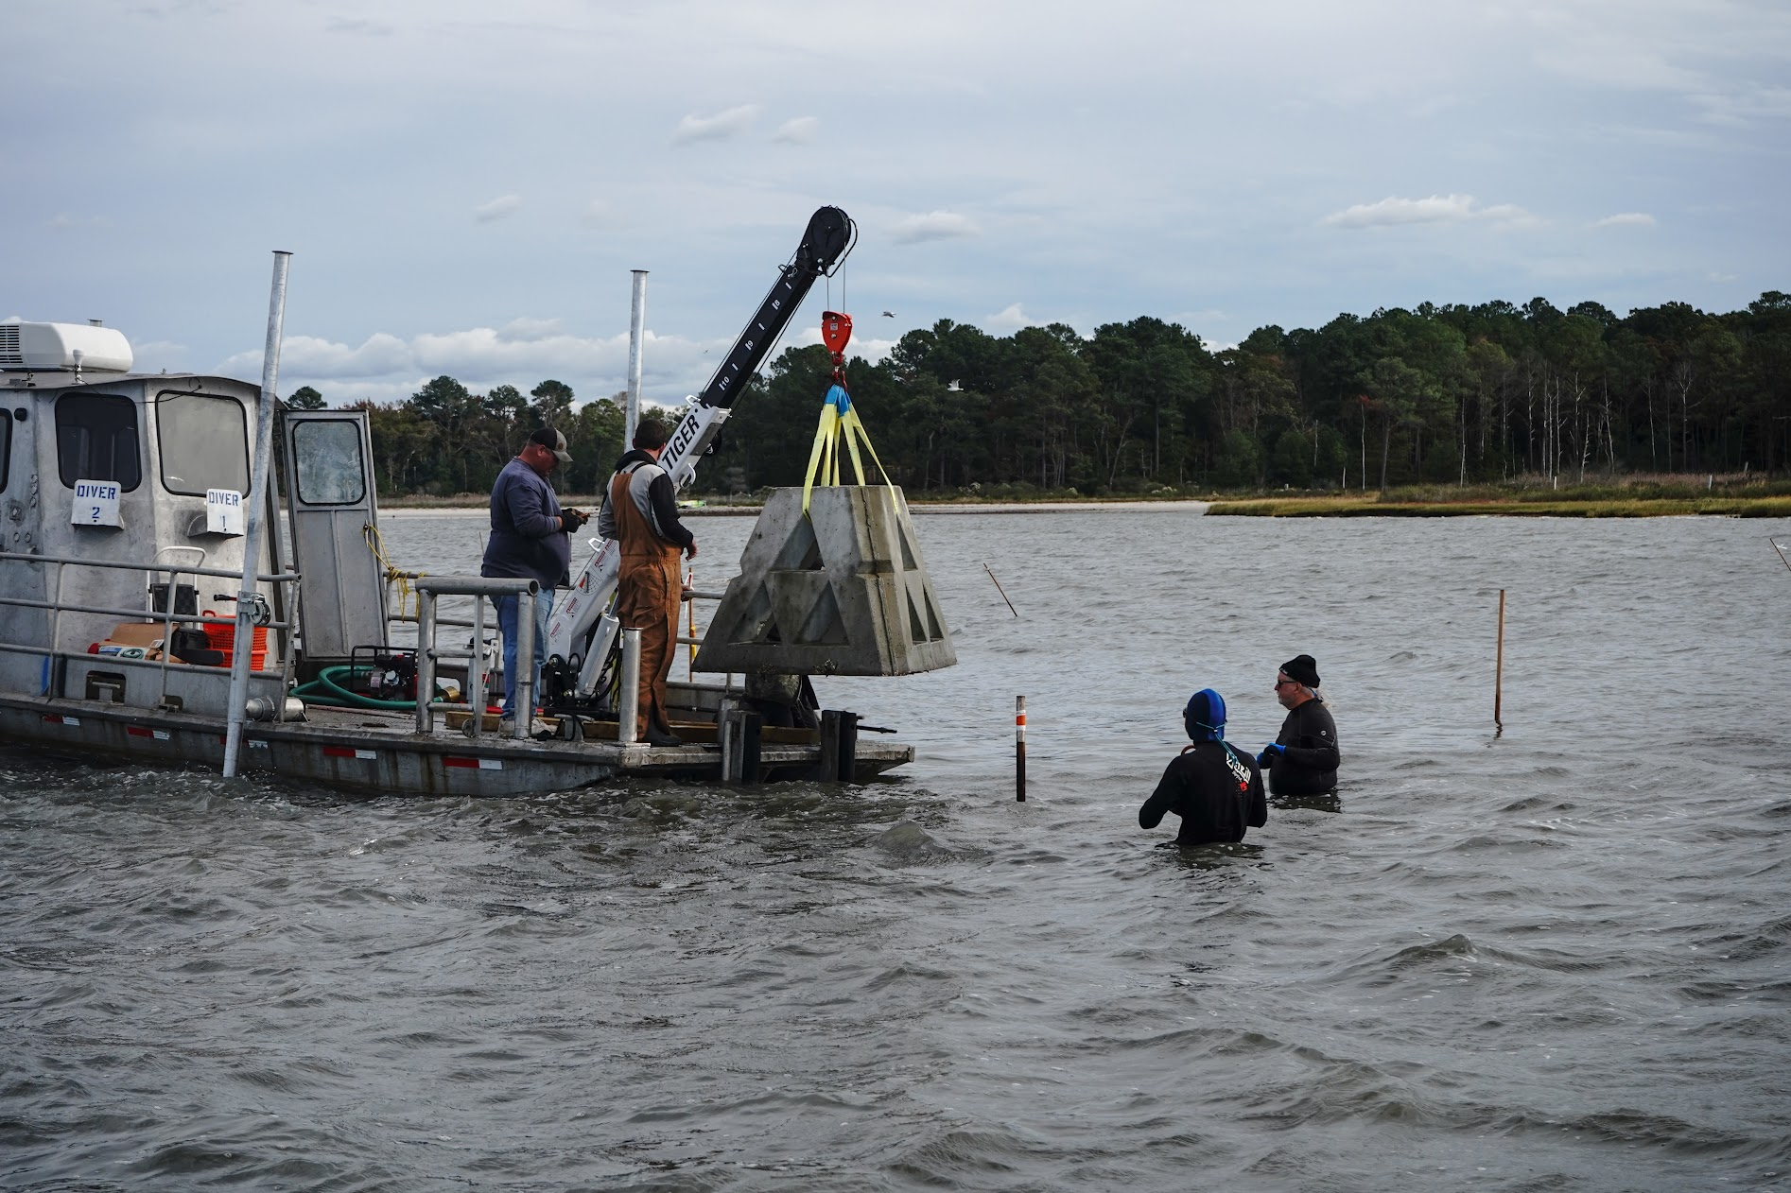

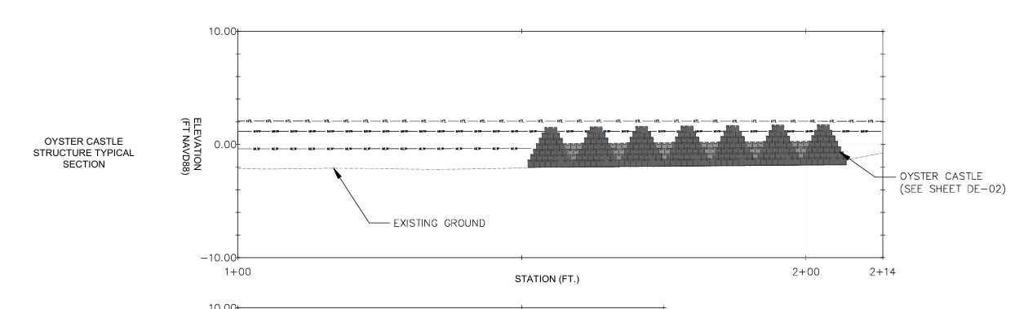
Reach 2
WADs vs.
Oyster Castles

Slide 19
Next Steps:
(As reported to DB Town Council February 2024)
Complete Design
Submit Permitting
  Anticipated issuance December 2025
Implementation February 2026 (?) fall 2026 (more likely)

Slide 20
Phase 1 Funding:
Community Water Quality Improvement Grant (CWQIG)-
Bipartisan Infrastructure Law
  At risk

Slide 21
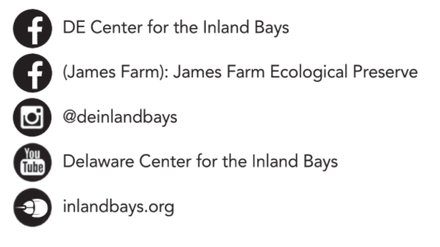
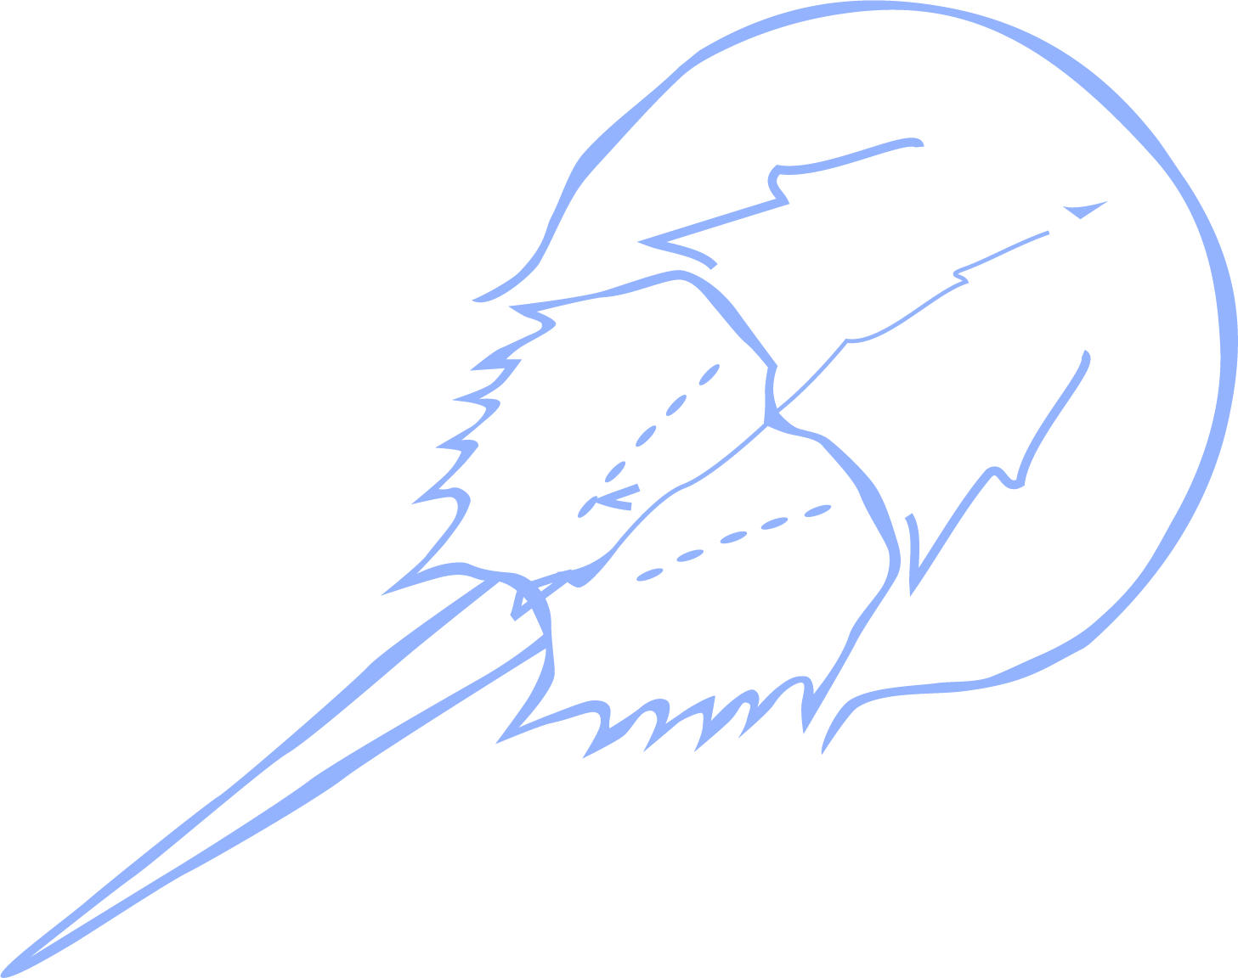
Get on Board with the Bays
Stay informed & engaged! Volunteer, join our mailing list & follow us online!

Slide 22
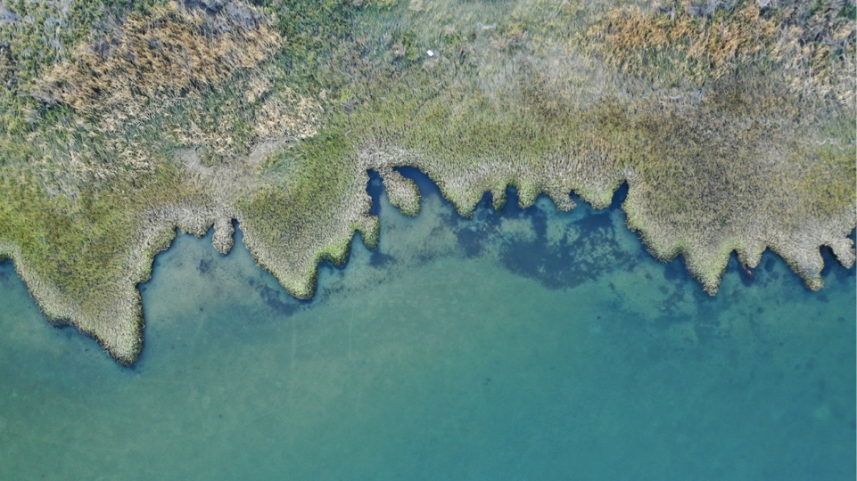
Photo: Driscoll Drones
Bob Collins
Programs and Facilities Manager
jamesfarm@inlandbays.org

