Slide 1
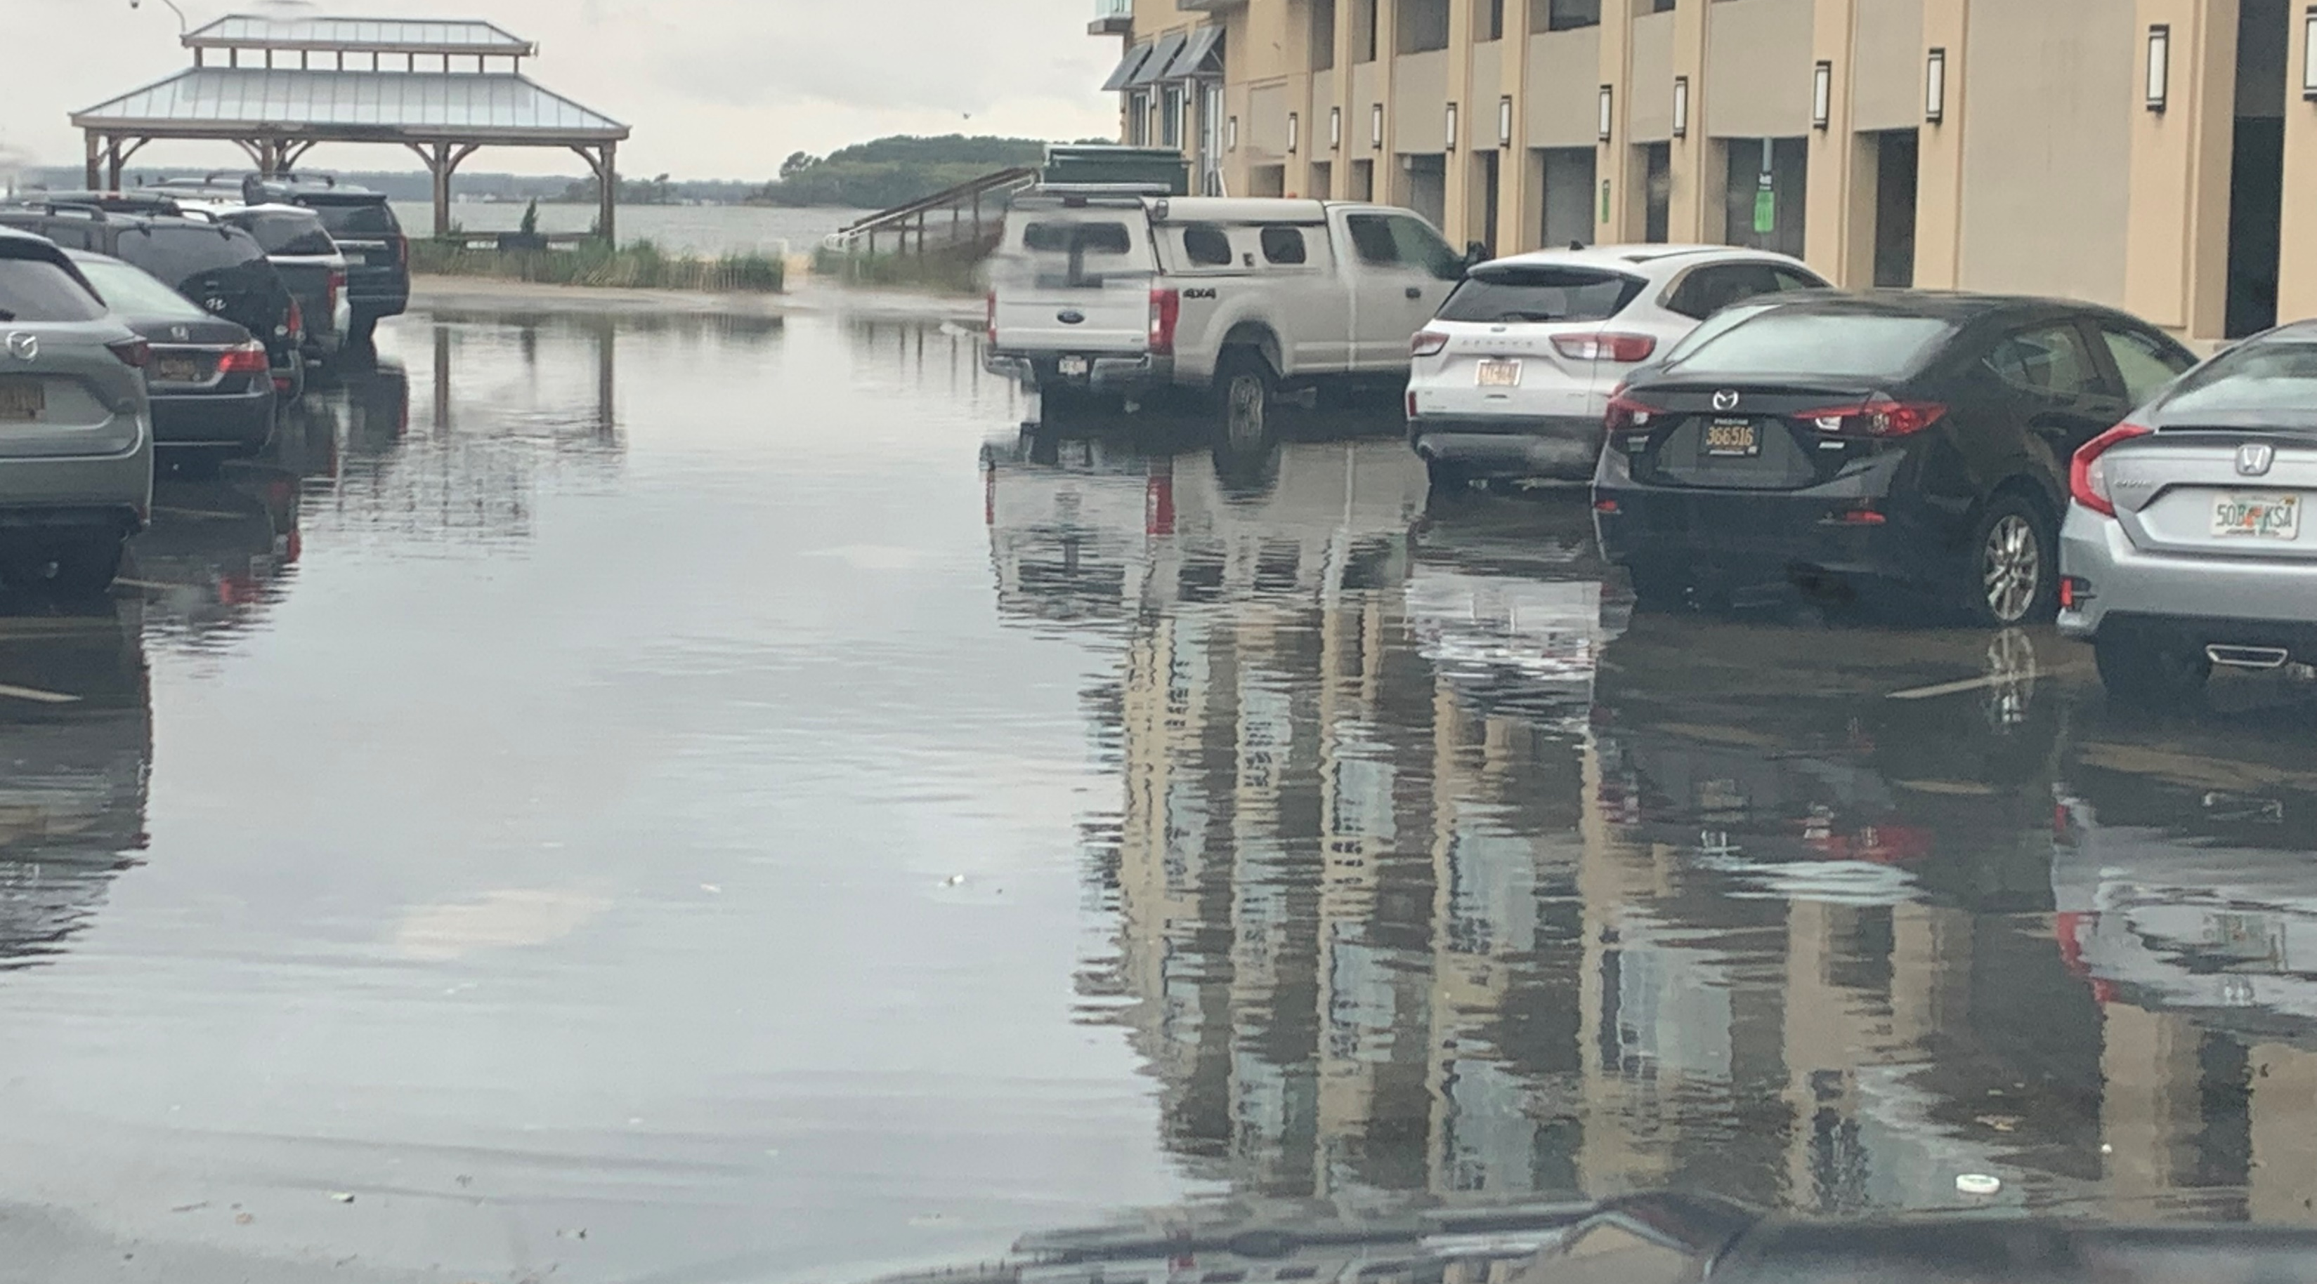

Van Dyke Avenue
Stormwater Quantity Improvements
Project Update
August 12, 2025
Presented to: Town of Dewey Beach

Slide 2





Presentation Agenda
Project Goals
SWMP Grant
Project Tasks
Schedule
Concept Plan

Slide 3
Project Goals

Slide 4

Project Goals
Provide water quantity control to alleviate flooding along Van Dyke Street
Relocate existing outfall to improve public safety at the Van Dyke Street outfall
Enhance the water quality of the Rehoboth Bay Watershed by implementing targeted measures at the point of discharge

Slide 5
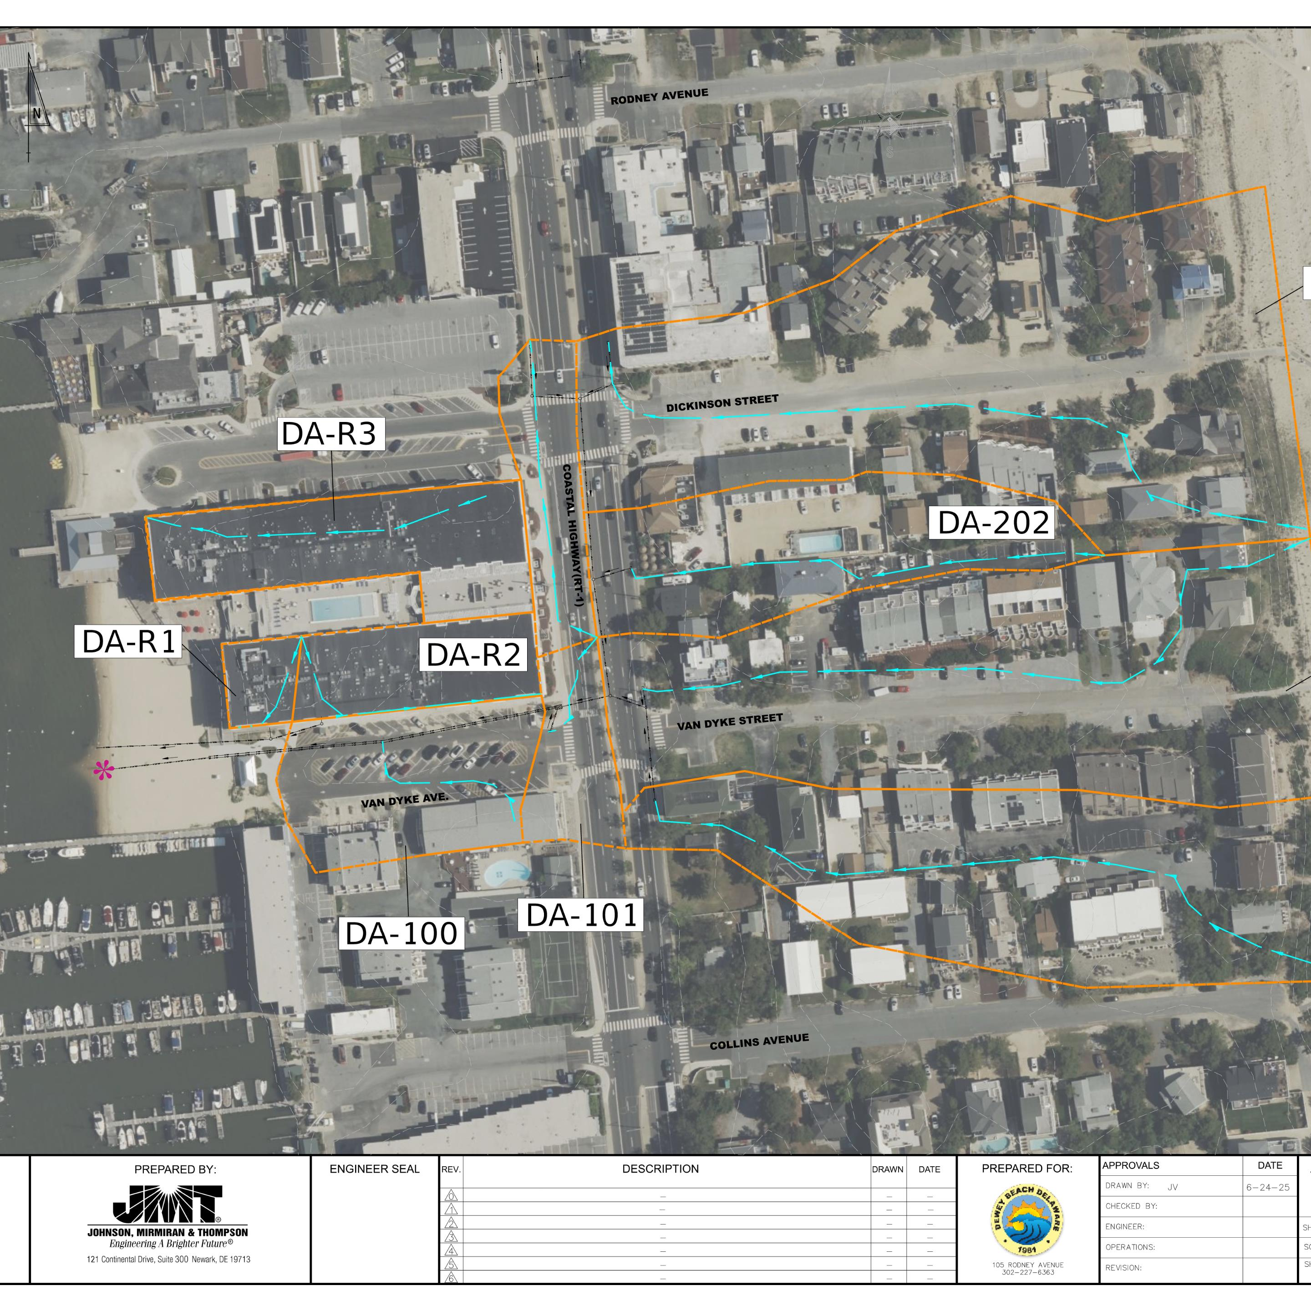
Our Agenda
Project Location
21-acre drainage area
77% impervious
Notes:
According to 2017 Phase II Stormwater Planning Report (completed in 2017)

Slide 6
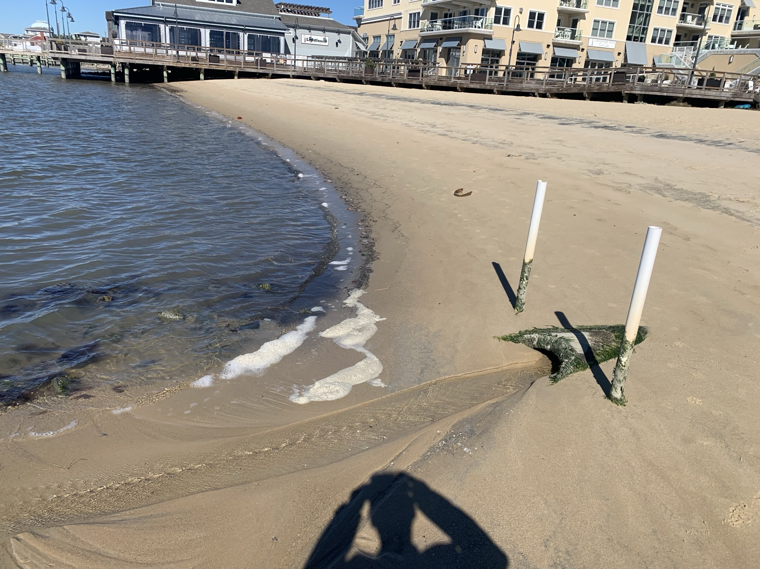
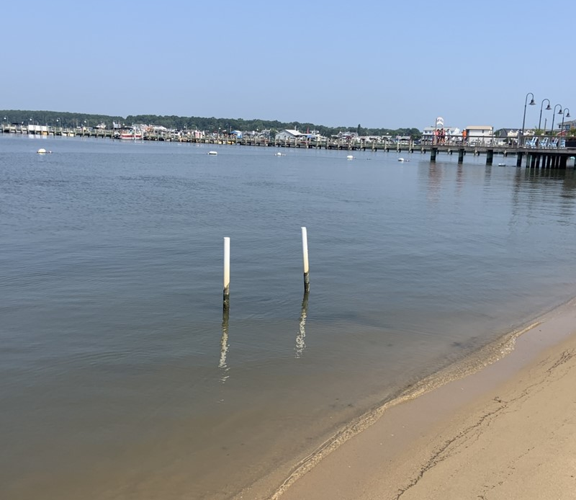

Project Goals
Outfall photos
Low Tide
High Tide
Notes:
Eliminate safety concern: Current outfall pipe is exposed and a risk to beach-goers at increasingly popular Beach in all tide conditions.
Outfall pipe is prone to clogging with sand, backing up water and flooding the public parking lot on Van Dyke Ave and RT 1 – current maintenance plan: Dewey Beach Enterprises employee goes out with a shovel at low tide and cleans this out.

Slide 7

Project Tasks

Slide 8
Project Tasks
Site Survey
Conduct
field survey
Hydraulic Analysis
Perform H&H analysis and modeling
Conceptual Designs
Develop design concepts, coordinating with Town of Dewey Beach, Center
for Inland Bays,
and Delaware
Sea Grant
Consider drainage routing & pump station sizing
Concept Selection
Obtain input through public discussion
Further refine concepts based on resident feedback
Ultimate concept selection by Town
Gather data on topography, land use, hydrology
Delineate
drainage basin
Notes:
Site Survey:
Field Survey - storm sewer inlets, manholes, storm pipes – confirm connectivity within storm sewer network and exactly what drains to outfall
Hydraulic Analysis
Data gathered on inputs that affect water movement to understand how the water within the drainage basin behaves. Analyze to understand baseline scenarios and assess flows under varying conditions and storm events. To determine the discharge flows at the outfall as well as potential areas of inundation, backwater effects, and timing.
Conceptual Designs
The H&H analysis will lend itself to understanding whether we can rely on gravity flow methods or if a pump station will be required to adequately get the water from the roadways to the Rehoboth Bay and keep it there!
Will develop (3) conceptual designs including renderings, cost estimate, and applicable permitting requirements for each.
Concept Selection
Public meetings to be held to discuss options with town residents; gather input and feedback. Incorporate relevant suggestions into final analysis and design. Town to select alternative to continue to refine with desire to eventually design, permit, and construct.

Slide 9
Project Costs – Revised and Reduced
Tasks 1, 3, & 4 – Funded 50% By DNREC
Tasks 2 – Funded 100% By Town
Task 1 – Site Survey and Basin Delineation
    Field Survey of Basin $6,500
    Basin Delineation and Field Verification $3,500
Sub-total $10,000
Task 2 – Hydraulic Analysis
    Hydraulic Analysis & Modeling $15,000
    Routing and Pump Station Sizing $5,000
Sub-total $20,000
Task 3 – Conceptual Designs
    Development of Three Concepts $26,000
    Meetings $5,000
    Finalization of Concepts $6,000
Sub-total $37,000
Task 4 – Public Input and Concept Selection
    Public Meetings $5,000
    Refining of Concepts $5,000
    Selection of Final Concept $5,000
Sub-total $15,000
Total Project Cost $82,000
Total Town Contribution = $51,000
Total DNREC Contribution = $31,000

Slide 10

Concept Plan

Slide 11
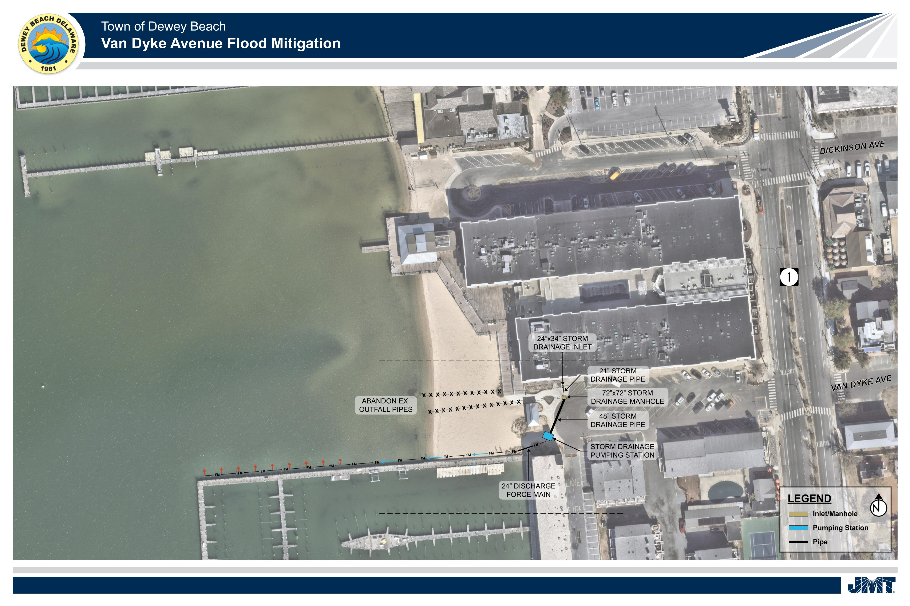
Notes:
Concept Provided by Sussex County

Slide 12
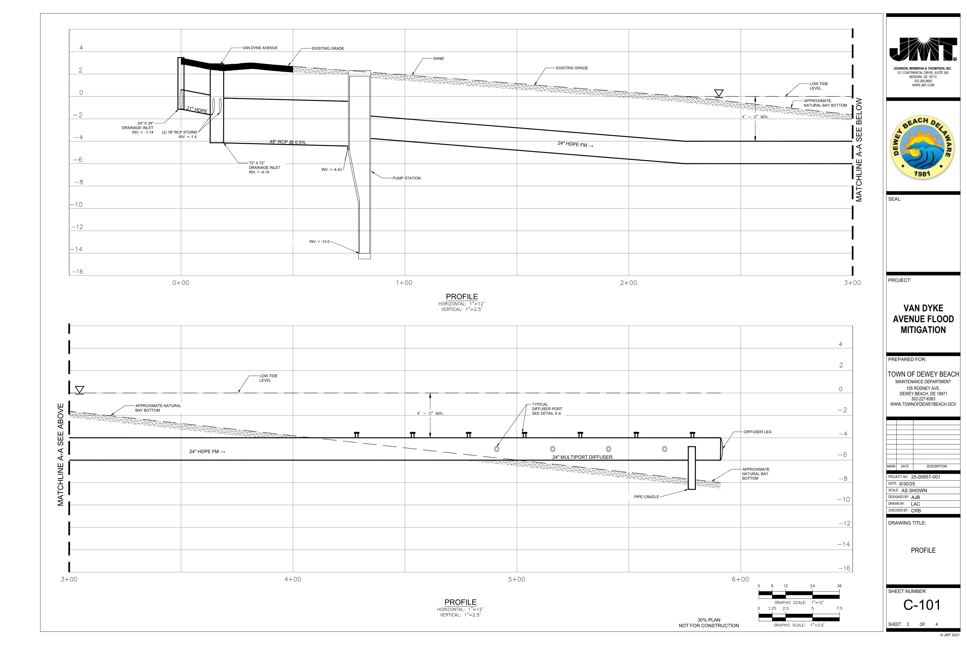
Notes:
Concept Provided by Sussex County

Slide 13
Thank You!

