Slide 1
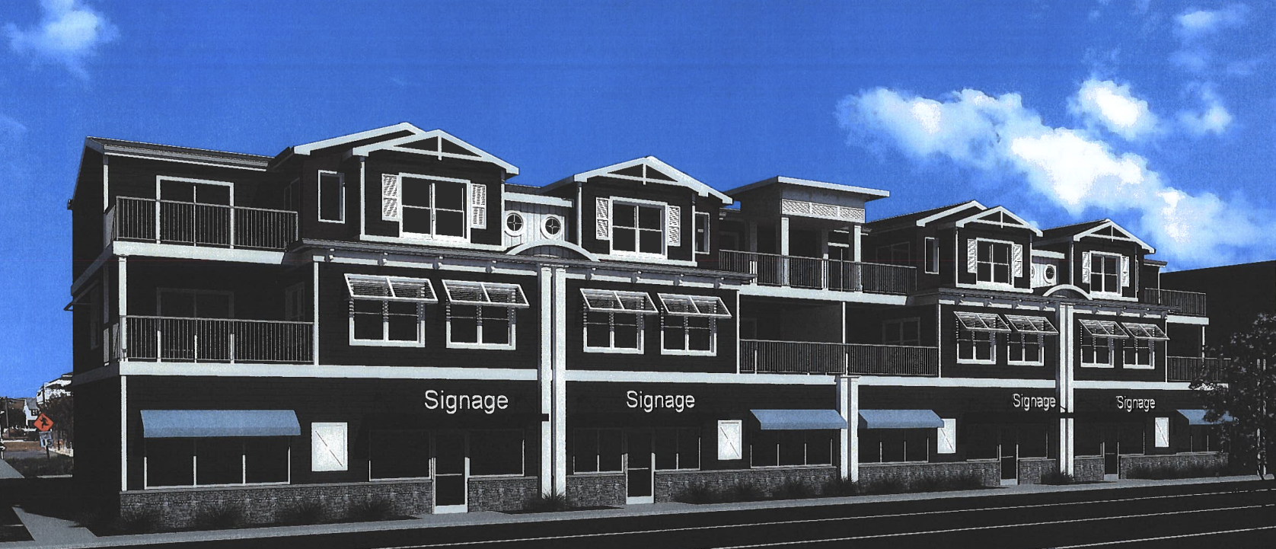






Jonathan Silver Glenn Mandalas, Esq Heather Morrison, AIA Alan Decktor, PE David Grayson
1603 Coastal Highway, Dewey Beach
Dewey Beach
Board of Adjustment
Nov 5, 2025

Slide 2
Agenda
Project Overview
Our variance requests
Circumstances leading to our variance requests
Exceptional Practical Difficulty
Conclusion

Slide 3
Project Overview
Located at 1603 Coastal Highway, on the corner of Read and Coastal Highway—the former Grotto Pizza location
Zoning: Resort Business 2 (RB2)
December 16, 2022: the Town of Dewey Beach voted unanimously to approve (by conditional use approval) a mixed-use plan
Three-story structure / ~15,000 sf
four townhouse units over four first-floor retail spaces
Four enclosed garages associated with the townhouse units (garage doors not permitted under CU approval)

Slide 4
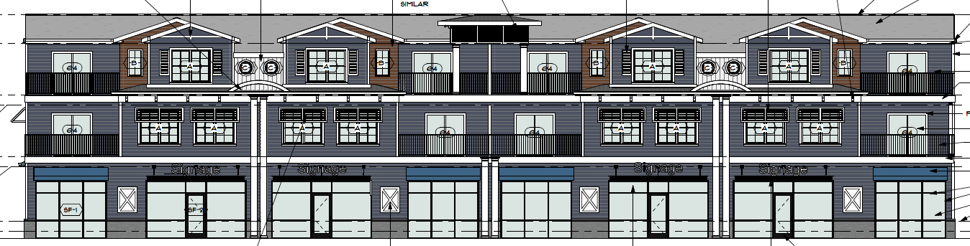
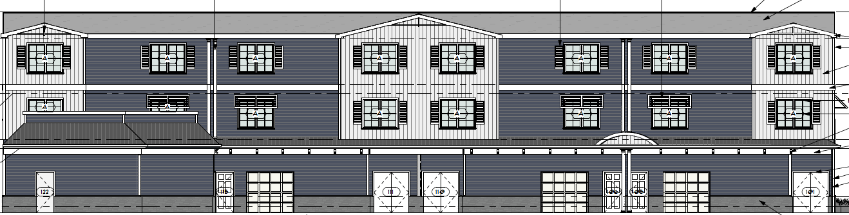

Slide 5
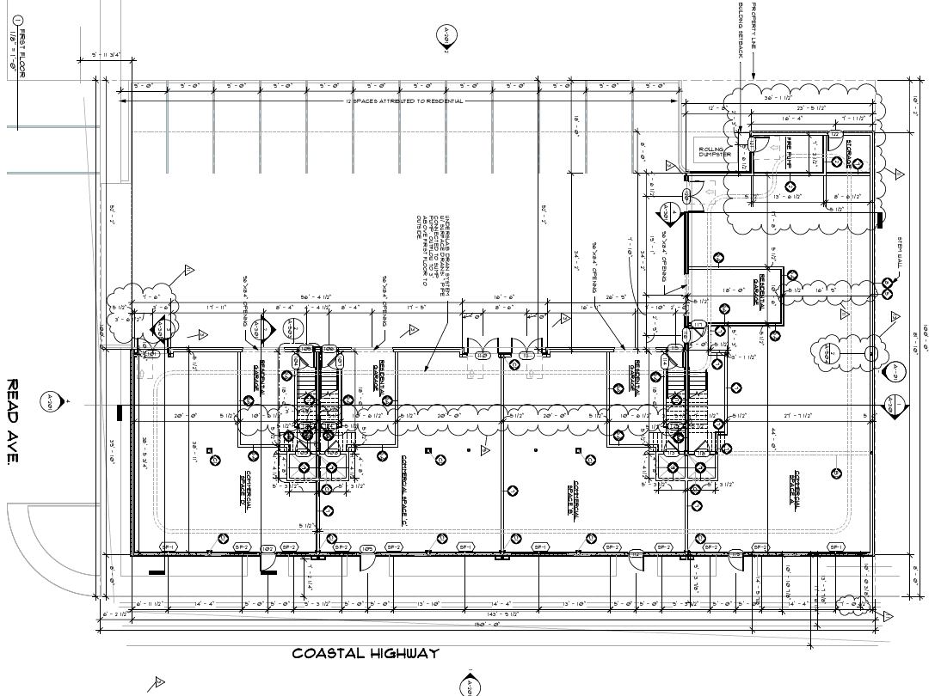

Slide 7
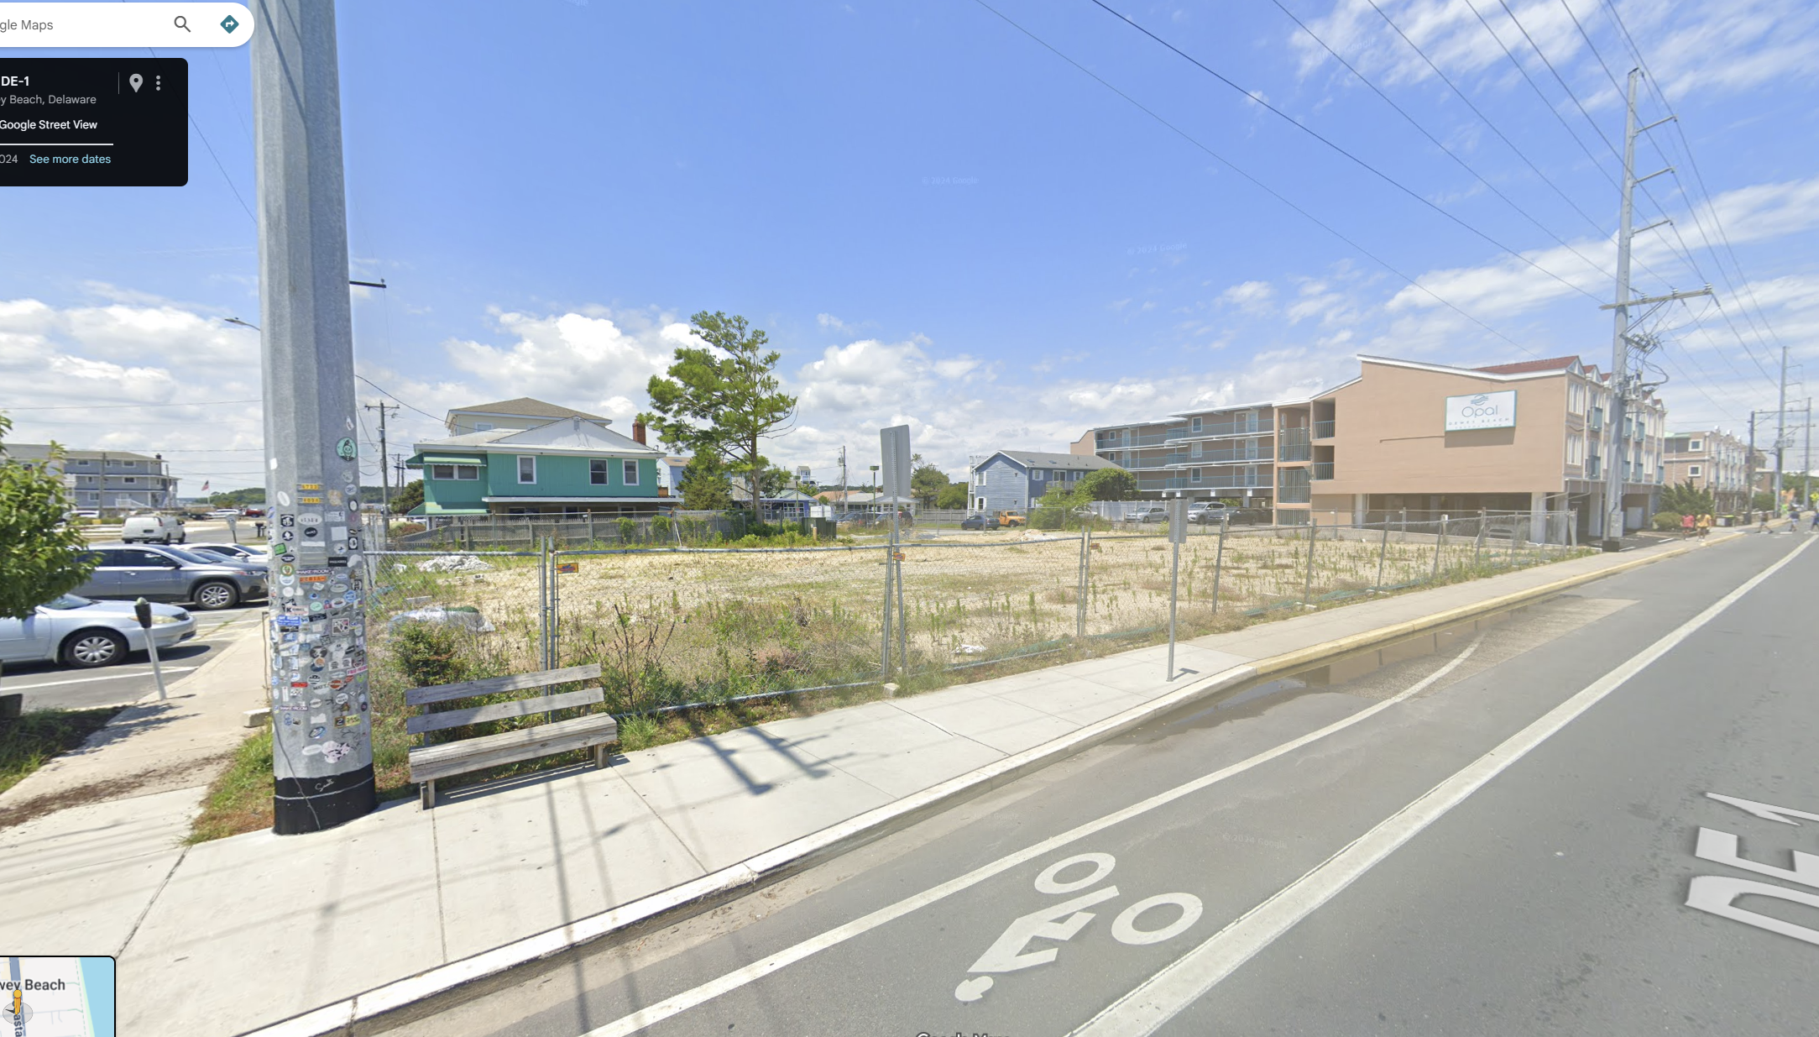

Slide 8
Our Request
A variance from § 185-25.1(A), prohibiting residential areas on the first floor, to allow first floor enclosed garages associated with the townhomes.
A variance from § 185-51(F), requiring pervious pavement, to permit impervious pavement.

Slide 9
Our Request (four enclosed parking garages)
§ 185-25.1(A)
RB-2 Resort Business District-2.
Purpose of the district. This district represents the middle level of commercial development intensity in a main-street-like district lining the Coastal Highway corridor (S.R. 1). The features of this zone include structures that are either entirely dedicated to commercial land use, or mixed-use structures of floor-area footage of not less than 1/3 commercial land use and not greater than 2/3 residential land use, providing use of the first floor or street level is restricted to commercial land use activities. Single-family detached dwellings and multifamily dwellings in a building or structure dedicated to residential use are prohibited.

Slide 10
Our Request (impervious paving)
§ 185-51(F)
No portion of any building lot area developed with a residential use or a mixed commercial and residential use in any district of Dewey Beach shall be covered or paved with impervious materials, installed in a manner as to create an impervious surface for any ground level surface, including driveways, parking spaces, and sidewalks, or any other structure not directly under roof…

Slide 11
Circumstances Leading to Our Request
Garages (§ 185-25.1(A))
First identified during the December 16, 2022 conditional use hearing
Approved, conditioned upon garage bays being open, with acknowledgment that the Board of Adjustment could grant relief to permit garage enclosures.

Slide 12
Circumstances Leading to Our Request
Impervious pavement
§ 185-51(F), requiring pervious pavement
Construction drawings included pervious pavement with a standard detail.

Slide 13
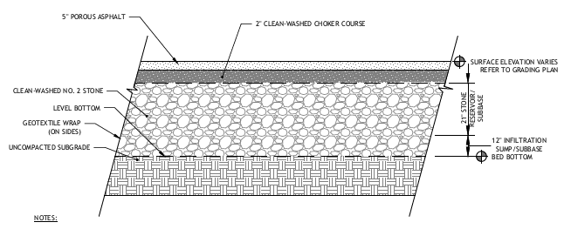
Circumstances Leading to Our Request
§ 185-51(F), requiring pervious pavement
Standard detail.
40”
40 inches comprised of porous asphalt, clean washed choker course, stone subbase and infiltration subbase

Slide 14
Circumstances Leading to Our Request
§ 185-51(F), requiring pervious pavement

Slide 15
Circumstances Leading to Our Request
§ 185-51(F), requiring pervious pavement
Standard acceptable detail.
40”
28”
Pervious pavement will be ineffective.

Slide 16
Exceptional Practical Difficulty
Bd. of Adjustment of New Castle Cty v. Kwik-Check Realty, Inc
Delaware Supreme Court: “[s]uch [exceptional] practical difficulty is present where the requested dimensional change is minimal and the harm to the applicant if the variance is denied will be greater than the probable effect on the neighboring properties if the variance is granted.”
Conway & Conway v. Zoning Bd. of Adjustment
Delaware Superior Court: the Kwik-Check analysis is “…a determination as to whether the Appellants are experiencing exceptional practical difficulty in their efforts to make normal improvements to their property, which, in turn, is decided by weighing the interest of the applicants against the interest of the public. The balancing of competing interests is the essence of the Kwik-Check test.”

Slide 17
Exceptional Practical Difficulty
The exceptional practical difficulty arises from the condition that (1) the applicant is required to provide parking for the residences, but the least offensive option (enclosed garage parking) is arguably prohibited by the code, and (2) given the depth of the water table, pervious pavement will not enhance storm water management.

Slide 18
Exceptional Practical Difficulty
Four factors to be considered by a Board of Adjustment:
The nature of the zone in which the property lies;
The character of the immediate vicinity and the uses contained therein;
Whether, if the restriction upon the applicant’s property were removed, such removal would seriously affect such neighboring property and uses; and
Whether, if the restriction is not removed, the restriction would create [hardship] for the owner in relation to his efforts to make normal improvements in the character of that use of the property which is a permitted use under the use provisions of the ordinance.

Slide 19
Exceptional Practical Difficulty (enclosed garages)
(1) The nature of the zone in which the property lies
The Property is in the Resort Business District-2 (RB-2) Zoning District, where mixed-use projects are permitted by conditional use approval. The residential portion of a mixed-use project is required to have off-street parking.

Slide 20
Exceptional Practical Difficulty (enclosed garages)
(2) The character of the immediate vicinity and the uses contained therein
Structures in the surrounding area utilize a mix of parking under the structure as well as enclosed garages. Aesthetically, enclosed garages are a preferred approach. The proposal is in character with the surrounding area.

Slide 21
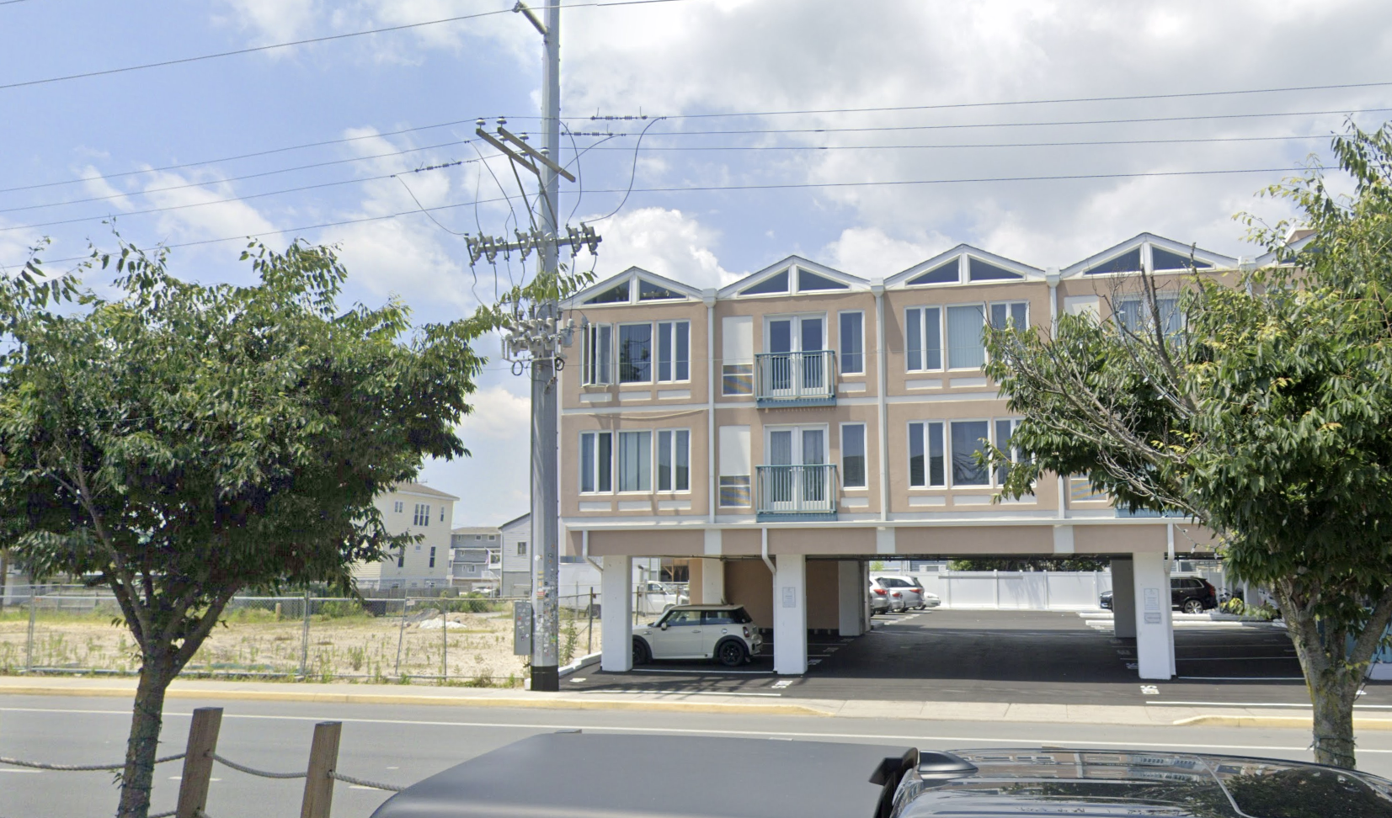
Opal Condominium

Slide 22
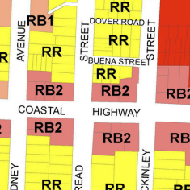
Exceptional Practical Difficulty (enclosed garages)
(2) The character of the immediate vicinity and the uses contained therein

Slide 23
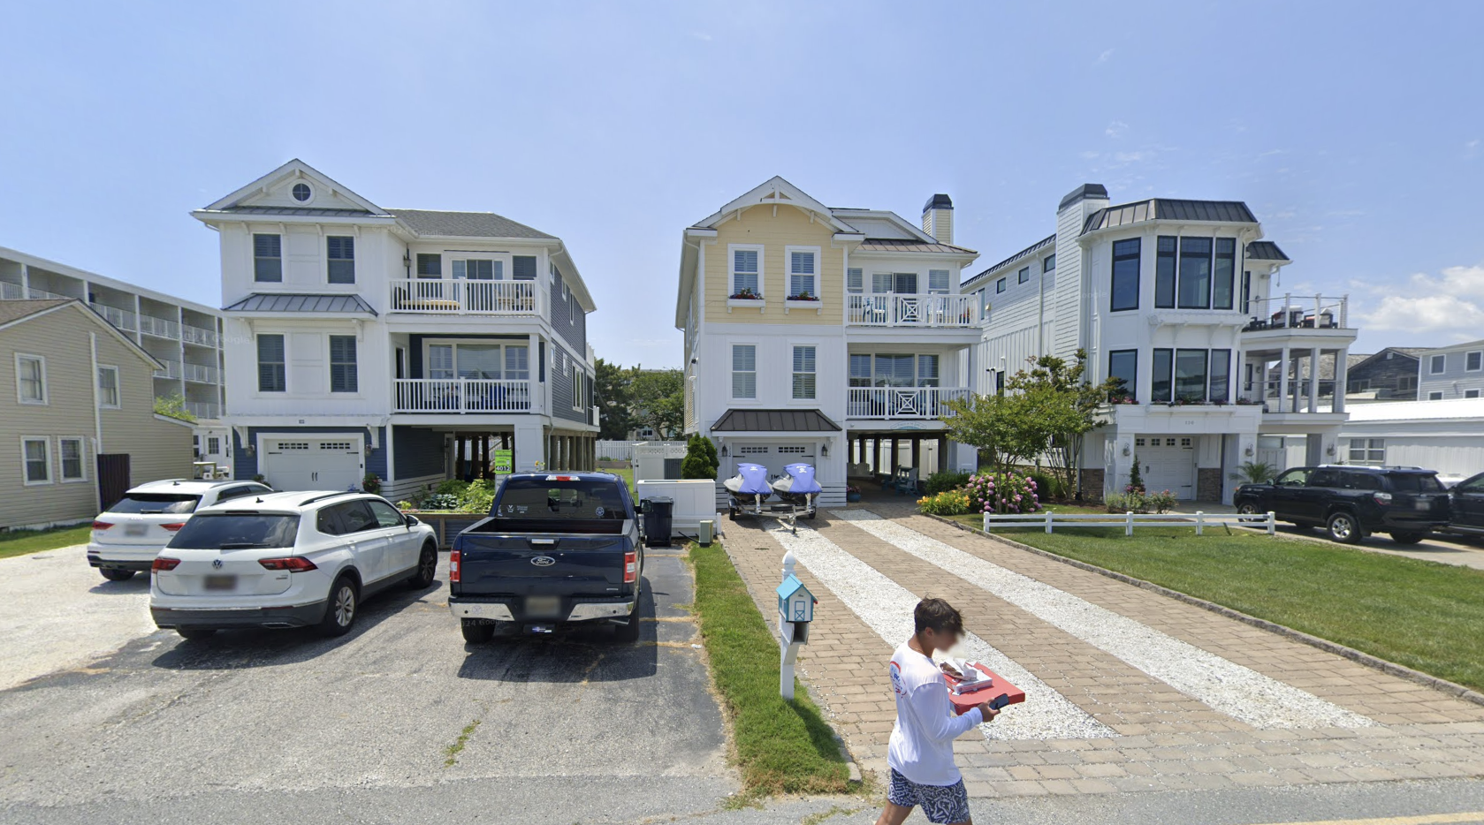
Rodney Street

Slide 24
Exceptional Practical Difficulty (enclosed garages)
(3) Whether, if the restriction upon the applicant’s property were removed, such removal would seriously affect such neighboring property and uses
Granting of the requested relief would not seriously affect neighboring property. Rather it would enhance views by shielding four vehicles from view.

Slide 25
Exceptional Practical Difficulty (enclosed garages)
(4) Whether, if the restriction is not removed, the restriction would create [hardship] for the owner in relation to his efforts to make normal improvements in the character of that use of the property which is a permitted use under the use provisions of the ordinance.
As shown, enclosed garages are a normal improvement where a residential use is permitted. If the variance is not granted, the residential owners will be deprived of enclosed garages when residential owners in adjacent properties to the west are permitted enclosed garages without any need for a variance.

Slide 26
Exceptional Practical Difficulty (enclosed garages)
Conway & Conway v. Zoning Bd. of Adjustment
Delaware Superior Court: the Kwik-Check analysis is “…a determination as to whether the Appellants are experiencing exceptional practical difficulty in their efforts to make normal improvements to their property, which, in turn, is decided by weighing the interest of the applicants against the interest of the public. The balancing of competing interests is the essence of the Kwik-Check test.”

Slide 27
Exceptional Practical Difficulty (impervious paving)
Four factors to be considered by a Board of Adjustment:
The nature of the zone in which the property lies;
The character of the immediate vicinity and the uses contained therein;
Whether, if the restriction upon the applicant’s property were removed, such removal would seriously affect such neighboring property and uses; and
Whether, if the restriction is not removed, the restriction would create [hardship] for the owner in relation to his efforts to make normal improvements in the character of that use of the property which is a permitted use under the use provisions of the ordinance.

Slide 28
Exceptional Practical Difficulty (impervious paving)
March 15, 2024
Code amended to add definition of “Pervious.”
PERVIOUS
A material or surface that allows water or other fluids to pass through it and infiltrate into the ground, reducing runoff and helping to recharge groundwater. Pervious surfaces include but are not limited to gravel, porous concrete, or permeable pavers.

Slide 29
Exceptional Practical Difficulty (impervious paving)
40”
28”
Exceptional Practical Difficulty: Cannot install “a material or surface that allows water or other fluids to pass through it and infiltrate into the ground, reducing runoff and helping to recharge groundwater.”

Slide 30
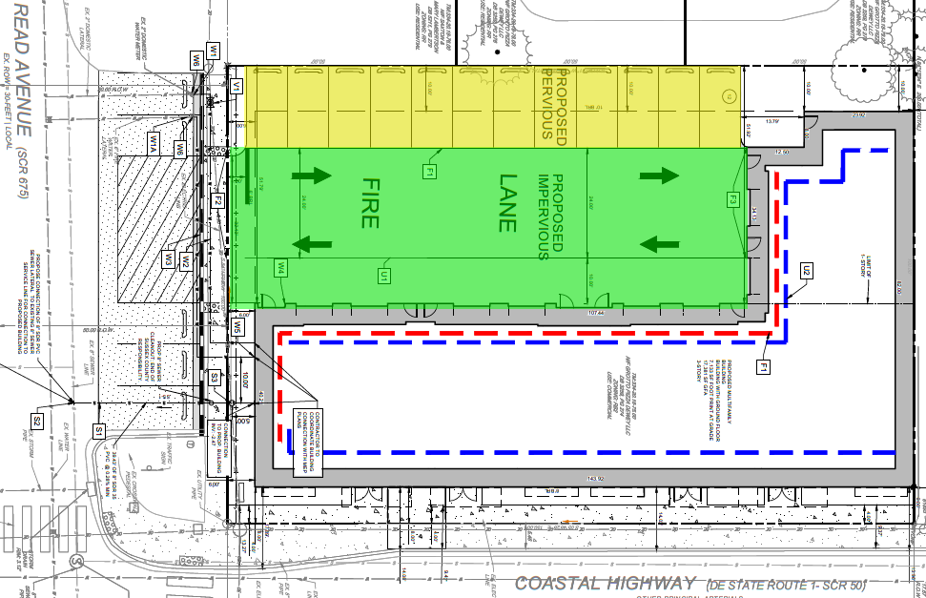
PERVIOUS/IMPERVIOUS PROPOSAL

Slide 31
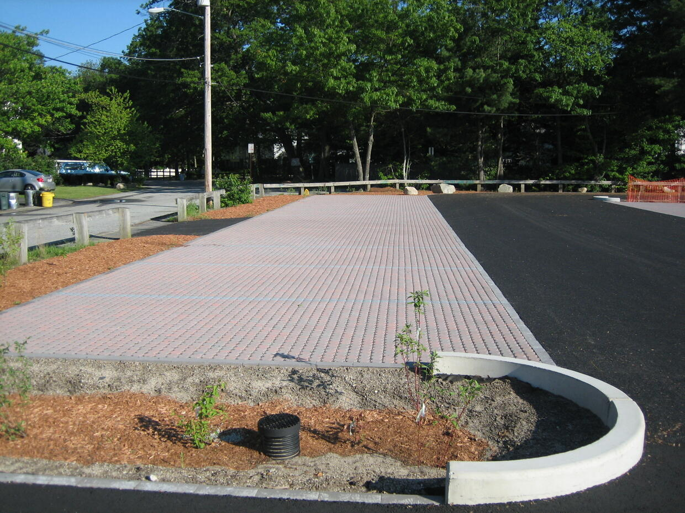
Exceptional Practical Difficulty (impervious paving)

Slide 32
Exceptional Practical Difficulty (impervious paving)
Alan Decktor, PE
Civil Engineer

Slide 33
Exceptional Practical Difficulty
Conway & Conway v. Zoning Bd. of Adjustment
Delaware Superior Court: the Kwik-Check analysis is “…a determination as to whether the Appellants are experiencing exceptional practical difficulty in their efforts to make normal improvements to their property, which, in turn, is decided by weighing the interest of the applicants against the interest of the public. The balancing of competing interests is the essence of the Kwik-Check test.”
Balancing the interest of the applicant against the interest of the public demonstrates that an exceptional practical difficulty exists such that the applicant should be granted the relief to enclose four ground level garages and utilize impervious pavement.

Slide 34
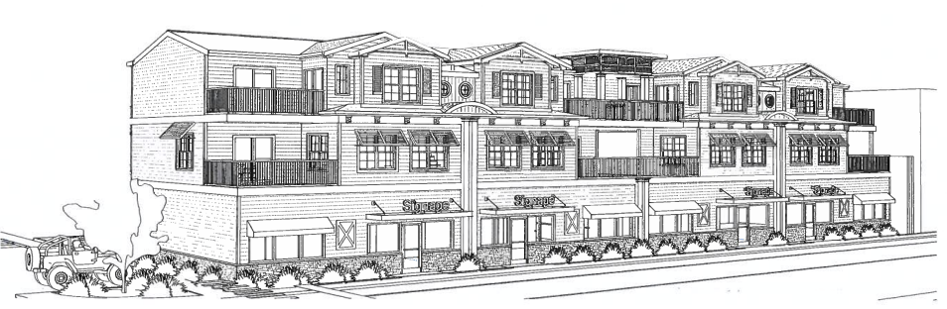
Questions

