Slide 1
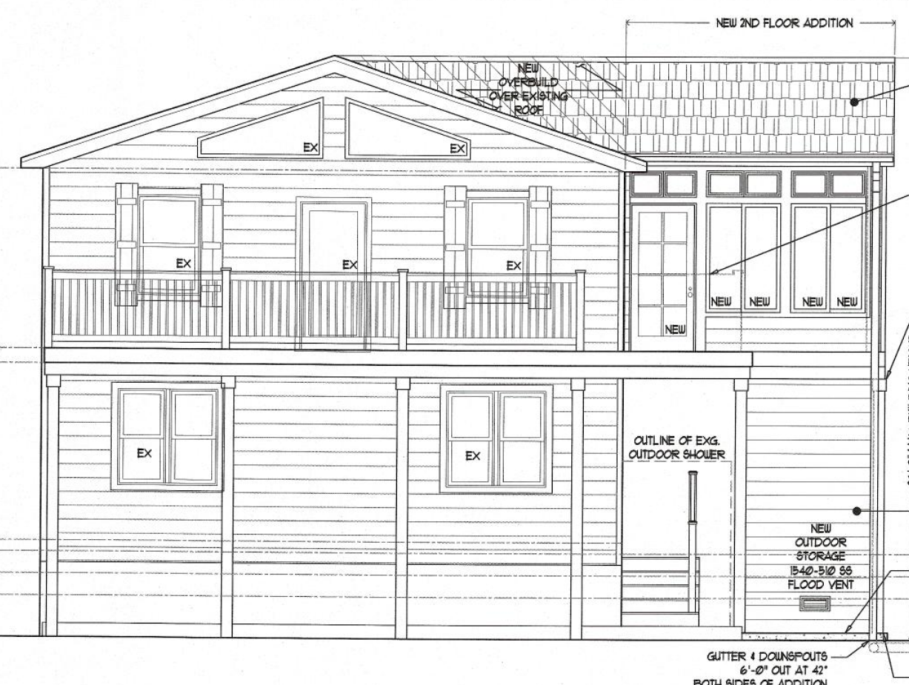


Glenn Mandalas, Esq
1603 Coastal Highway, Dewey Beach
Dewey Beach
Board of Adjustment
Dec 17, 2025

Slide 2
Agenda
Home addition overview
Our variance request
Circumstances leading to our variance requests
Exceptional Practical Difficulty
Conclusion

Slide 3
Home Addition Overview
Located at 114 Bellevue Street
Zoning: Resort Business 3 (RB3)
Setbacks
  Front yard: 22 feet
  Rear yard: 10 feet
  Side yard: 8 feet
Approx. 210 sf second-floor addition

Slide 5
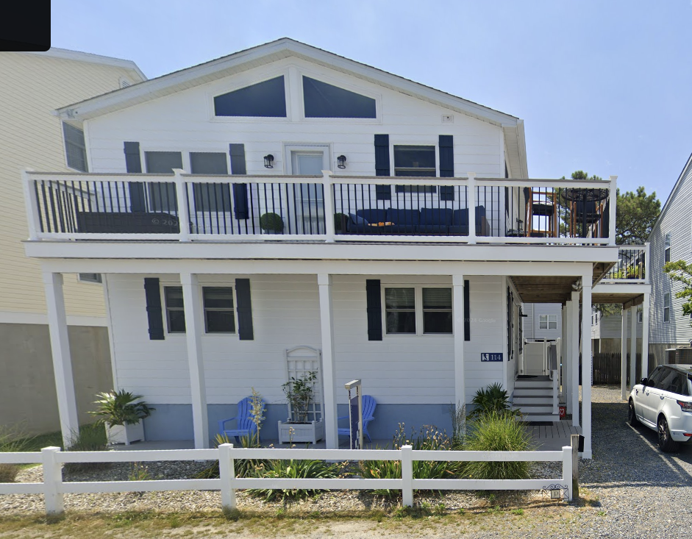

Slide 6
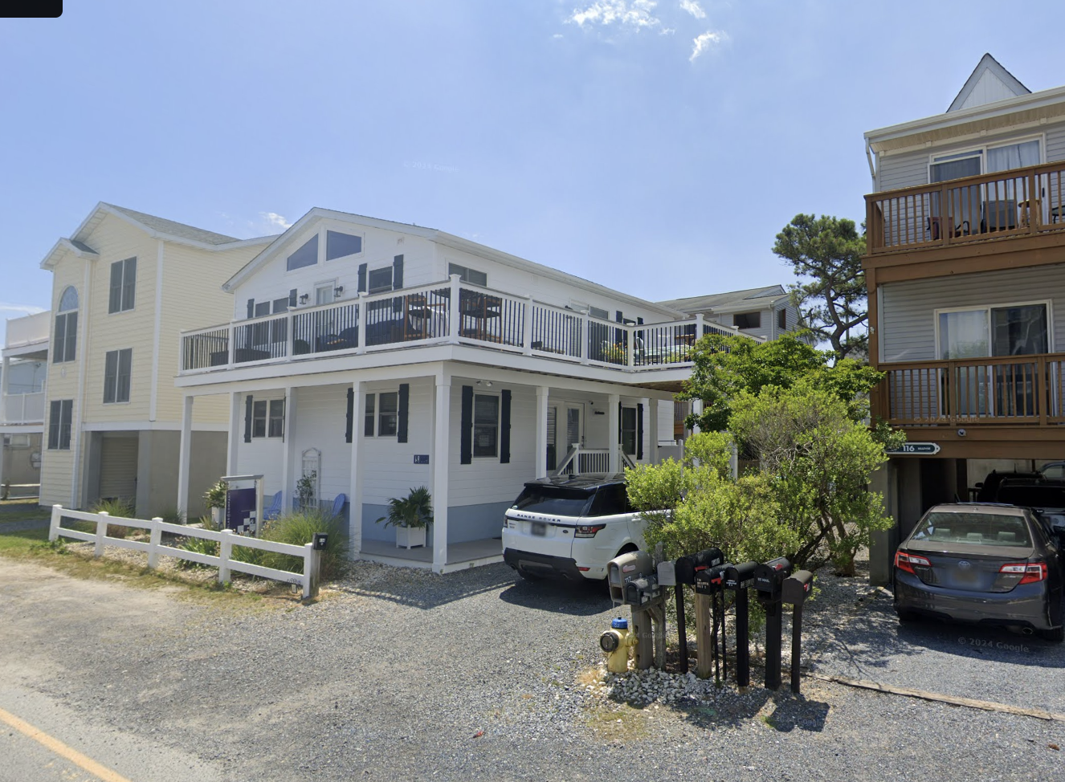

Slide 7
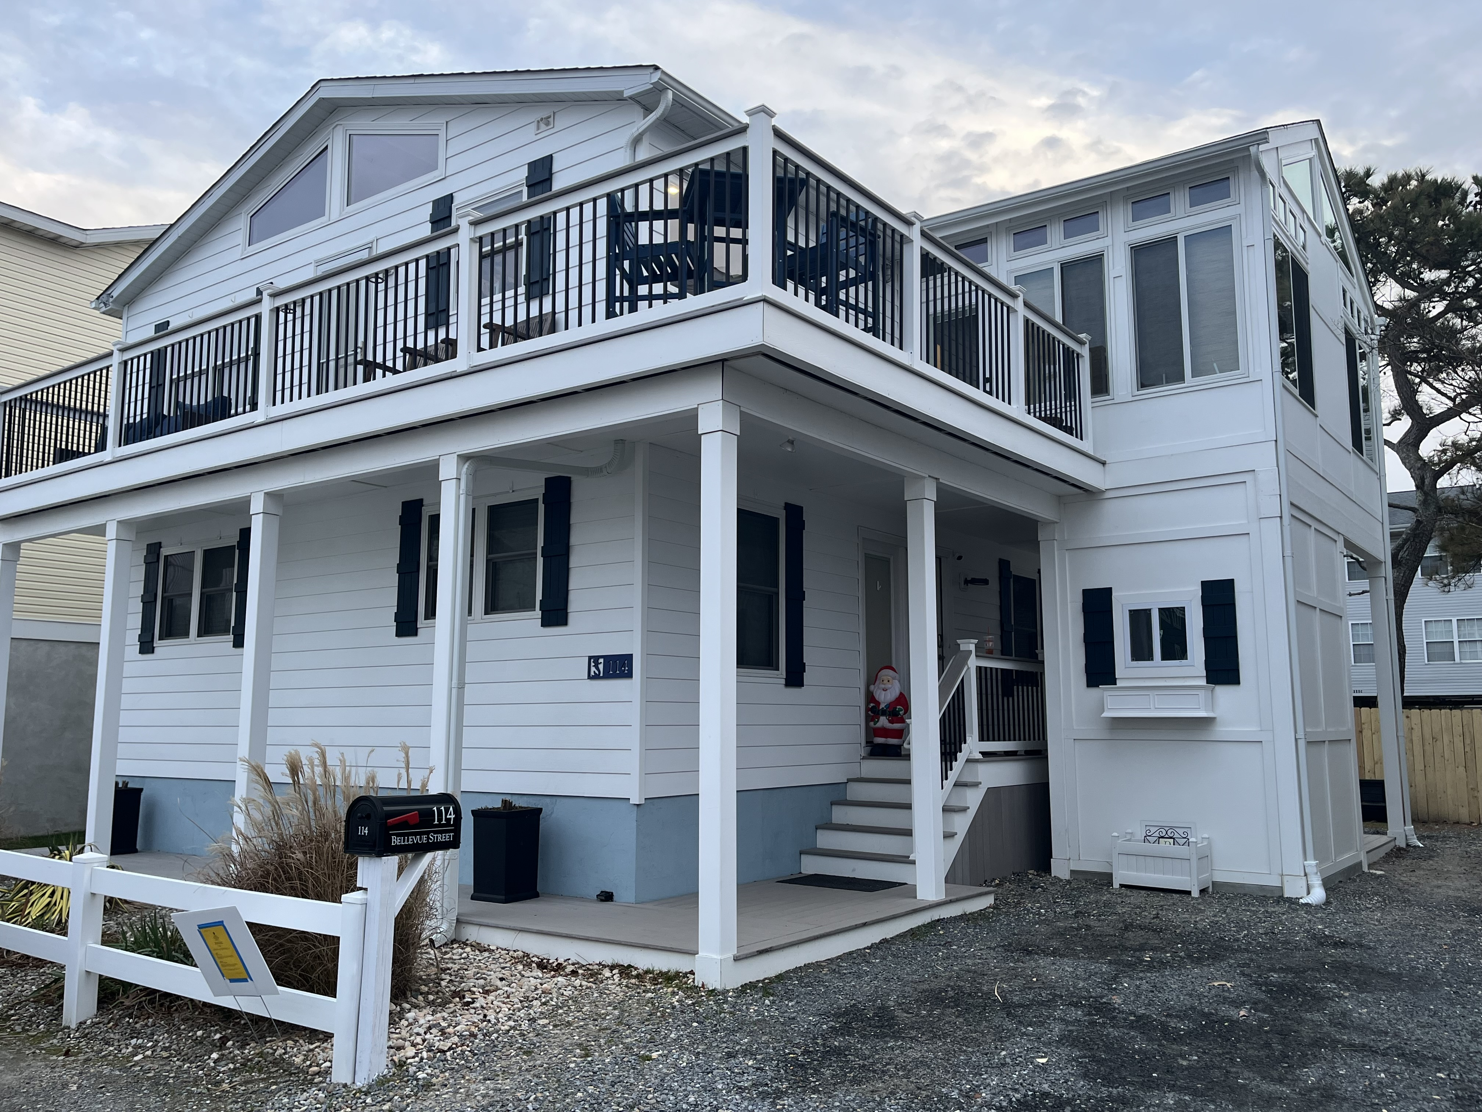

Slide 8
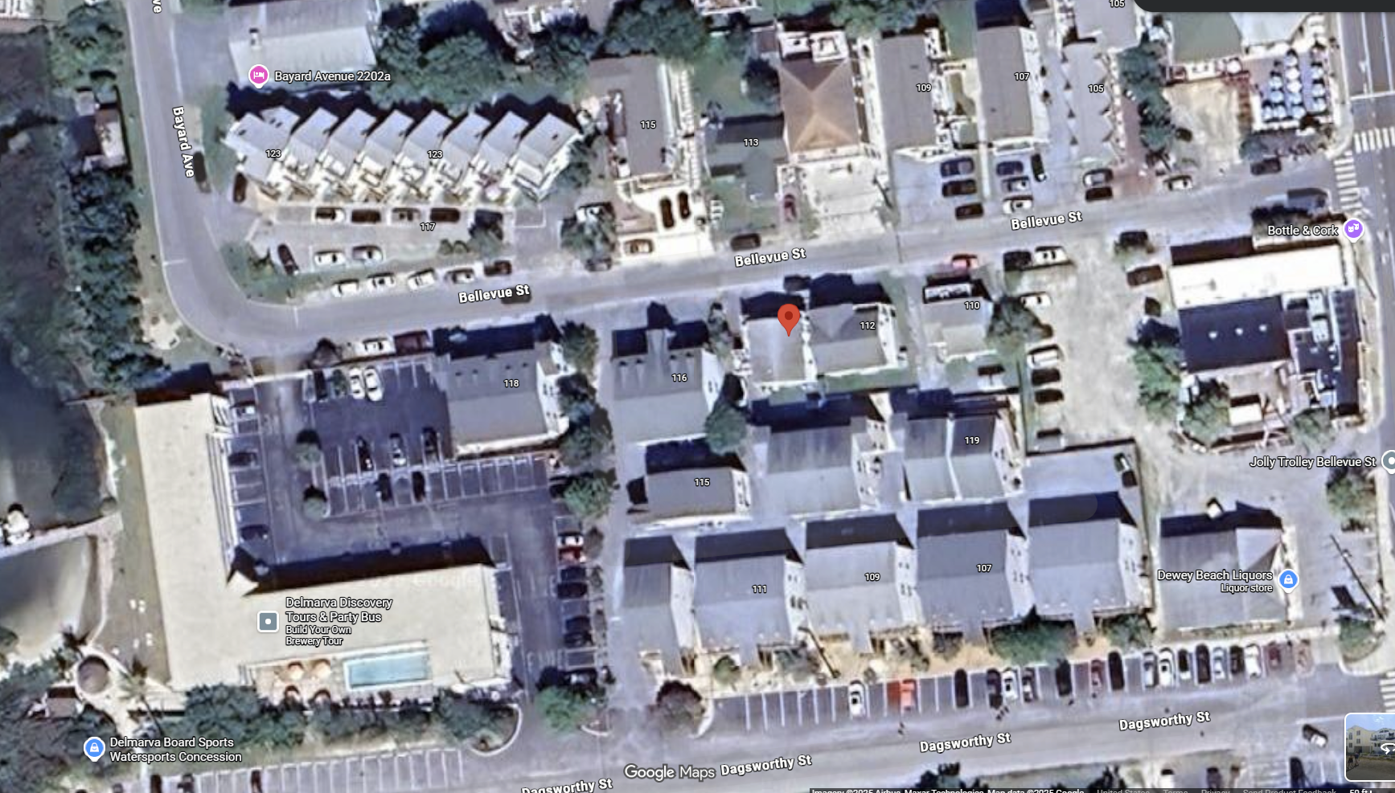

Slide 9
Our Request
The new addition encroaches the front yard setback by 0.4 feet such that the addition is 21.6 feet from the front lot line rather than the required 22 feet.
Requesting a 0.4 feet variance from the 22-feet front yard setback requirement.
0.4 feet = 4.8 inches

Slide 10
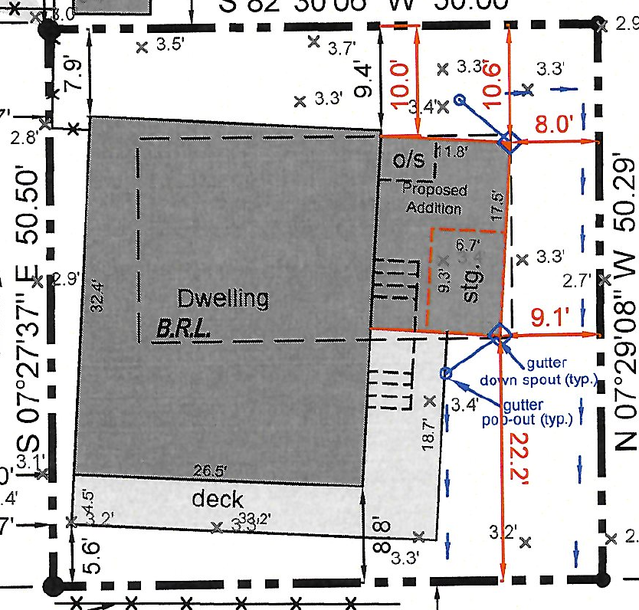
Circumstances Leading to Our Request
Proposed Addition Plan

Slide 11
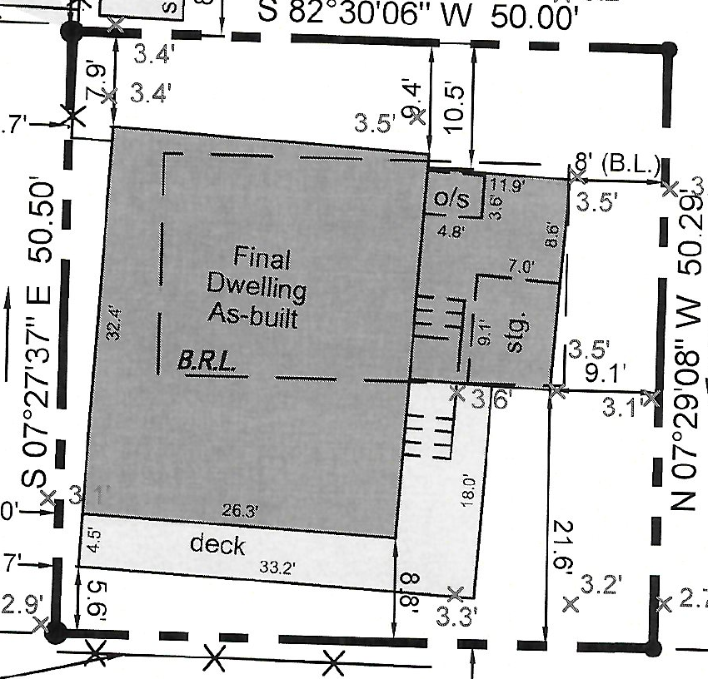
Circumstances Leading to Our Request
As-Built Addition

Slide 12

Exceptional Practical Difficulty
Bd. of Adjustment of New Castle Cty v. Kwik-Check Realty, Inc
  Delaware Supreme Court: “[s]uch [exceptional] practical difficulty is present where the requested dimensional change is minimal and the harm to the applicant if the variance is denied will be greater than the probable effect on the neighboring properties if the variance is granted.”
Conway & Conway v. Zoning Bd. of Adjustment
  Delaware Superior Court: the Kwik-Check analysis is “…a determination as to whether the Appellants are experiencing exceptional practical difficulty in their efforts to make normal improvements to their property, which, in turn, is decided by weighing the interest of the applicants against the interest of the public. The balancing of competing interests is the essence of the Kwik-Check test.”

Slide 13
Exceptional Practical Difficulty
The exceptional practical difficulty arises from the fact that the structure exists in its present configuration due to no fault of the Perrys and the encroachment, if not legalized through a variance, would create a greater harm to the applicant than would be the probable effect on the neighboring properties if the variance is granted.

Slide 14
Exceptional Practical Difficulty
Four factors to be considered by a Board of Adjustment:
The nature of the zone in which the property lies;
The character of the immediate vicinity and the uses contained therein;
Whether, if the restriction upon the applicant’s property were removed, such removal would seriously affect such neighboring property and uses; and
Whether, if the restriction is not removed, the restriction would create [hardship] for the owner in relation to his efforts to make normal improvements in the character of that use of the property which is a permitted use under the use provisions of the ordinance.

Slide 15
Exceptional Practical Difficulty
(1) The nature of the zone in which the property lies
The Property is in the Resort Business District-3 (RB-3) Zoning District, where residential, mixed-use, and commercial uses are permitted. Front yard setback for commercial uses is 18 feet.

Slide 16
Exceptional Practical Difficulty
(2) The character of the immediate vicinity and the uses contained therein
Structures in the surrounding area include residential multi-floor dwellings (east, west, and north) and commercial structures. The subject property is in character with the immediate vicinity and the surrounding uses.

Slide 17
Exceptional Practical Difficulty
(3) Whether, if the restriction upon the applicant’s property were removed, such removal would seriously affect such neighboring property and uses
Every bayside property on the south side of Bellevue Street is closer to the front property line than the encroaching portion of the new addition. Granting of the requested relief would not seriously affect neighboring property.

Slide 18
Exceptional Practical Difficulty
(4) Whether, if the restriction is not removed, the restriction would create [hardship] for the owner in relation to his efforts to make normal improvements in the character of that use of the property which is a permitted use under the use provisions of the ordinance.
The modest addition at issue here is a normal improvement. If the variance is not granted, the owners will be required to remove the encroachment—far outweighing any harm created if it remains.

Slide 19
Exceptional Practical Difficulty
Conway & Conway v. Zoning Bd. of Adjustment
  Delaware Superior Court: the Kwik-Check analysis is “…a determination as to whether the Appellants are experiencing exceptional practical difficulty in their efforts to make normal improvements to their property, which, in turn, is decided by weighing the interest of the applicants against the interest of the public. The balancing of competing interests is the essence of the Kwik-Check test.”

Slide 20
By the way…
Delaware Code, Title 22, Section 327
. . . the legislative body of any city or incorporated town may, by ordinance, vest a designated town official or department with authority to administratively grant a dimensional variance for existing conditions that do not exceed 1 foot of the required dimension restrictions without the application being considered by the board of adjustment. . .

Slide 21
Exceptional Practical Difficulty
Balancing the interest of the applicant against the interest of the public demonstrates that an exceptional practical difficulty exists such that the applicant should be granted the variance.

Slide 22
Questions

