Slide 1



Glenn Mandalas, Esq
1603 Coastal Highway, Dewey Beach
Dewey Beach
Board of Adjustment
Dec 17, 2025
Douglas M. Warner, P.E.

Slide 2
Agenda
Building lot overview
Our variance request
Circumstances leading to our variance requests
Exceptional Practical Difficulty
Conclusion

Slide 3
Building Lot
Overview
Located at 116 Dagsworthy Avenue
Zoning: Resort Business 3 (RB3)
Setbacks
  Front yard: 22 feet
  Rear yard: 10 feet
  Side yard: 8 feet
Approx. 2,239 sf lot

Slide 4
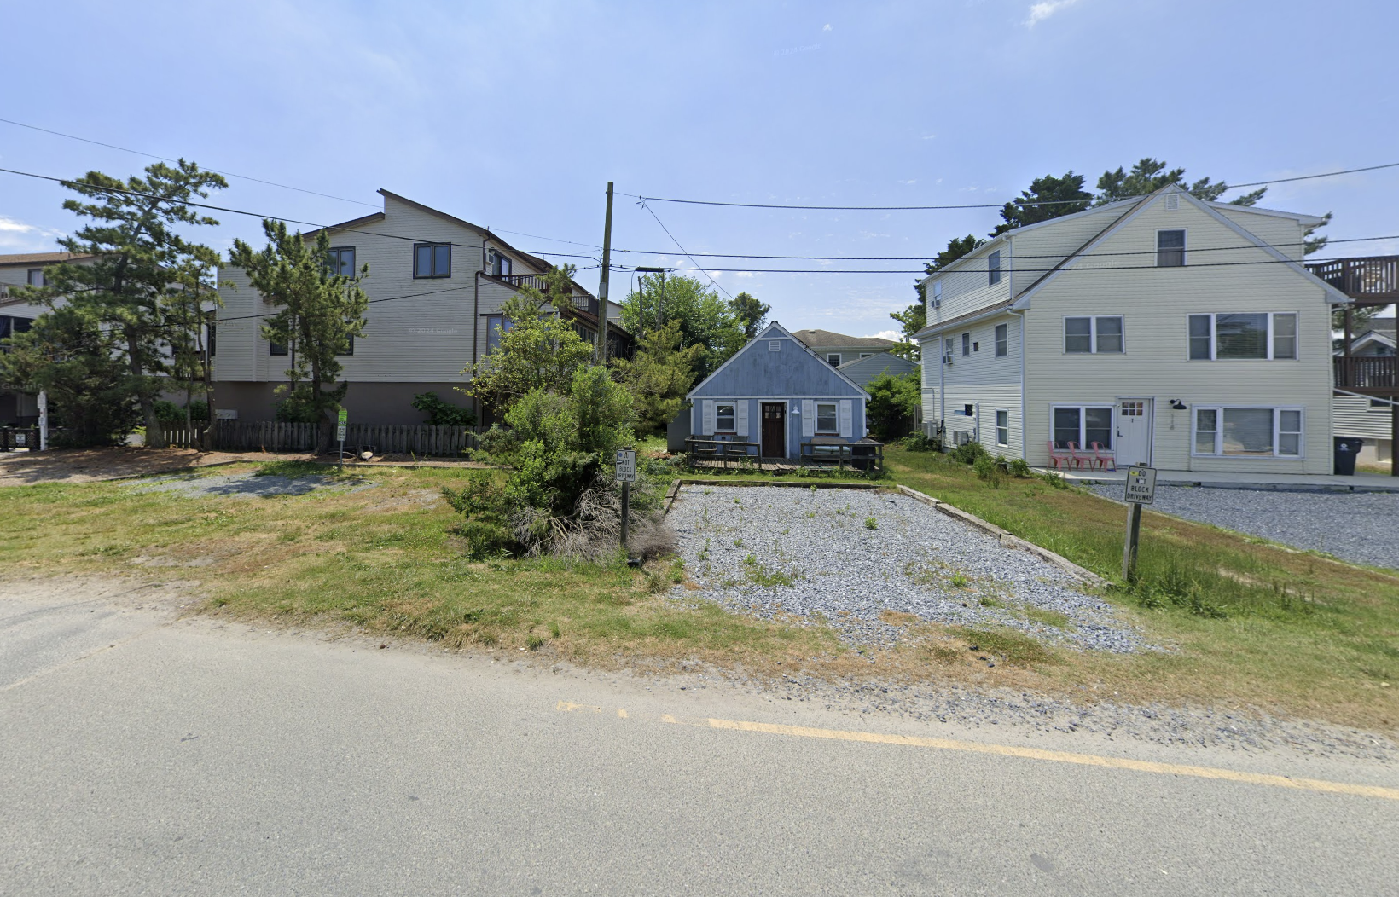

Slide 5
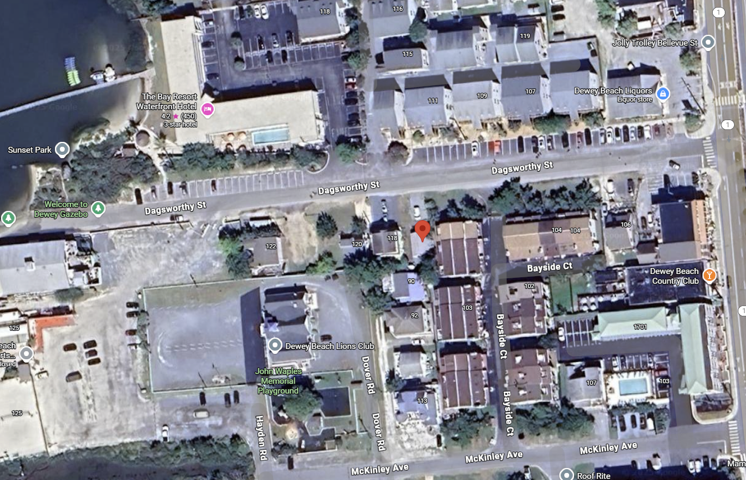
Established Building Lines

Slide 6
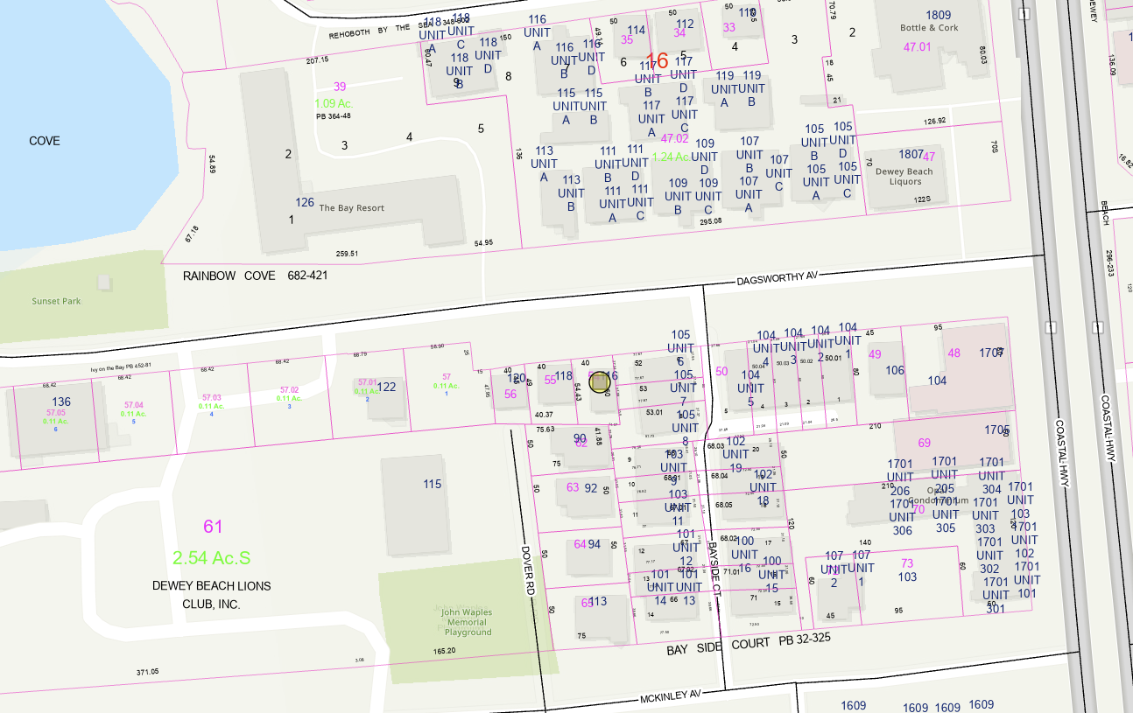
Dagsworthy Right-of-Way
100+ ft
25 ft

Slide 7
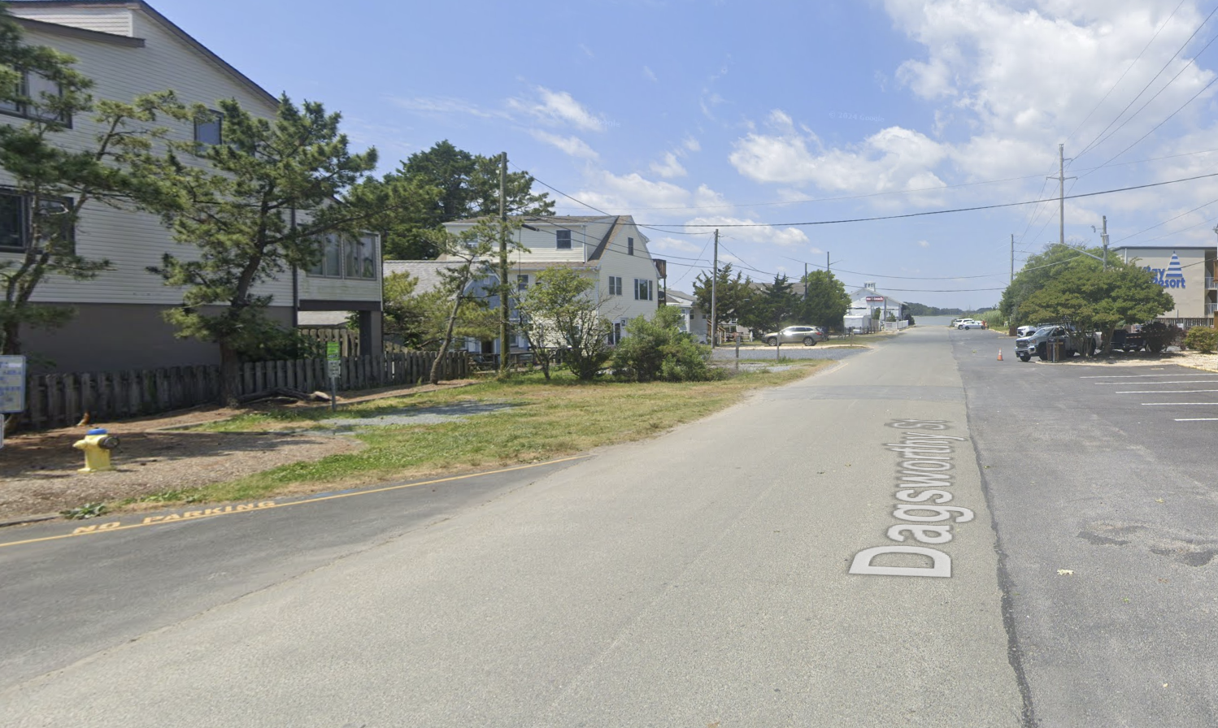

Slide 8
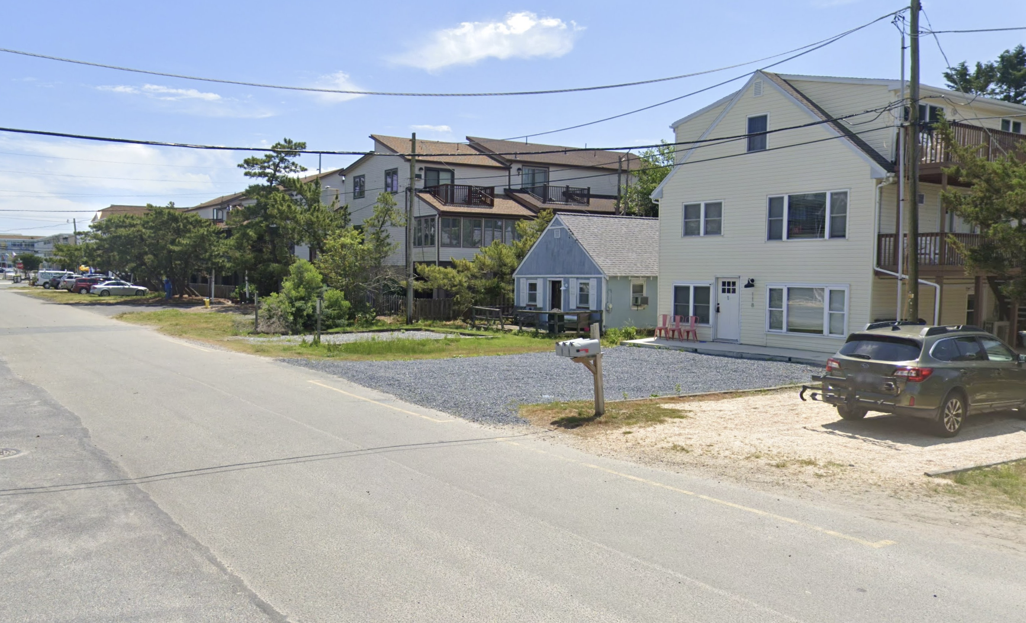

Slide 9
Our Request
An 18.8 feet variance from the 22-feet front yard setback requirement; and
A 2 feet variance from the 10-feet rear yard setback requirement

Slide 10
Circumstances Leading to Our Request
Severely undersized lot
At 2,239 sf, the lot is less than half the size of most lots
In the RB-3 zoning district, the minimum lot size is 5,000 sf
Two lots the size of 116 Dagsworthy combined would not satisfy the minimum lot size requirement

Slide 11
Circumstances Leading to Our Request
§ 185-47 Lot area.
A. If the deed or instrument under which an owner acquired title to a lot was of record prior to the application of any zoning regulations and restrictions to the premises, and if such lot does not conform to the requirements of such regulations and restrictions as to width of lots and lot area per dwelling unit, the provisions of such lot area per dwelling unit and lot width regulations and restrictions shall not prevent the owner of such lot from erecting a single-family detached dwelling or making other improvements on the lot.

Slide 12
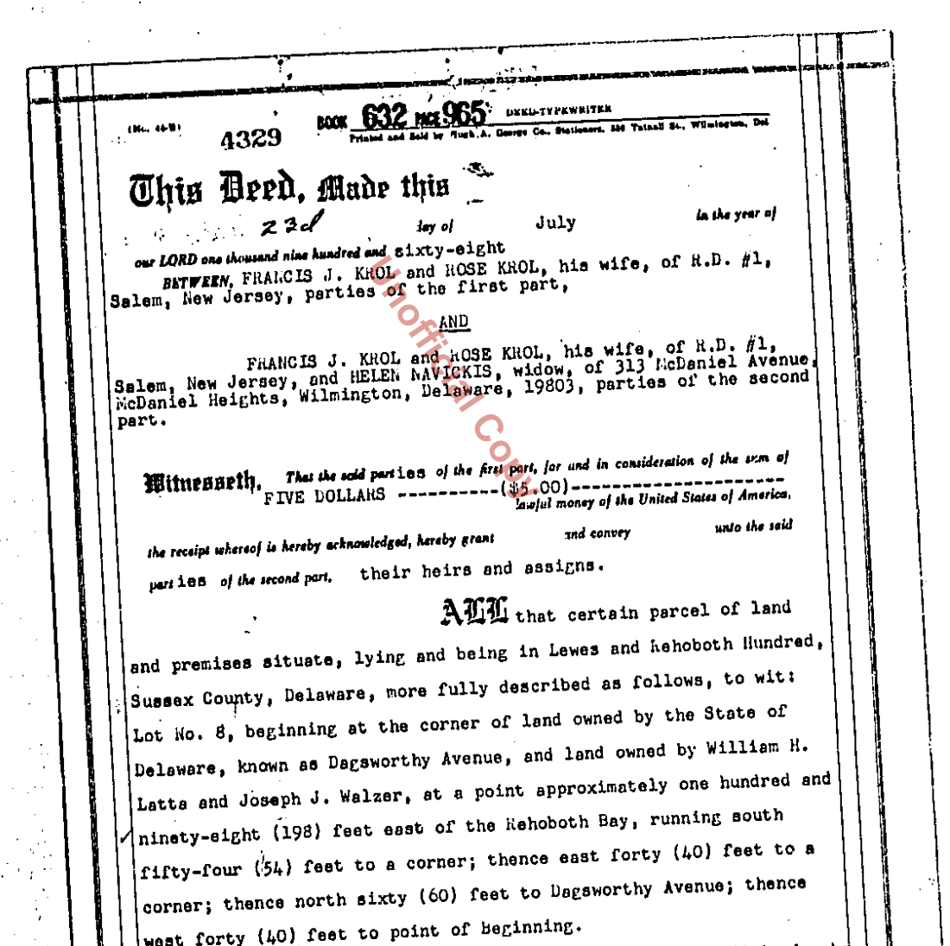
Circumstances Leading to Our Request

Slide 13
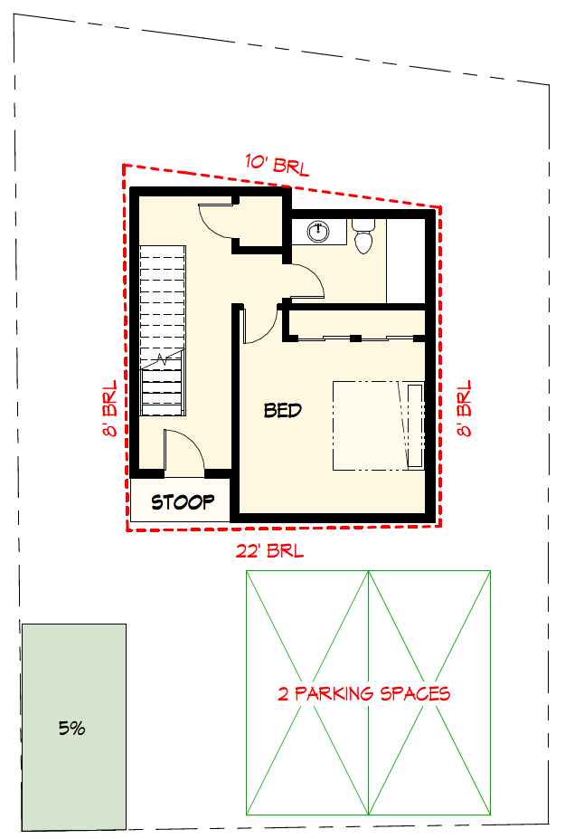
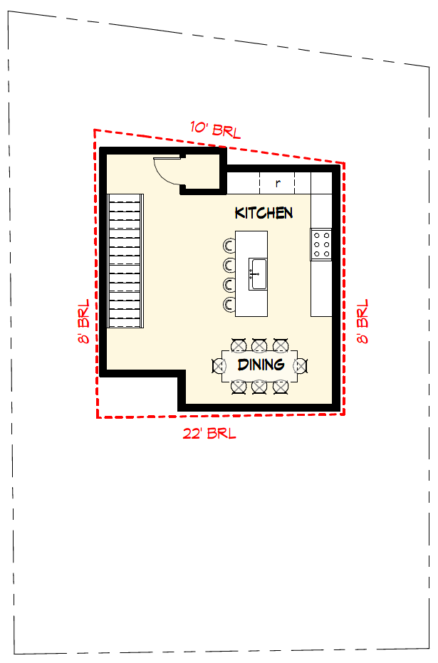
Code Compliant First Floor
Code Compliant Second Floor

Slide 14
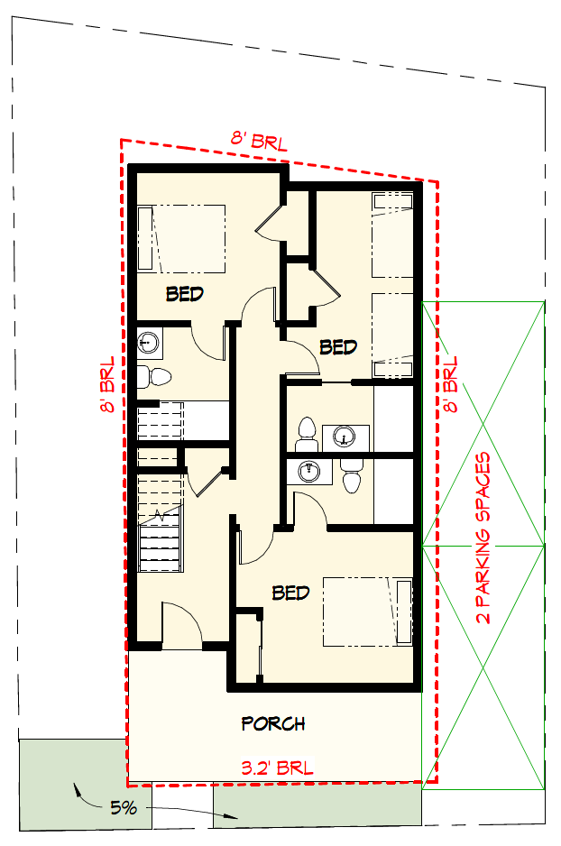
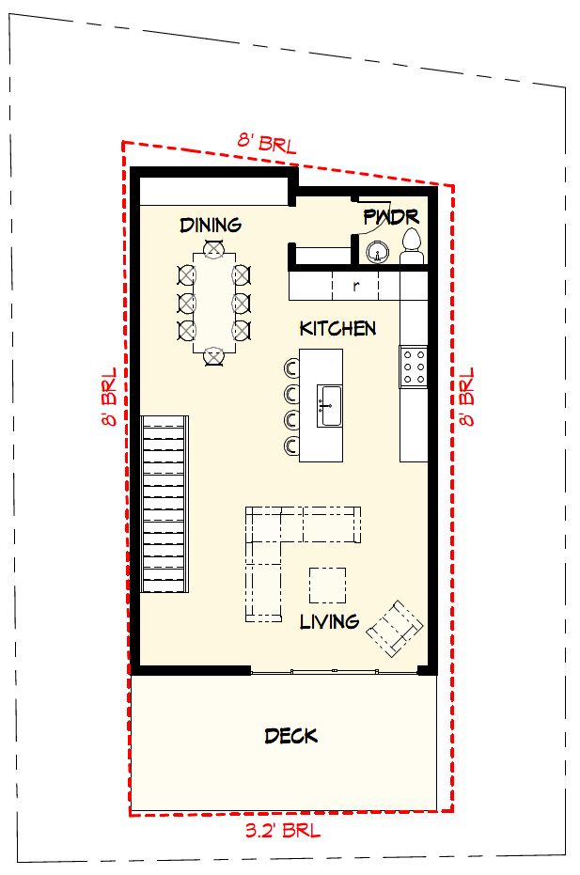
First Floor
Second Floor

Slide 15
Circumstances Leading to Our Request
If variances are granted
  Rebuild within the front and back setbacks observed by the previous structure
  Rebuild well-within established building lines

Slide 16
Established Building Lines

Slide 17
Circumstances Leading to Our Request
If variances are granted
  Edge of existing pavement is approximately 40 feet from the property line, so the home will be approximately 43 feet from the edge of pavement (almost double the 22 foot setback requirement).

Slide 18
100+ ft
Dagsworthy Ave Pavement
25 ft
40 ft

Slide 19
40 ft+-

Slide 20
Circumstances Leading to Our Request
If variances are granted
  consistent with the rhythm and scale of the neighborhood

Slide 22

Exceptional Practical Difficulty
Bd. of Adjustment of New Castle Cty v. Kwik-Check Realty, Inc
  Delaware Supreme Court: “[s]uch [exceptional] practical difficulty is present where the requested dimensional change is minimal and the harm to the applicant if the variance is denied will be greater than the probable effect on the neighboring properties if the variance is granted.”
Conway & Conway v. Zoning Bd. of Adjustment
  Delaware Superior Court: the Kwik-Check analysis is “…a determination as to whether the Appellants are experiencing exceptional practical difficulty in their efforts to make normal improvements to their property, which, in turn, is decided by weighing the interest of the applicants against the interest of the public. The balancing of competing interests is the essence of the Kwik-Check test.”

Slide 23
Exceptional Practical Difficulty
The exceptional practical difficulty arises from the fact that the Property is a substantially undersized lot, making it infeasible to improve the Property with a residential single-family home consistent with other new home construction in Dewey Beach.

Slide 24
Exceptional Practical Difficulty
Four factors to be considered by a Board of Adjustment:
The nature of the zone in which the property lies;
The character of the immediate vicinity and the uses contained therein;
Whether, if the restriction upon the applicant’s property were removed, such removal would seriously affect such neighboring property and uses; and
Whether, if the restriction is not removed, the restriction would create [hardship] for the owner in relation to his efforts to make normal improvements in the character of that use of the property which is a permitted use under the use provisions of the ordinance.

Slide 25
Exceptional Practical Difficulty
(1) The nature of the zone in which the property lies
The Property is in the Resort Business District-3 (RB-3) Zoning District, where residential, mixed-use, and commercial uses are permitted.

Slide 26
Exceptional Practical Difficulty
(2) The character of the immediate vicinity and the uses contained therein
Structures in the surrounding area include residential multi-floor dwellings considerably larger than the code compliant option, and larger than the proposed construction. The code-compliant option would be out of character with the immediate vicinity. The proposed option is in character with the immediate vicinity and the surrounding uses.

Slide 27
Exceptional Practical Difficulty
(3) Whether, if the restriction upon the applicant’s property were removed, such removal would seriously affect such neighboring property and uses
The proposal has a front yard setback and rear yard setback consistent with bayside properties on the south side of Dagsworthy Avenue. Granting of the requested relief would not seriously affect neighboring property.

Slide 28
Exceptional Practical Difficulty
(4) Whether, if the restriction is not removed, the restriction would create [hardship] for the owner in relation to his efforts to make normal improvements in the character of that use of the property which is a permitted use under the use provisions of the ordinance.
The code compliant option allows for a single bedroom, and single bathroom home, which is not a normal improvement to the property. Homes in Dewey Beach routinely exceed the home proposed here. If the variance is not granted, the owners will be prohibited from making normal improvements to the property, significantly diminishing the use and enjoyment of the property as compared to typical properties in Dewey Beach.

Slide 29
Exceptional Practical Difficulty
Conway & Conway v. Zoning Bd. of Adjustment
  Delaware Superior Court: the Kwik-Check analysis is “…a determination as to whether the Appellants are experiencing exceptional practical difficulty in their efforts to make normal improvements to their property, which, in turn, is decided by weighing the interest of the applicants against the interest of the public. The balancing of competing interests is the essence of the Kwik-Check test.”

Slide 30
Exceptional Practical Difficulty
Balancing the interest of the applicant against the interest of the public demonstrates that an exceptional practical difficulty exists such that the applicant should be granted the variances.

Slide 31
Questions
Glenn Mandalas, Esq
Douglas M. Warner, P.E.

