Slide 1

Beach Dining

Slide 2
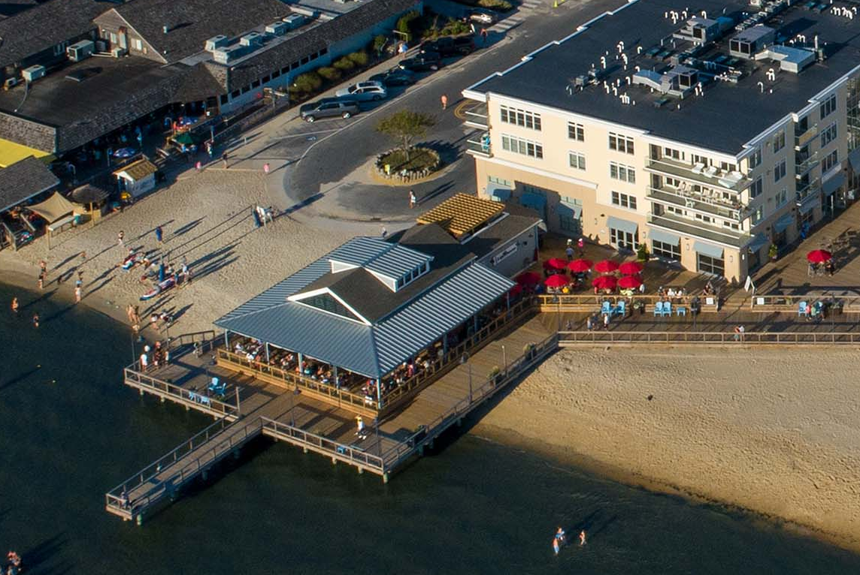

Slide 3
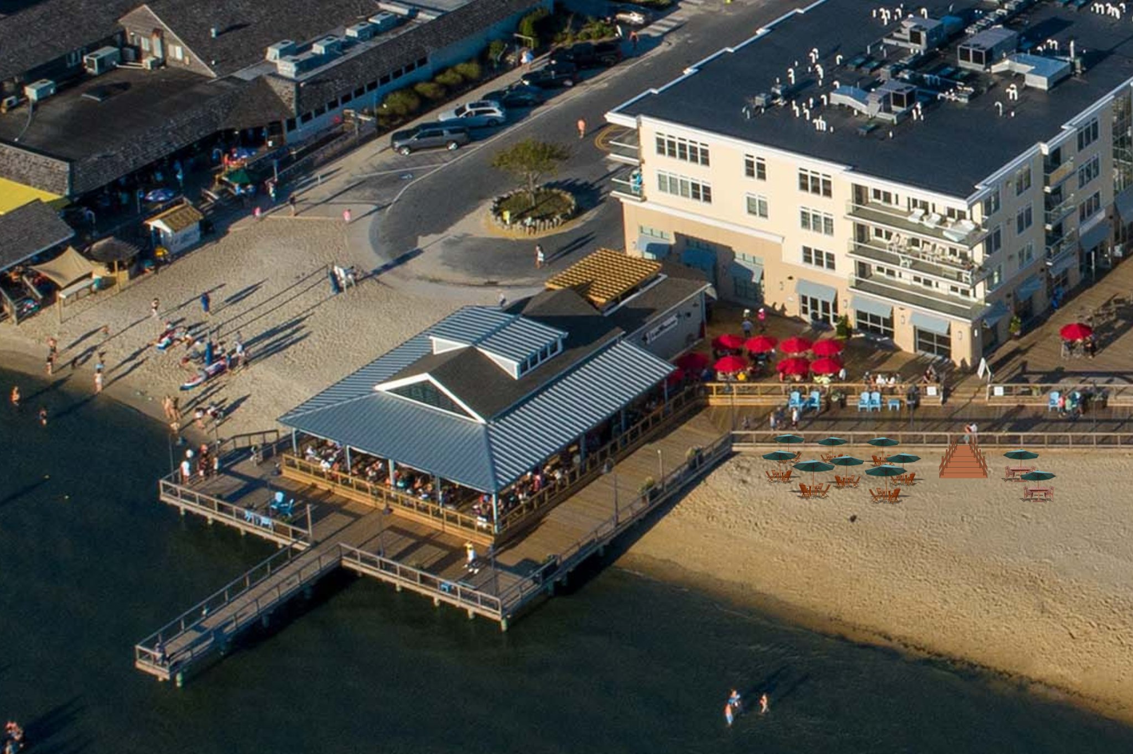

Slide 4
