Slide 1
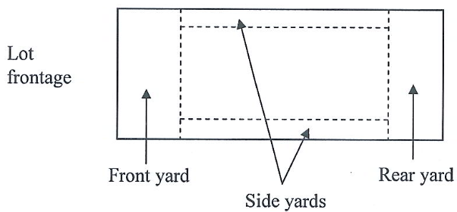
Yard:
The area extending between the lot lines and respective building setback lines on a lot or parcel….

Slide 2
Ex. 1B Sec. 185-92. Fences
Ornamental fences or walls may project into or enclose any yard, provided:
(1) No fence or wall shall exceed seven feet in height.
(2) No fence or wall exceeding 3 1/2 feet in height shall project into or enclose any portion of the yard located within the front yard setback.

Slide 3
Ex. 1A 185-51.A. Accessory Buildings and Structures
A hedge, fence or wall not more than 3.5 feet in height may project into or enclose any required front or side yard to a depth from the street line equal to the required depth of the front yard.
Any fence, hedge, or wall for residential use may project into or enclose other required yards, provided such fences, hedges, and walls do not exceed a height of seven feet. This height limit does not apply to fences or walls used for commercial screening or tennis courts.

Slide 4
Ex. 1B. 185-51.B. Accessory Buildings and Structures
Accessory swimming pools, open and unenclosed, may occupy a required yard or side yard, provided they are not located closer than 10 feet to an interior side lot line or six feet to a rear lot line. A walk space at least three feet wide shall be provided between pool walls and protective fences or barrier walls. Every swimming pool shall be protected by a safety fence or barrier at least 4.5 feet in height and constructed of concrete, stockade wood or material of equal quality.

Slide 5
Green Space Ordinance No. 843
All front yard area shall be green space except for one 20x18 driveway or two 10x18 driveway spaces and one 4x18 space for a walkway.

Slide 6
Section 85-67. Special Exceptions
A. In order to provide for adjustments in the relative location of uses and buildings, to promote the usefulness of these regulations and to supply the necessary elasticity to their efficient operation, special use exceptions and, limited as to locations described in this article, special yard and height exceptions are permitted by the terms of these regulations. The following buildings and uses are permitted as special exceptions if the Board of Adjustment finds that, in its opinion, as a matter of fact, such exceptions will not substantially affect adversely the uses of adjacent and neighboring property.

